Slide 1
Business Zone - Clearing your Cache
BT Wholesale Online
V.2

Slide 2
Contents:
p4- Introduction
p5- How to clear cache on Internet Explorer
p6- How to clear cache on FireFox
p7- How to clear cache on Chrome

Slide 3
Version Control
Date | Change | Slide | Version
16/01/17 | Clearing your Cache User Guide Creation | All | 1
23/04/18 | Updated Internet Explorer instructions | 5 | 2

Slide 4
Introduction Why is this an issue?
During a weekend release, you may experience distorted data due to browser cache issues. Some of these issues may prevent you from ordering or tracking faults/orders and you may come across inaccurate information.
To assist you in resolving these issues, we have created an easy guide on how to clear your cache for the top 3 browsers used. You may access the guide via My BT Wholesale

Slide 5
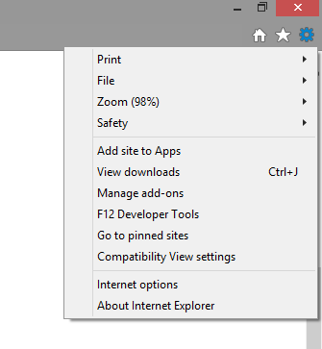
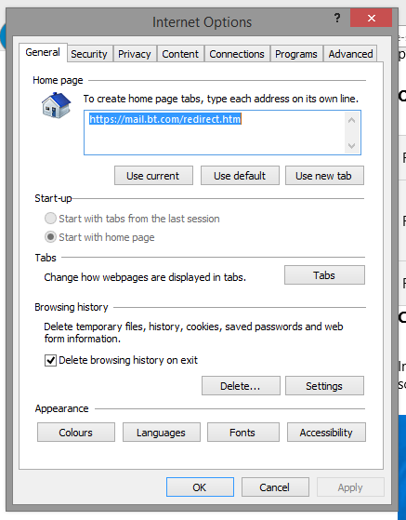
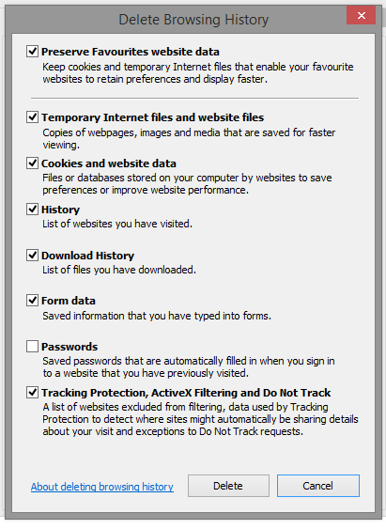
How to clear cache on Internet Explorer
Select the Tools button on the top right corner of your screen:
When the window open select Internet options
A new window will open to the left of the screen. When this opens, under the General tab and the Browsing history section, make sure that Delete browsing history on exit is ticked as shown. You can now click on Delete
A new window will open. Make sure that all sections are ticked except Password as shown. Click on Delete
You should now be able to view any new releases clearly.
1
3
2
4

Slide 6
How to clear cache on Firefox
Click the Menu button
Choose Options
Select the Privacy and Security panel
In the Cached Web Content section, click Clear Now
Close the about:preferences page. Any changes you've made will automatically be saved.

Slide 7
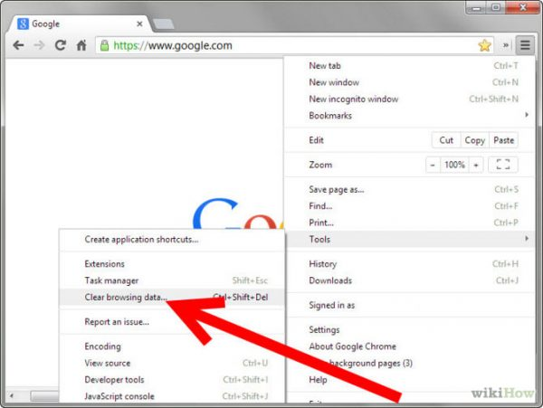
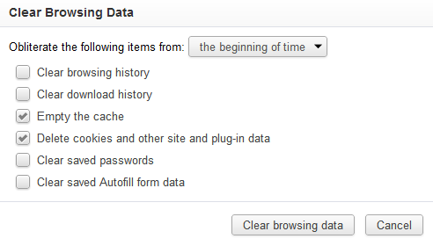
How to clear cache on Chrome
On your browser toolbar, click on More > Tools > Clear Browsing Data
Click the check boxes for Cookies and other site data and Cached images and files
Use the menu at the top to select the amount of data that you want to delete. Choose beginning of time to delete everything.
Click Clear browsing data
1
3
2
4

