Slide 1

Ethernet – View Asset
BT Wholesale Online
V2
LEGAL NOTICE: The information contained in this briefing is confidential information as per your terms and conditions with BT. Please do not forward, republish or permit unauthorised access. The content is accurate at the time of writing and is subject to change.

Slide 2
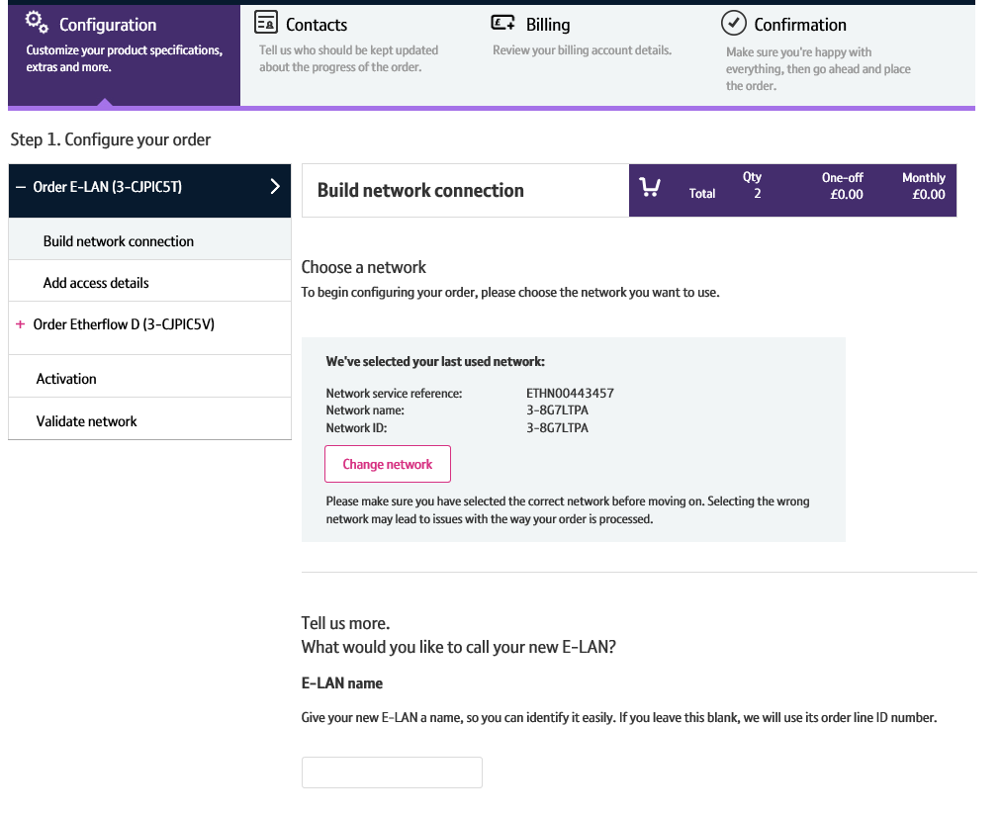
Contents
What’s in this User Guide?
p4 - Pre-requisites
p5 – Introduction
p6 – View Asset Layout
p7 – Searching for an Asset
p9 – View Asset Details

Slide 3
Version Control
Date | Change | Version
10/08/16 | User Guide Published. | 1
30/04/18 | Re-branded | 2

Slide 4
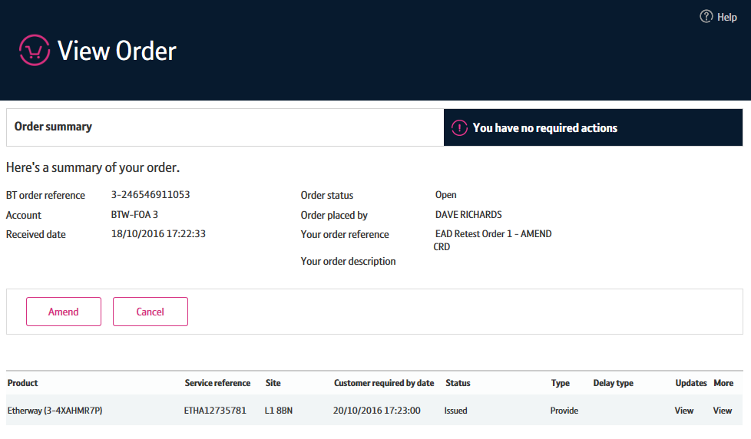
Pre-Requisites
What do you need to view an Ethernet order via the new journey?
You need correct access and privileges, including Business zone. If you don’t have this, please contact your company administrator to action.
Please visit our Transformed Ethernet Ordering page to learn about what order journeys are available.
You must be using a Windows machine and using the latest version of Internet Explorer, Chrome or Firefox
Mobile devices, Mac and Safari are not supported

Slide 5
Introduction
What is the new Ethernet View Asset Journey?
We’ve replaced the Eco Plus view asset journey with a new improved view asset journey for Ethernet.
Accessed via Business Zone, the new journey will allow you to make it easier to:
View details of your asset / service easier
The new journey has improved navigation and layout, is compatible with modern browsers and is more stable and easier to use than Eco Plus.

Slide 6
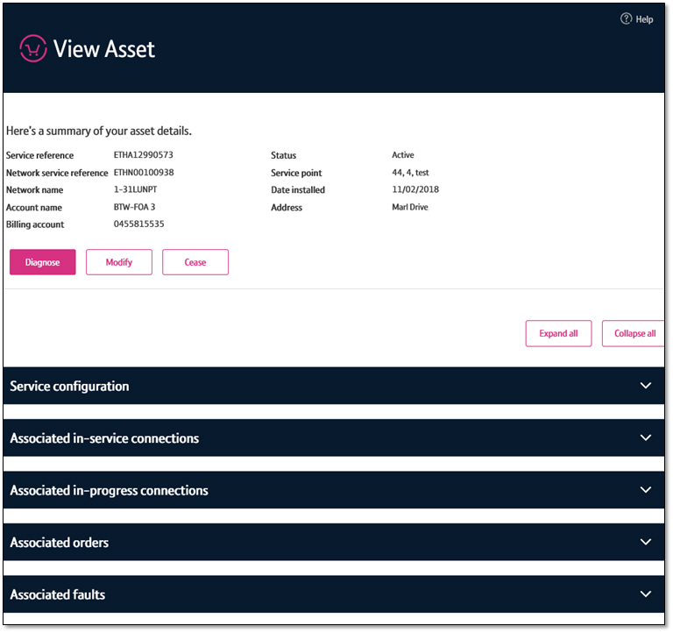
View Asset Layout
1. Asset summary
The asset summary gives you a view of the BT order reference and your customer reference if entered, the account it was raised for, when and where the service was installed and the status of the service.
2. Action buttons
You’ll also see some buttons here that allow you to Diagnose, Modify and Cease your service.
3. Configuration and Associations
At the bottom of your screen, you can see how your service is configured, associated Etherflow and Etherways, associated orders and associated faults.
1
2
3

Slide 7
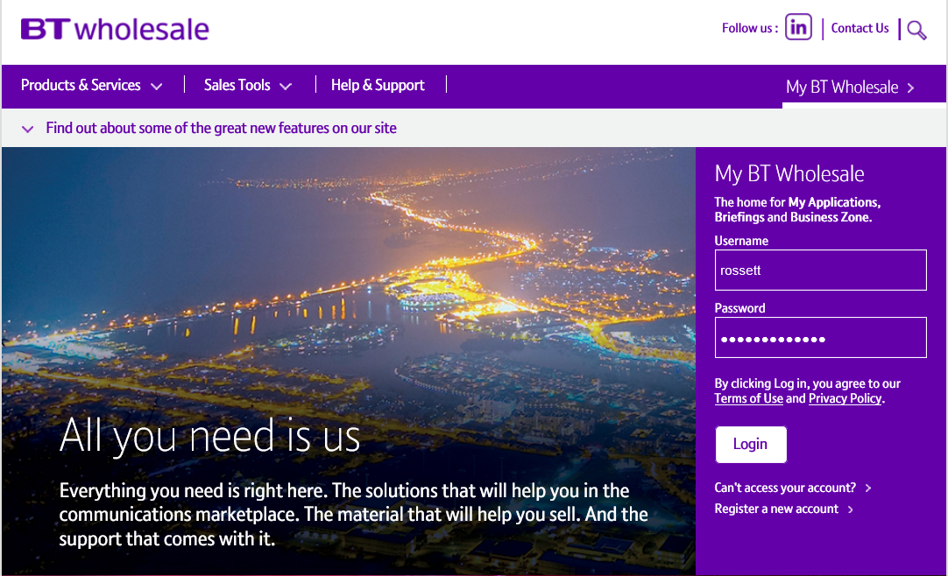
Searching for an asset
To view an asset, you first need to search for it on Business Zone.
Step 1: Logging In
Go to www.btwholesale.com
Enter your Username and Password
Click ‘Login’

Slide 8
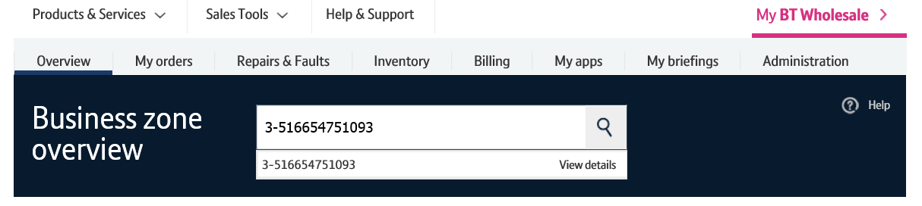
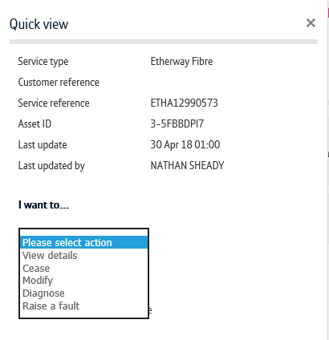
Searching for an asset
Step 2: Searching
There’s a lot of different ways you can search for an asset in Business Zone. The easiest way is by entering your order reference in the search bar.
Clicking ‘View Details’ will take to directly into the View Asset journey
Alternatively, click on the reference number to see the order quick view
From the quickview, click ‘View Details’ in the actions dropdown.
You can also find the asset by using the filters on the inventory section of the Overview page and on the Inventory page. Please see the Business Zone guide for more details.
2
1
3

Slide 9
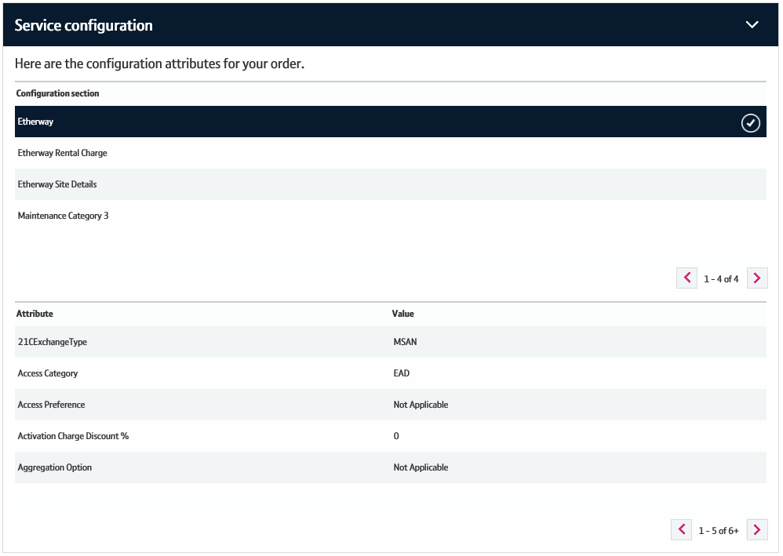
View Asset Details
Service Configuration
This section allows you to see how the service is configured.
The configuration section allows you to apply filters to the configuration details you are viewing.
Here, you can see the details for the filter you’ve applied.
1
2

Slide 10
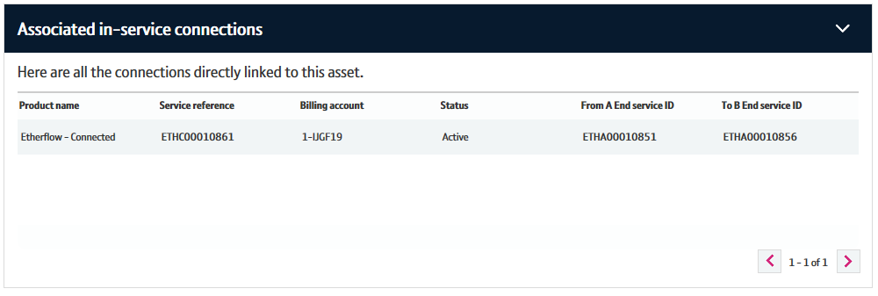
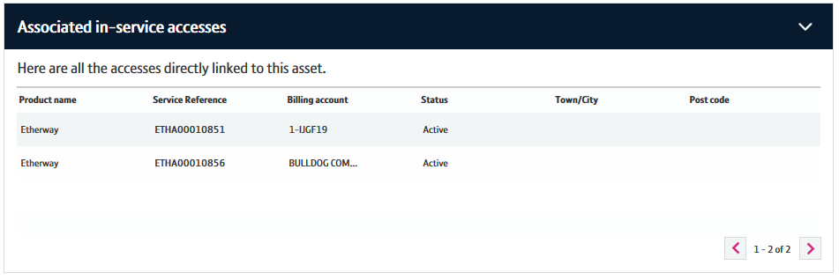
View Asset Details
Associated in-service connections/accesses
This section allows you to see assets associated with the service you are viewing.
If you are viewing an Etherway, you’ll be able to see where they are connected to. This includes details of the associated Etherflow and it’s connected Etherway.
If you are viewing an Etherflow, you’ll be able to see the associated Etherways it’s connected to.
In this section, you can click on the service reference (ETHA/ETHC) to view that asset.

Slide 11
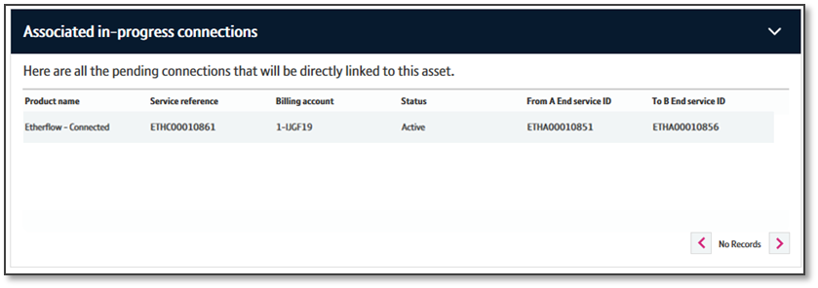
View Asset Details
Associated in-progress connections
If you are viewing an Etherway asset, you can use the ‘Associated in-progress connections’ section to view any associated Etherflows that are being provided.
Clicking on the ‘Service Reference’ will allow you to view the order details.

Slide 12
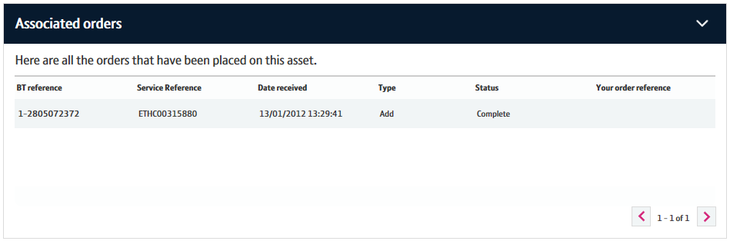
View Asset Details
Associated orders
The associated orders section allows you to see details of recent orders associated with your asset.
You can click on the BT Reference to view the order details.

Slide 13
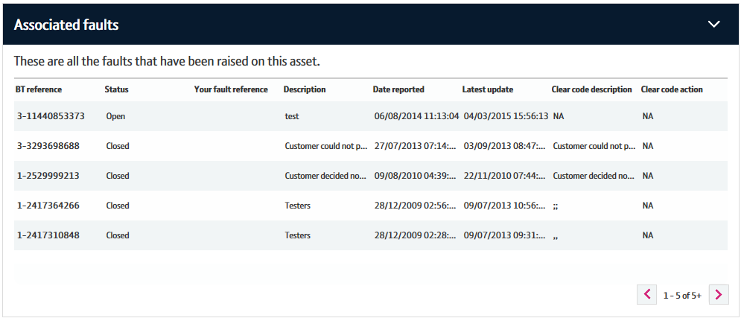
View Asset Details
Associated faults
The associated faults section allows you to see recent faults raised associated with the service you are viewing.
You can click the ‘BT Reference’ to view the fault in Eco Plus.

