Slide 1
Placing an order for Etherway Fibre and Etherflow Connected
BT Wholesale Online
V2
LEGAL NOTICE: The information contained in this briefing is confidential information as per your terms and conditions with BT. Please do not forward, republish or permit unauthorised access. The content is accurate at the time of writing and is subject to change.

Slide 2
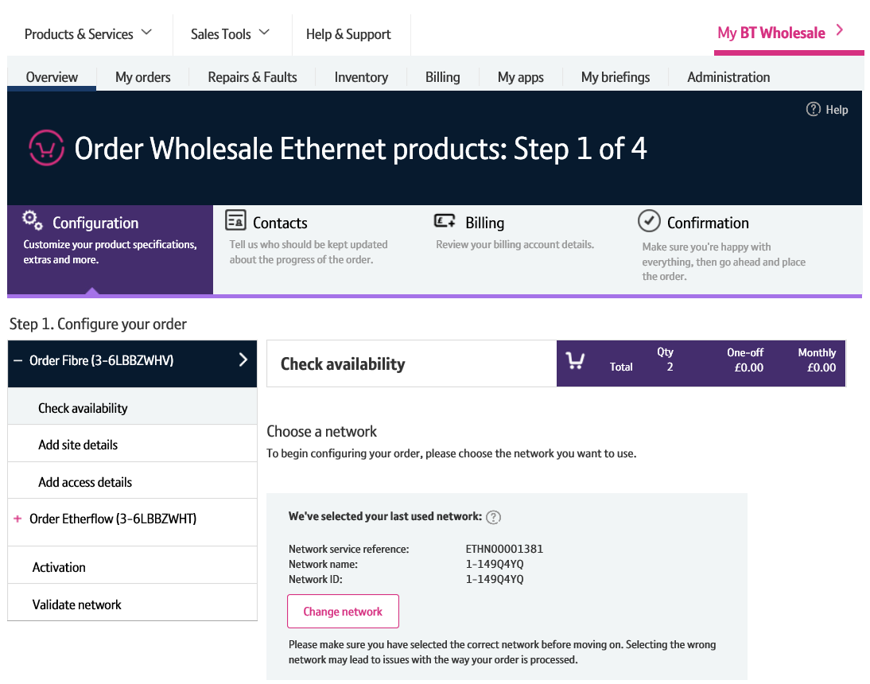
Contents
What’s in this User Guide?
p3 - Pre-requisites
p4 - How To Place an Etherway Fibre and Etherflow Connect Order

Slide 3
Version Control
Date | Change | Version
14/11/16 | User Guide Published. | 1
16/01/17 | New journey information added from recent release. | 1.1
30/04/18 | Re-branded | 2

Slide 4
Pre-Requisites
What do you need to enter an Ethernet order via the new journey?
You need correct access and privileges, including Business zone. If you don’t have this, please contact your company administrator to action.
Please visit our Transformed Ethernet Ordering page to learn about what order journeys are available.
You must be using a Windows machine and using the latest version of Internet Explorer, Chrome or Firefox
Mobile devices, Mac and Safari are not supported

Slide 5
How to place an Etherway Fibre and Etherflow Connected order
There’s multiple products available via the new order journey. There’s many combinations of Etherway and Etherflows.
This example shows you how to place an Etherway Fibre and Etherflow Connected order. All other variants follow the same steps, just with different types and quantities of Etherway and Etherflow.
The order journey is accessed via Business Zone.
To access it, you’ll need a valid btwholesale.com account with the relevant permissions.
If you don’t have the relevant permissions, please contact your company administrator to provide.

Slide 6
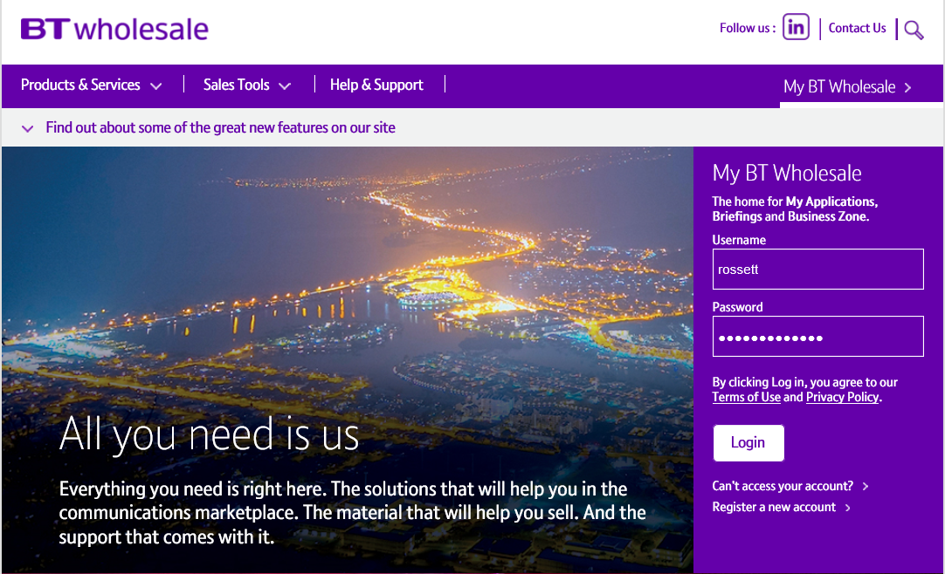
How to place an Etherway Fibre and Etherflow Connected order
Step 1: Logging In
Go to www.btwholesale.com
Enter your Username and Password
Click ‘Login’

Slide 7
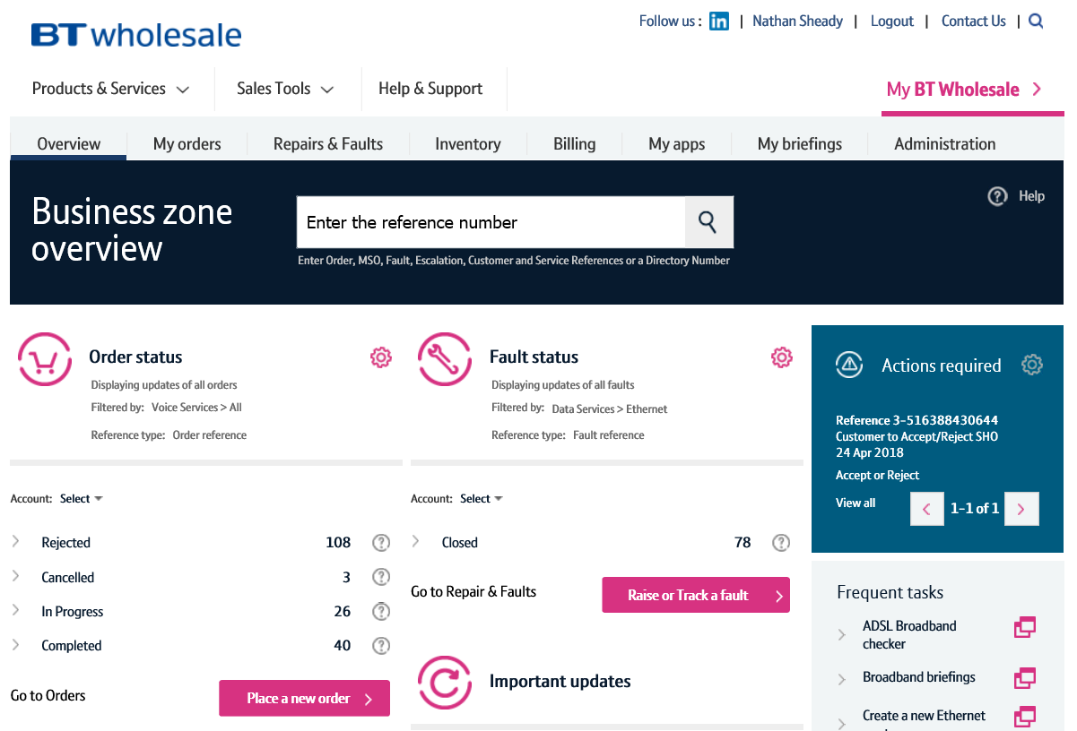
How to place an Etherway Fibre and Etherflow Connected order
Step 2: Accessing the new journey
Once logged in, you’ll be taken to Business Zone.
If you aren’t taken to Business Zone, you’ll need to arrange access via your company administrator.
To access the new journey:
Click ‘Place a New Order’

Slide 8
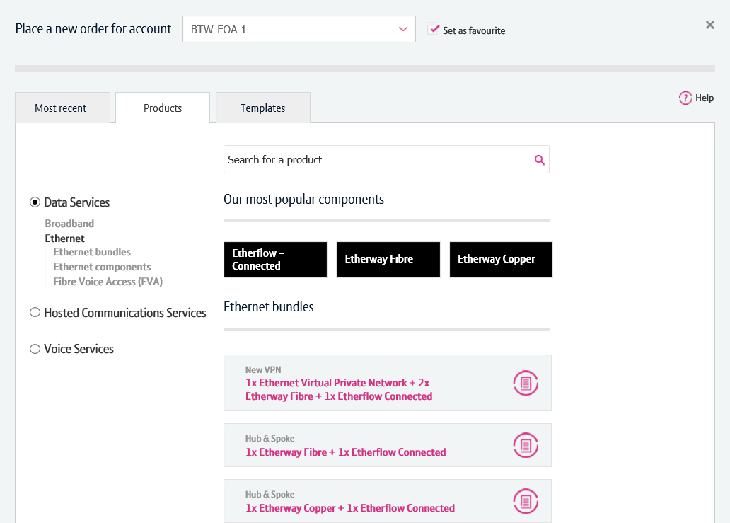
How to place an Etherway Fibre and Etherflow Connected order
Step 2: Accessing the new journey
If you have multiple accounts associated with your user id, you’ll need to select the applicable account from the dropdown.
Select your account. If you use the same account time and time again, you can select ‘Set as favourite’ to default the selection.
Once an account has been selected, click the ‘Products’ tab.
Click ‘Data Services’.
Click ‘Ethernet’.
Select ‘1x Etherway Fibre + 1x Etherflow Connected’.
Note: If you wish to order a stand-alone Etherway or Etherflow order, you can do so from the options under ‘Ethernet components’.
1
2
3
4
5

Slide 9
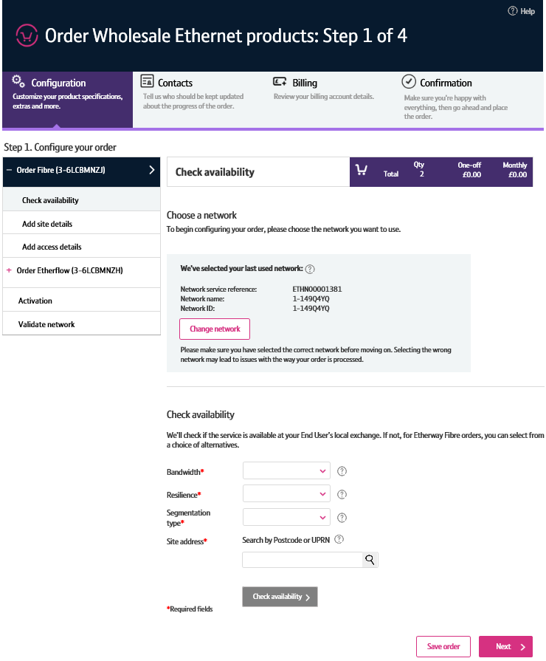
How to place an Etherway Fibre and Etherflow Connected order
Step 2: Accessing the new journey
You’ll now be taken to the provide order journey.
Please Note: Logging in for the first time may take a few seconds longer.

Slide 10
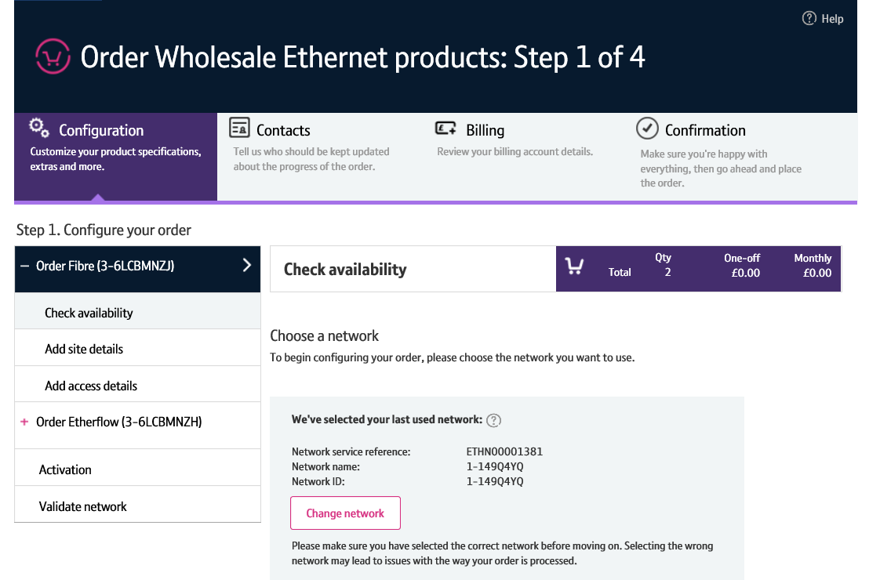
How to place an Etherway Fibre and Etherflow Connected order
Step 3: Choose a Network
You’ll begin by configuring your Etherway.
First, you’ll need to tell us what network (ETHN) you wish the Etherway order to be placed against.
If you’ve previously placed an order with us, we’ll default this to the most recently used network to save you some time.
If you need to change is:
Click ‘Change network’
1

Slide 11
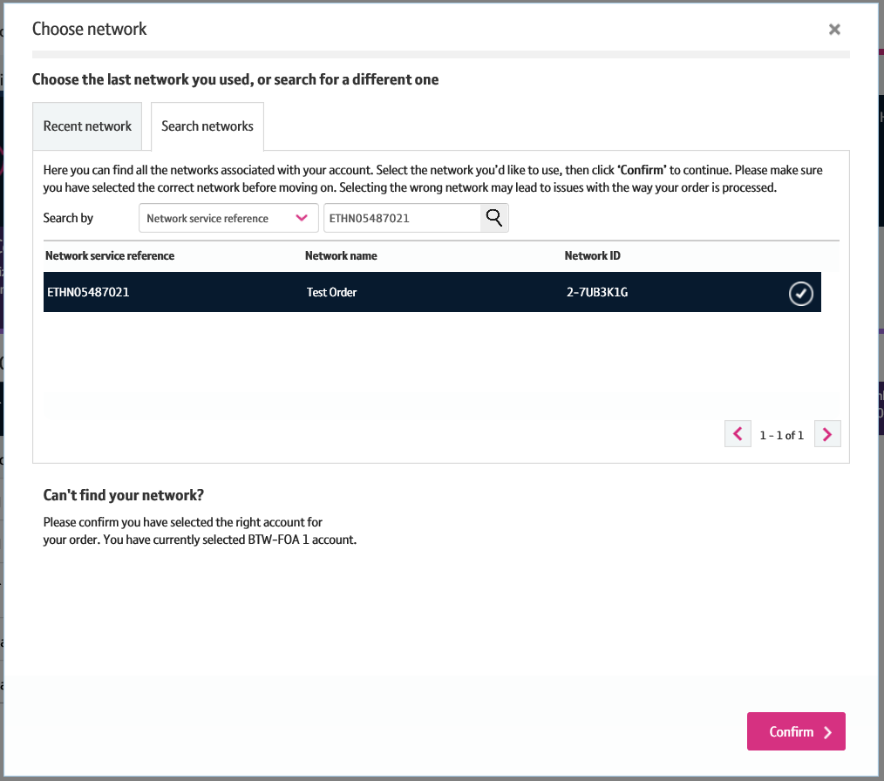
How to place an Etherway Fibre and Etherflow Connected order
Step 3: Choose a Network
If you have recently entered a Wholesale Ethernet order via the new journey, the most recently used network will be displayed in the ‘Recent Network’ tab. If you wish to use this network, you can just click ‘Confirm’ to continue.
If you wish to search for a network
Select the ‘Search Network’ tab
Enter your search criteria (Network Service Ref = ETHN, Network Name or Network ID) and click the magnifying glass.
Once the network details have been displayed and selected, click ‘Confirm’.
1
2
3

Slide 12
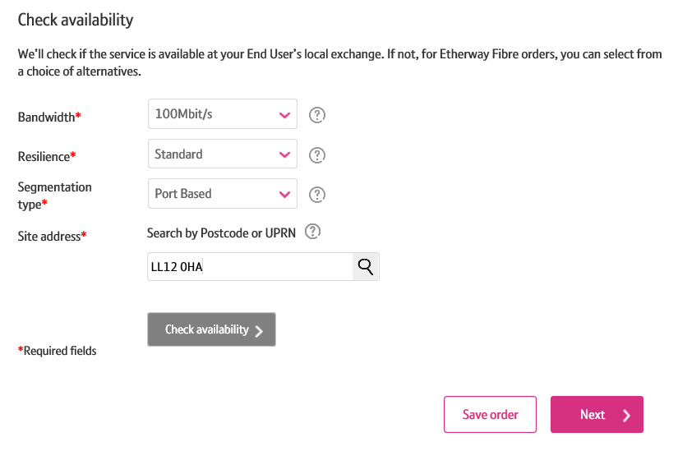
How to place an Etherway Fibre and Etherflow Connected order
Step 4: Check Availability
The next step is to check the availability of the service in the End User’s locale.
Select the required bandwidth
Select the resilience option. You can choose either Standard or Protected.
Enter the Segmentation Type
Enter the postcode or UPRN where the Etherway is to be installed and click the magnifying glass
Please note: You can click the ‘?’ icon to learn more about the inputs and options available to you.
1
2
3
4

Slide 13
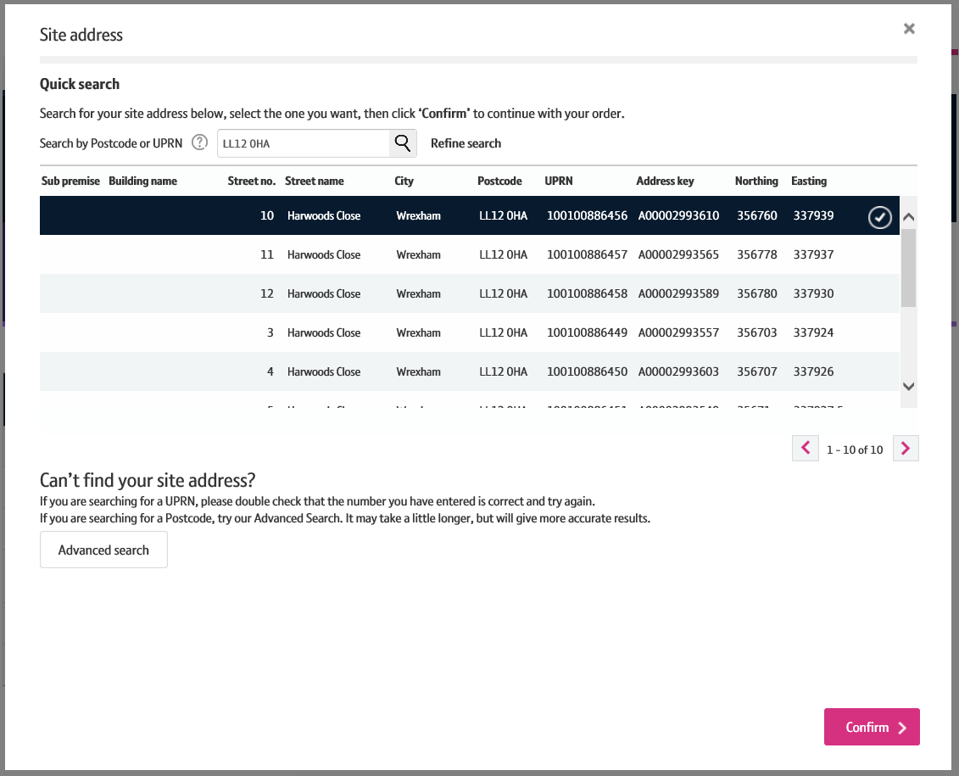
How to place an Etherway Fibre and Etherflow Connected order
Step 4: Check Availability
You’ll now need to select the address where the service is to be installed.
Select the address you require the service to be installed
The initial check will run a ‘quick search’. Sometimes the address you’re after won’t be displayed. If that’s the case, you’ll need to run an ‘Advanced Search’. From there, you can either select the address (if displayed) or add the address manually.
Click ‘Confirm’ to use the selected address.
1
2
3

Slide 14
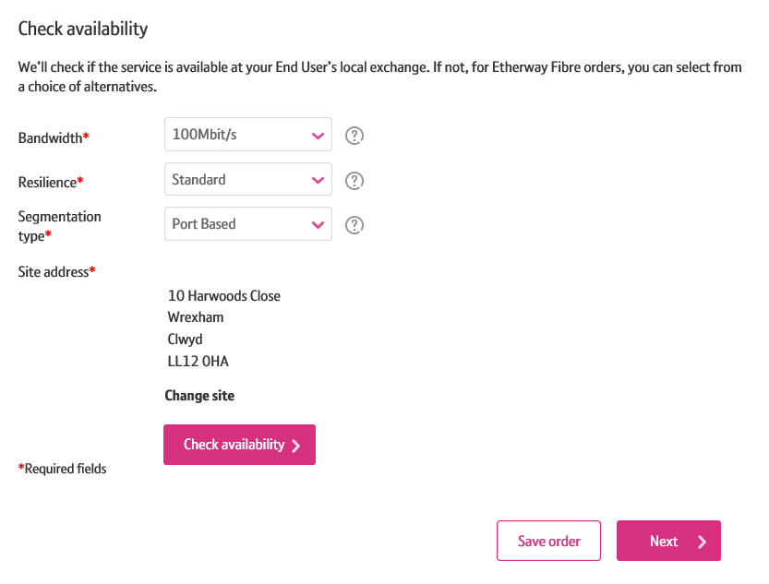
How to place an Etherway Fibre and Etherflow Connected order
Step 4: Check Availability
The address will now be populated.
If you wish to change the installation address, you can do so by clicking ‘Change Site’. If you are happy that the correct address is populated, click ‘Check Availability’.
1

Slide 15
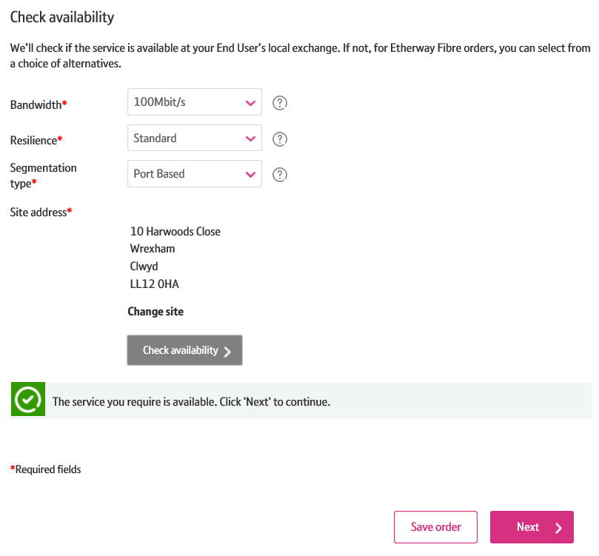
How to place an Etherway Fibre and Etherflow Connected order
Step 4: Check Availability
You will now see the availability check result.
The check will attempt to provide service from the node closest to the End User’s premises. If it’s not available, you will be given an option to select an alternative node for the order.
Click ‘Next’ to continue.
1

Slide 16
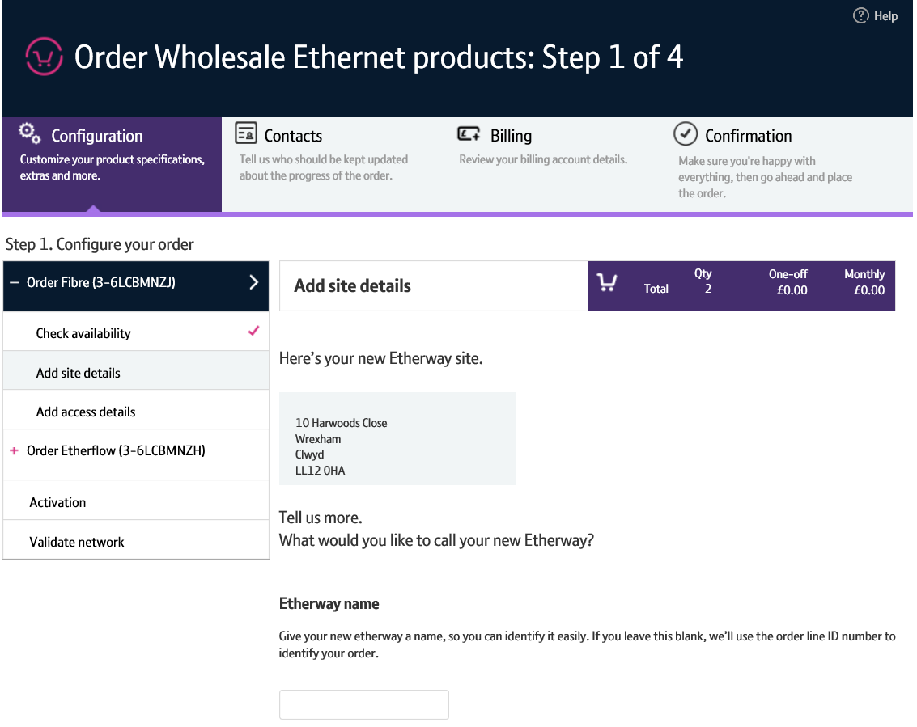
How to place an Etherway Fibre and Etherflow Connected order
Step 5: Site Details
You will now need to enter site details.
You have an option to give your Etherway a name. You can use this to search for your circuit on Business Zone. If you chose to apply an Etherway name, it’ll be displayed in the left hand menu. If you chose to not enter a name, the order number will be shown.
1

Slide 17
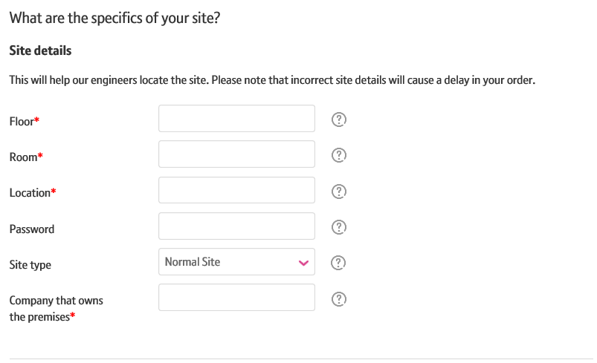
How to place an Etherway Fibre and Etherflow Connected order
Step 5: Site Details
You will now enter details on where the service will be installed at the site.
Once again, the ‘?’ next to each field will help you understand what these inputs are.

Slide 18
How to place an Etherway Fibre and Etherflow Connected order
Step 5: Site Details
Next, you’ll set up your primary contact details.
Click ‘Set up primary contact’
Please note: Although we expect the primary contacted to be contacted for all queries about the order, Openreach may also contact your end customer directly.
1

Slide 19
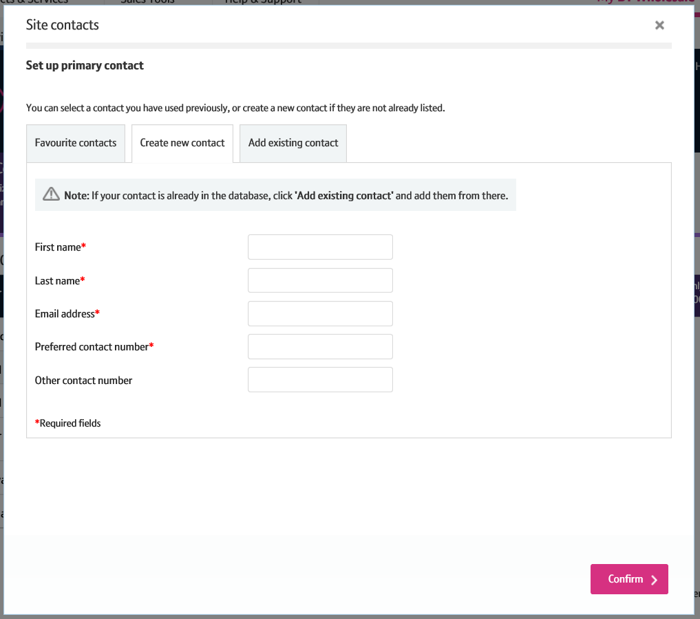
How to place an Etherway Fibre and Etherflow Connected order
Step 5: Site Details
We’ve defaulted the option to the ‘Create new contact’ tab. This allows you to manually enter the primary contact details.
If you wish to use a primary contact you’ve used in the past, you can search and select it from the ‘Add existing contact’ tab.
The fastest and easiest way to setup the primary contact, is to select one from a previously saved ‘Favourite contacts’ list
3
1
2

Slide 20
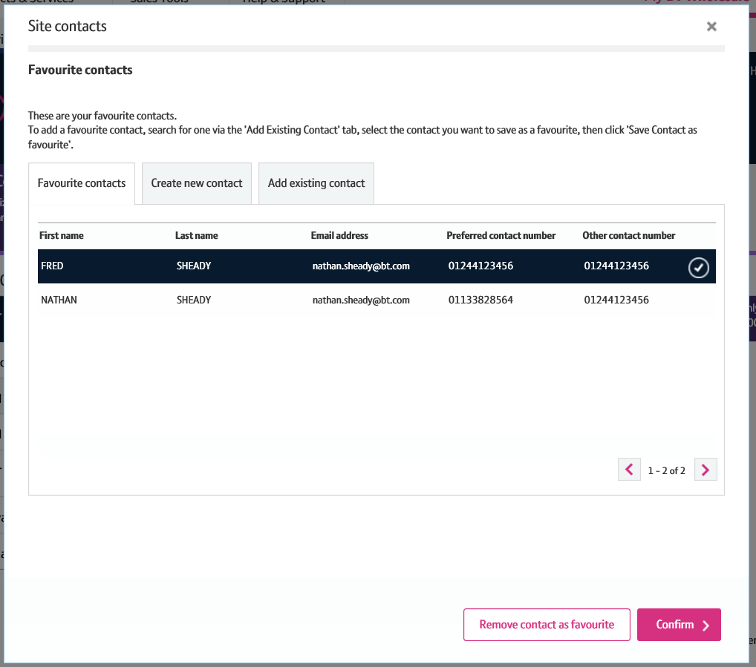
How to place an Etherway Fibre and Etherflow Connected order
Step 5: Site Details
On the favourite contacts tab, select the contact you wish to use
Clicking ‘Remove contact as favourite’ will remove the selected contact from the list.
If you wish to use this contact on your order, click ‘Confirm’.
1
2
3

Slide 21
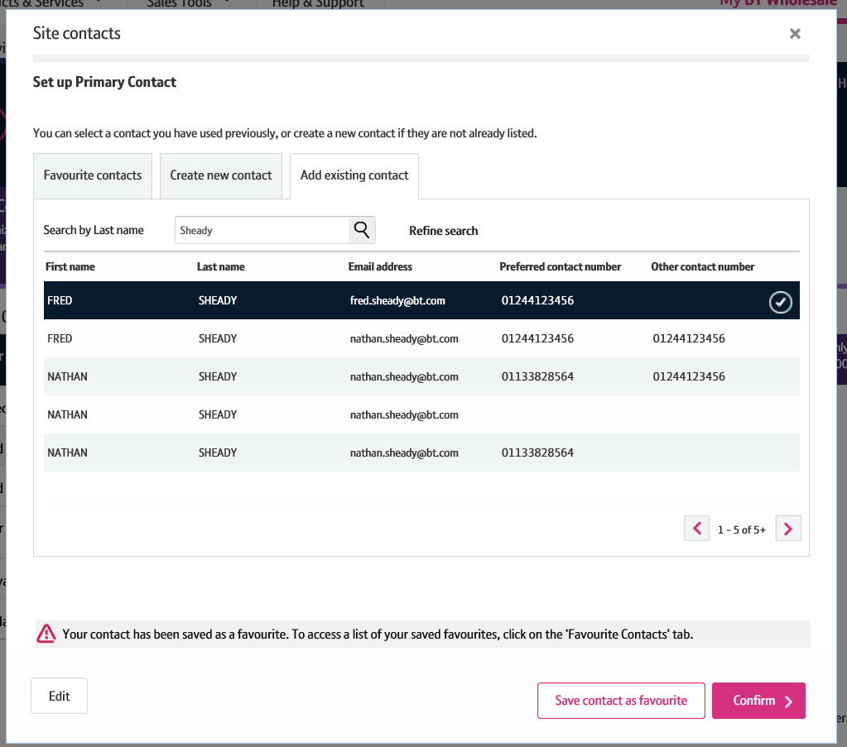
How to place an Etherway Fibre and Etherflow Connected order
Step 5: Site Details
To search for the contact in the ‘Add existing contact’ tab, enter the last name of the contact you want to add and click the magnifying glass.
The results will then be displayed. Select the contact you want to add.
If you’re going to use this contact again, you might want to add it to your favourites list. Click ‘Save contact as favourite’ to do this.
A message will be displayed confirming it’s been saved.
Click ‘Confirm’ to add the contact to your order.
You can also add a secondary contact using the same process if you wish.
1
2
4
3
5

Slide 22
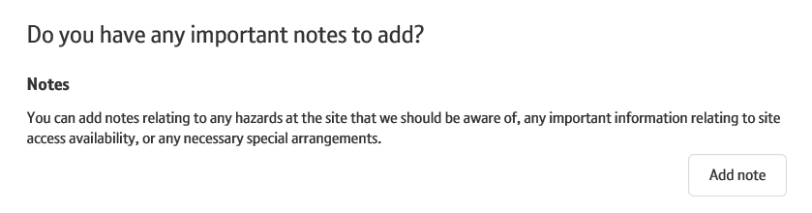
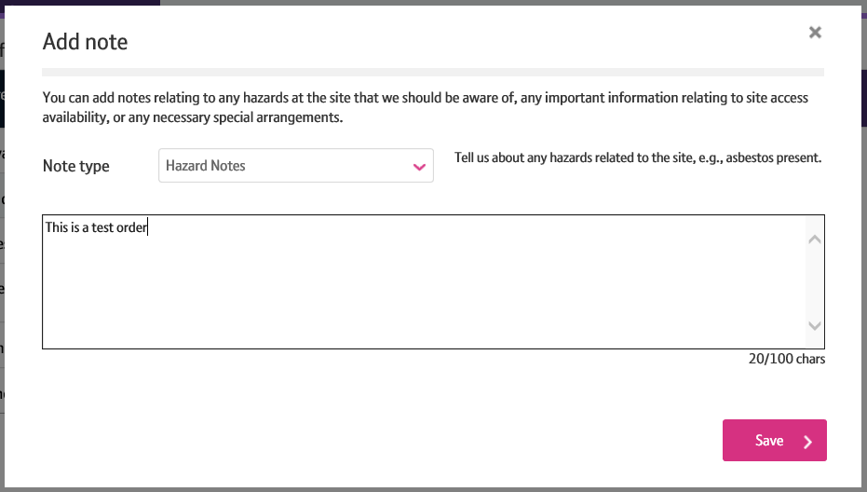
How to place an Etherway Fibre and Etherflow Connected order
Step 5: Site Details
You can also add optional site related notes. To do this, click ‘Add Note’
A lightbox will be opened where you can select the note type and enter the note.
Please Note: Note types available are Hazard Notes, Managed Install Notes, Site Access Availability and Special Arrangement notes.
2. Click ‘Save’ to save the note.
1
2

Slide 23
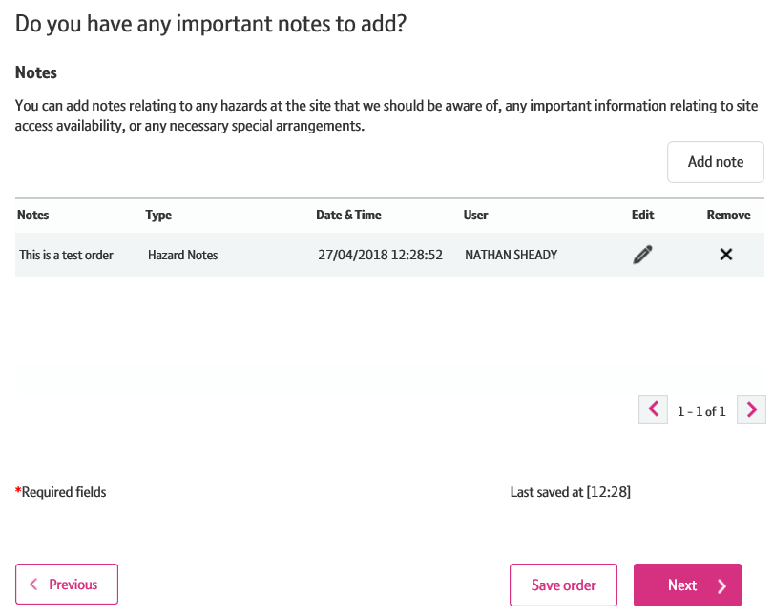
How to place an Etherway Fibre and Etherflow Connected order
Step 5: Site Details
If you have entered a note, you can see it in the main journey.
You have the option to edit or remove the note if you wish.
Click ‘Next’ to continue.
1
2
3

Slide 24
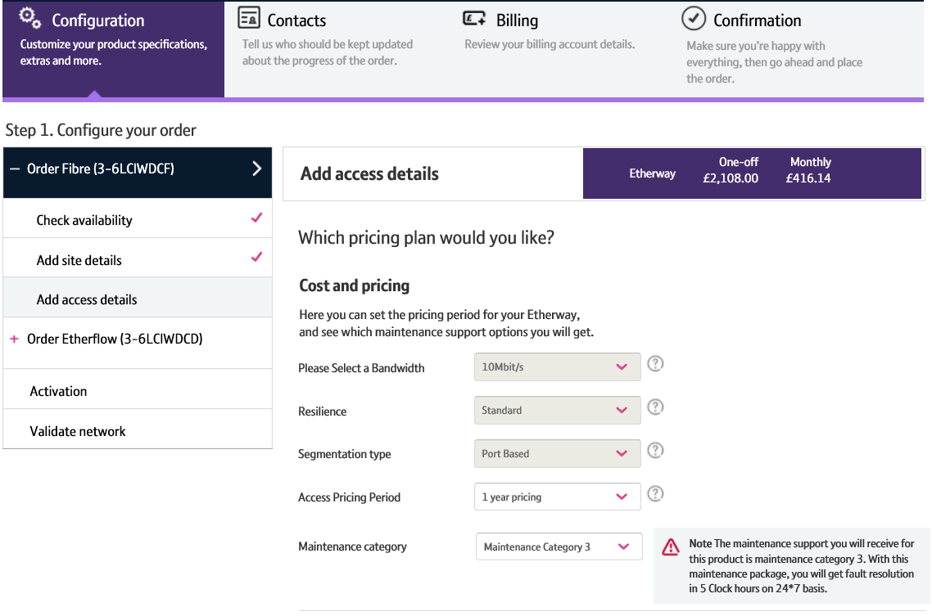
How to place an Etherway Fibre and Etherflow Connected order
Step 6: Access details
In this step, you’ll be adding access details.
Select the access pricing period.
Please Note: You can’t change the bandwidth, resilience, segmentation type or maintenance category in this section for Etherway fibre.
If you wish to change the bandwidth, you’ll need to navigate back to the ‘Check Availability’ step.
1

Slide 25
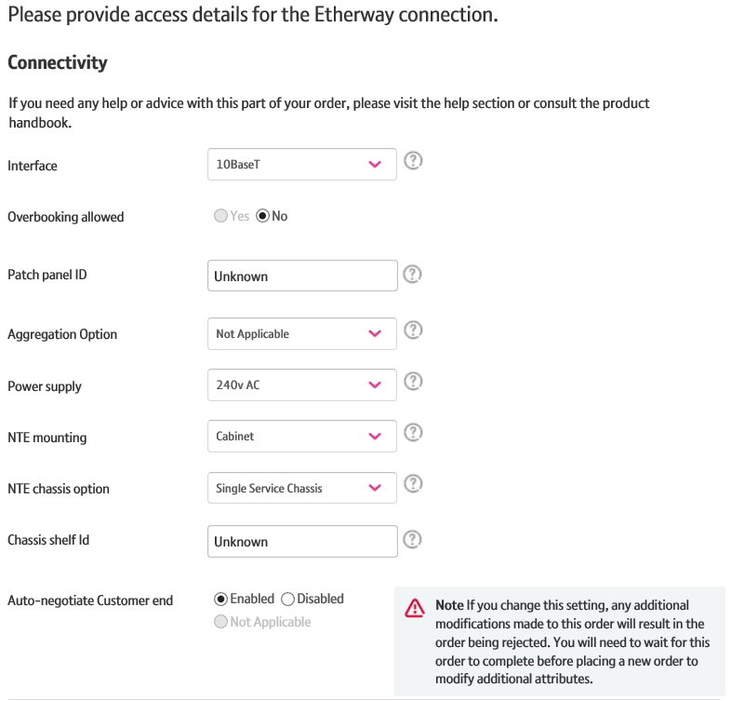
How to place an Etherway Fibre and Etherflow Connected order
Step 6: Access details
Enter the connectivity details.

Slide 26
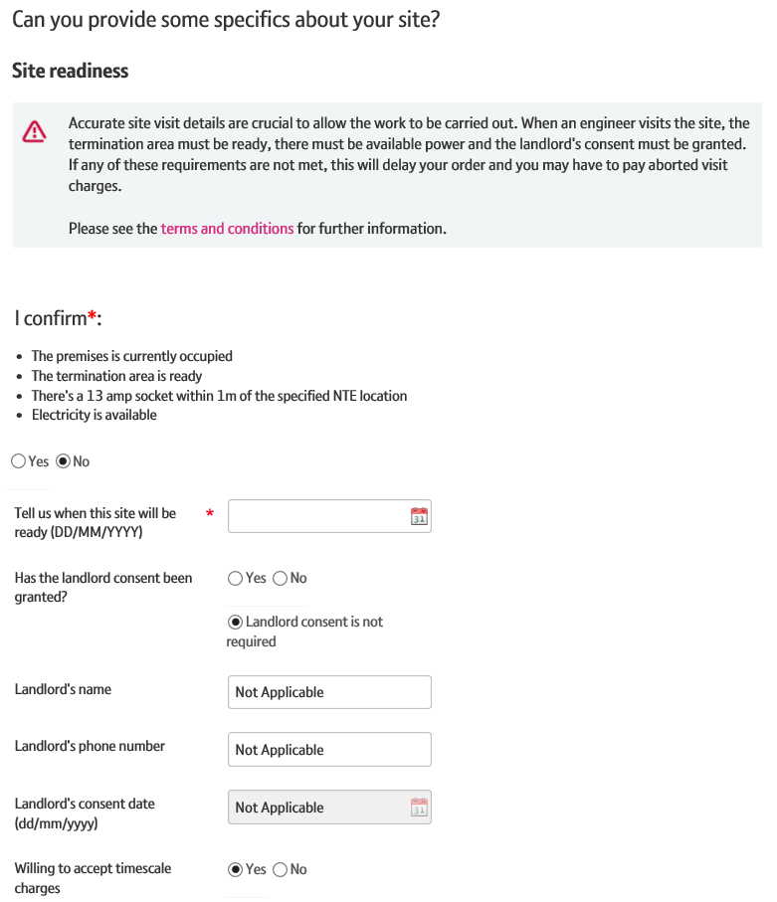
How to place an Etherway Fibre and Etherflow Connected order
Step 6: Access details
Enter the site readiness details.
Please note: The site and area must be ready by the date you’ve requested for the service to be installed, and all necessary landlord consent must be granted. Failure to do so will result in a delay to your order and an aborted visit charge.

Slide 27
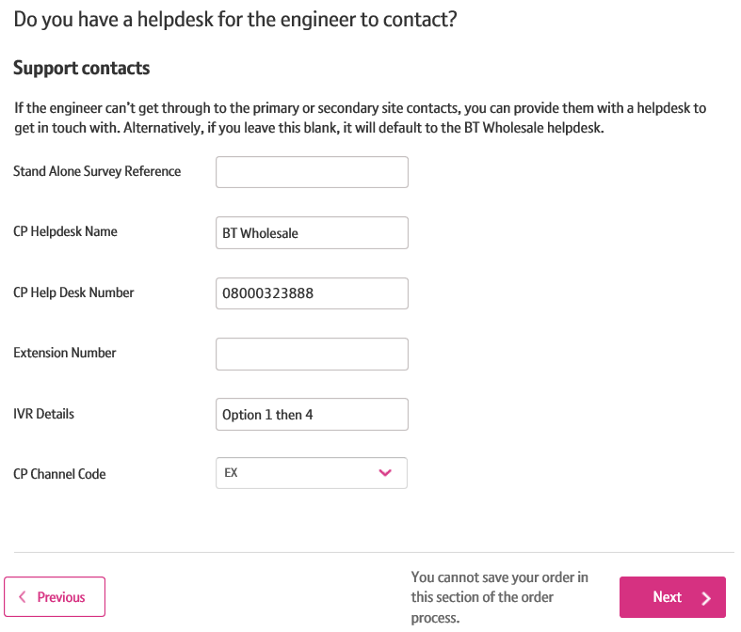
How to place an Etherway Fibre and Etherflow Connected order
Step 6: Access details
The support contact details provides Openreach a helpdesk number to call. It will default to the BT Wholesale number. If you wish to change this, you can do so.
When you are happy all Access Details are correct, click ‘Next’ to continue.
1

Slide 28
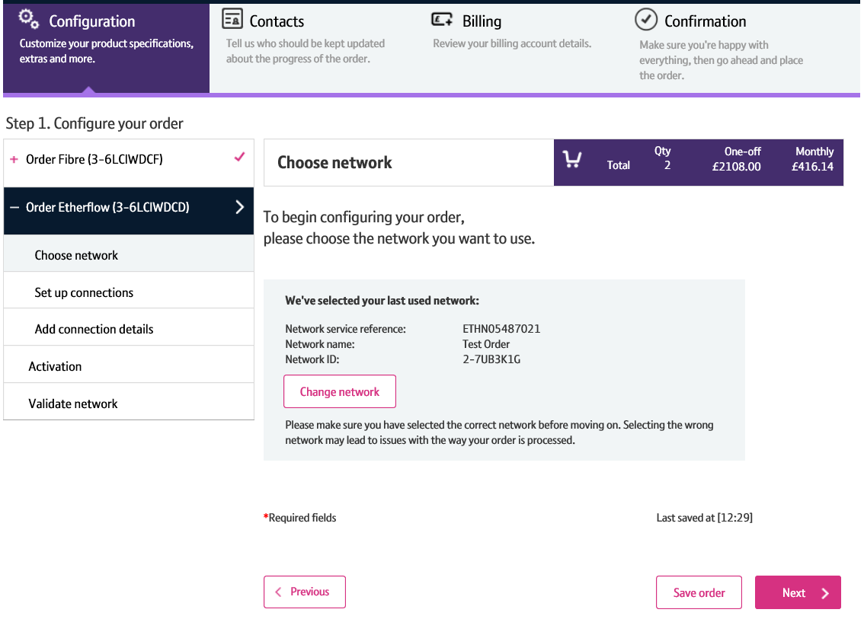
How to place an Etherway Fibre and Etherflow Connected order
Step 7: Etherflow – Choose Network
The left hand menu will show that you’ve configured the Etherway. You are now configuring the Etherflow.
As with the Etherway, the first step of the Etherflow journey is choosing a network. You’ll need to use the same network for both the Etherway and the Etherflow, so we’ve pre-filled it. There is an option to change this if you wish, but if you do, you’ll also be required to change the Etherway network to match..
Click ‘Next’ to continue.
1
2
3

Slide 29
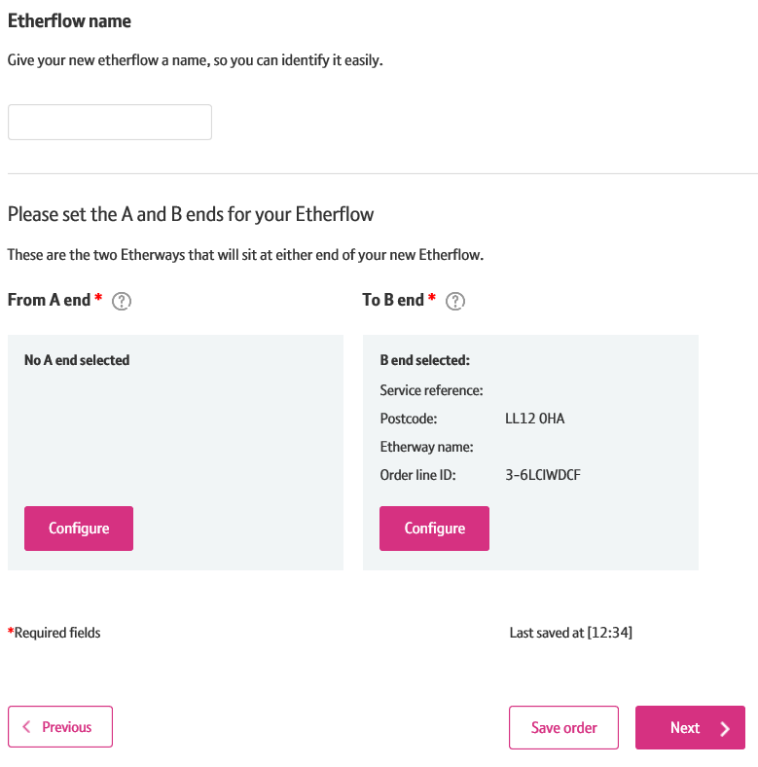
How to place an Etherway Fibre and Etherflow Connected order
Step 8: Etherflow – Set up connections
You’ll now be required to set up the connections for the service.
Like the Etherway, you have the option to give your Etherflow a name.
We’ll default the ‘B end’ of your order to the Etherway you’ve just configured. You can change this if you wish.
The ‘A end’ will usually be your hub site. To select this, click ‘Configure’
1
2
3

Slide 30
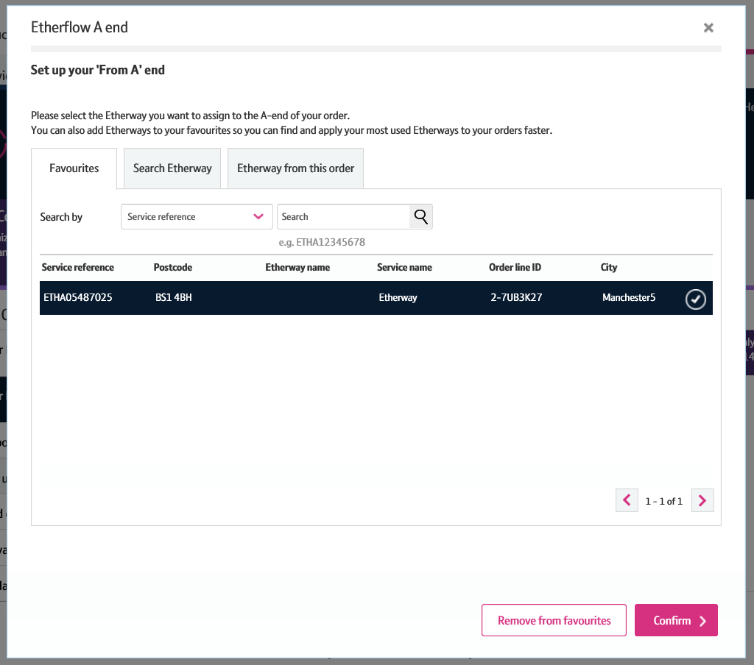
How to place an Etherway Fibre and Etherflow Connected order
Step 8: Etherflow – Set up connections
Similar to the site contacts, you can save Etherways as favourite A ends so you can easily pick commonly used ones every time you order with us.
Alternatively, you can search manually for an Etherway. But please note, searching by post code can often take a long time to return results, so we recommend you search via service reference.
Once you’ve searched for and selected the Etherway you want to assign to you’re a end, click ‘Confirm’.
1
2
3

Slide 31
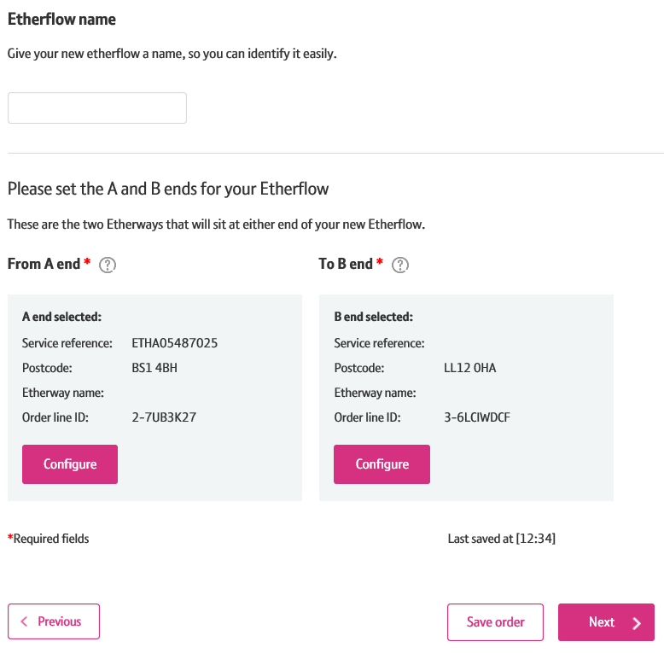
How to place an Etherway Fibre and Etherflow Connected order
Step 8: Etherflow – Set up connections
Once you have selected the A and B end connections, the details will be displayed on the screen. You can change the details by clicking ‘Set end’ again.
Once you’re happy the details are correct, click ‘Next’ to continue.
1
2

Slide 32
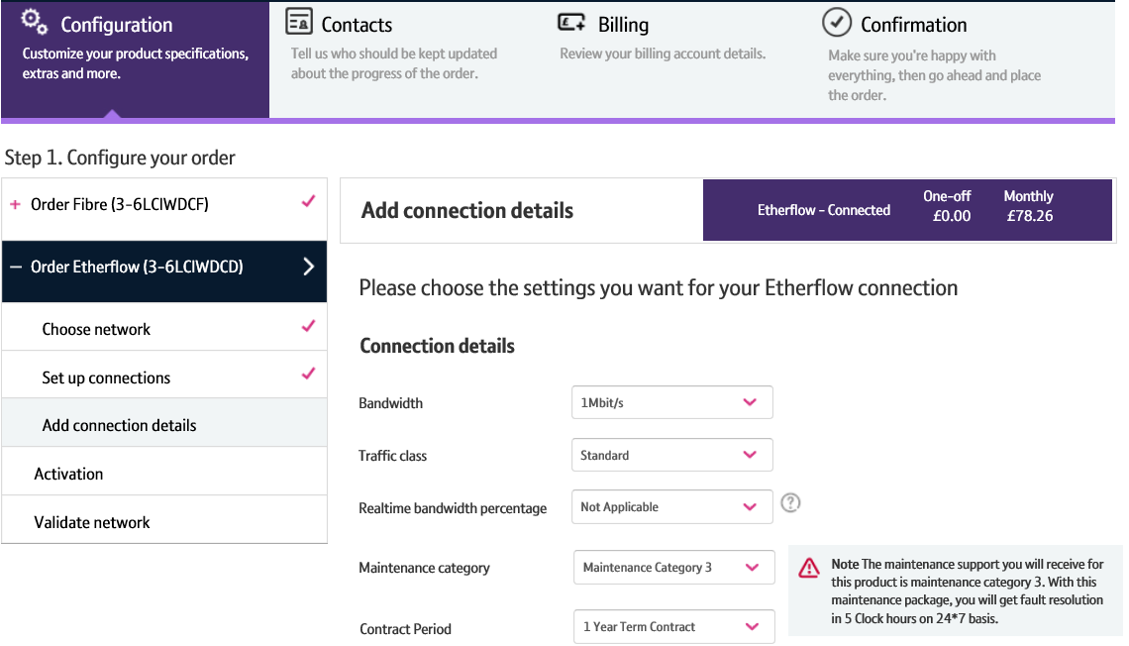
How to place an Etherway Fibre and Etherflow Connected order
Step 9: Etherflow – Add Connection Details
You’ll now need to add connection details.
Select the Bandwidth, Realtime Bandwidth, Traffic Class and Contract Period for the Etherflow.
Please note: Maintenance category can not be changed for this product type.
1
2

Slide 33
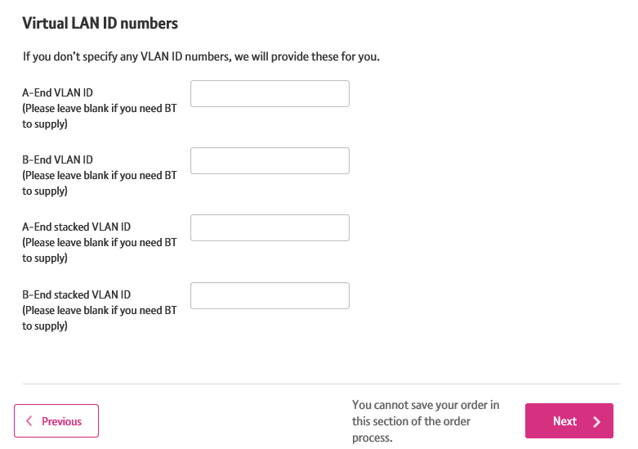
How to place an Etherway Fibre and Etherflow Connected order
Step 9: Etherflow – Add Connection Details
If you wish, you can enter the VLAN ID details for the connection.
Click ‘Next’ to continue.
1
2

Slide 34
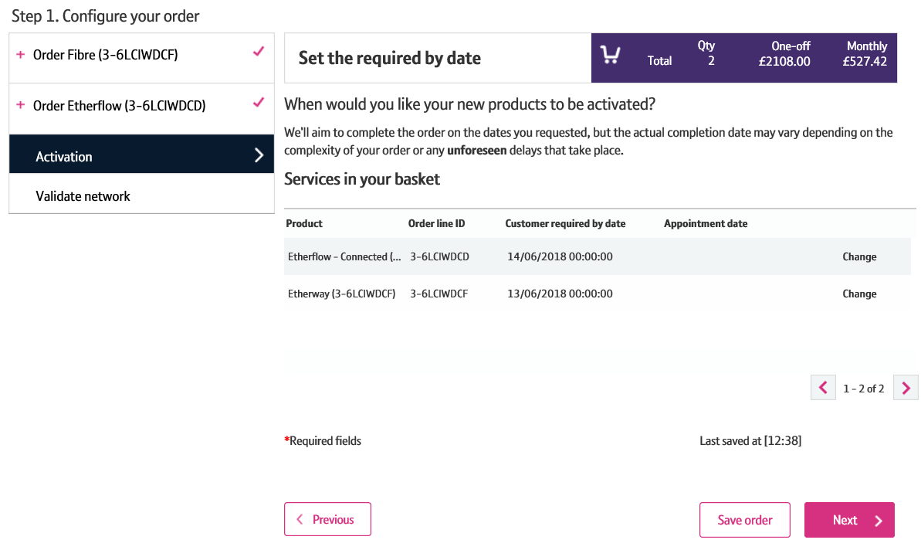
How to place an Etherway Fibre and Etherflow Connected order
Step 10: Set the Activation Date
You’ll now set the activation date for the order lines. This is the ‘Customer Required by Date (CRD)’.
They’re defaulted to the standard minimum lead time.
If you wish to change the CRD, you can do so by clicking ‘Change’.
Please note: We’ll automatically set the CRD for the Etherflow to one working day after the Etherway. If you change your Etherway CRD and the Etherflow isn’t already set to after the new Etherway date, the Etherflow CRD will change automatically.
2. Click ‘Next’ to continue.
1
2

Slide 35
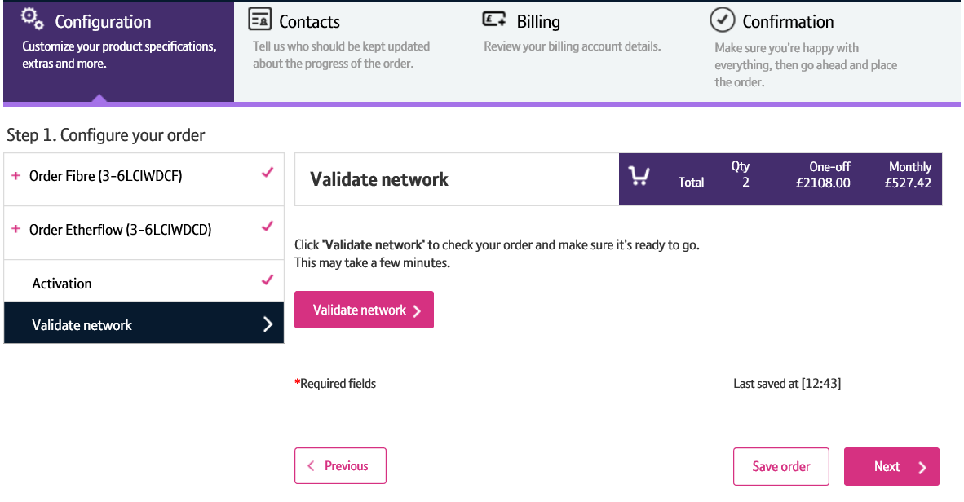
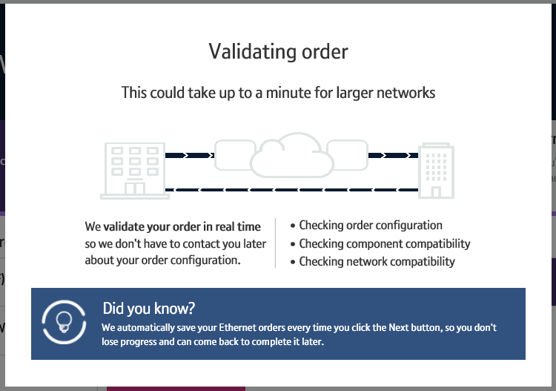
How to place an Etherway Fibre and Etherflow Connected order
Step 11: Validate Network
Next, you’ll need to perform a ‘Validate Network’ check.
This will check that your network can support the configuration of Etherway/Etherflow.
This check will take longer the bigger your network is.
Click ‘Validate Network’.
1

Slide 36
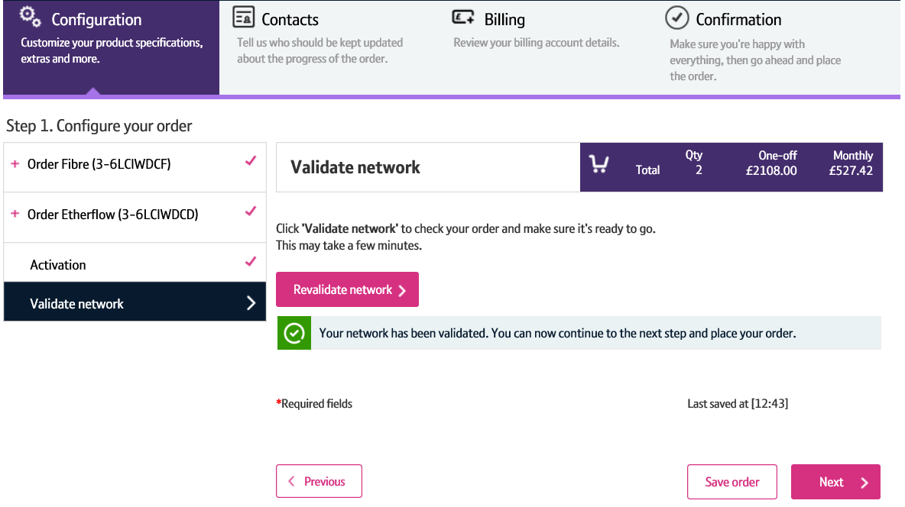
How to place an Etherway Fibre and Etherflow Connected order
Step 11: Validate Network
The validation result will be displayed.
Click ‘Next’ to continue.
Please Note: If validation fails, you can make the relevant changes and re-validate.
1
1
2

Slide 37
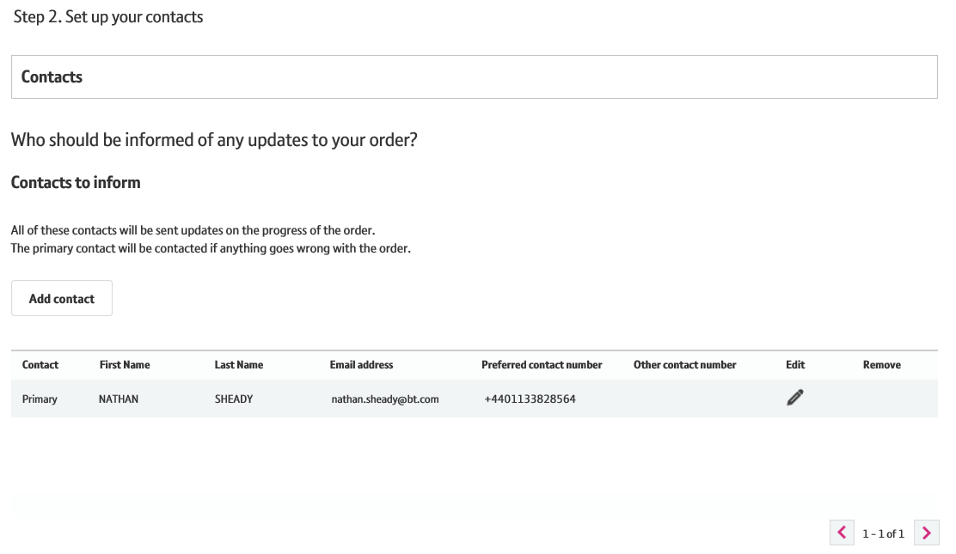
How to place an Etherway Fibre and Etherflow Connected order
Step 12: Set up your contacts
In this step, you can add and choose contacts who wish to be kept up to date with the order progress.
We default the contact details to the account issuing the order.
You can add a contact by clicking ‘Add Contact’.
Or you can edit the existing contact by clicking ‘Edit’.
1
2

Slide 38
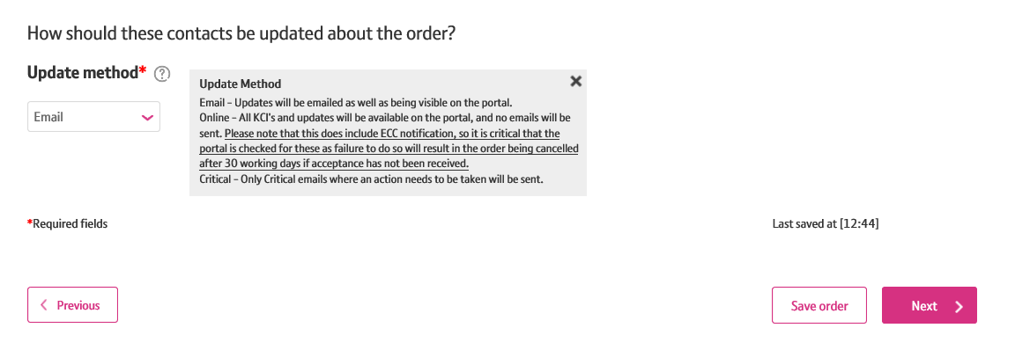
How to place an Etherway Fibre and Etherflow Connected order
Step 12: Set up your contacts
You can select how you would like to be kept up to date via the ‘Update Method’ dropdown.
Once you are happy that all the contact details are entered correctly, click ‘Next’ to continue.
1
2

Slide 39
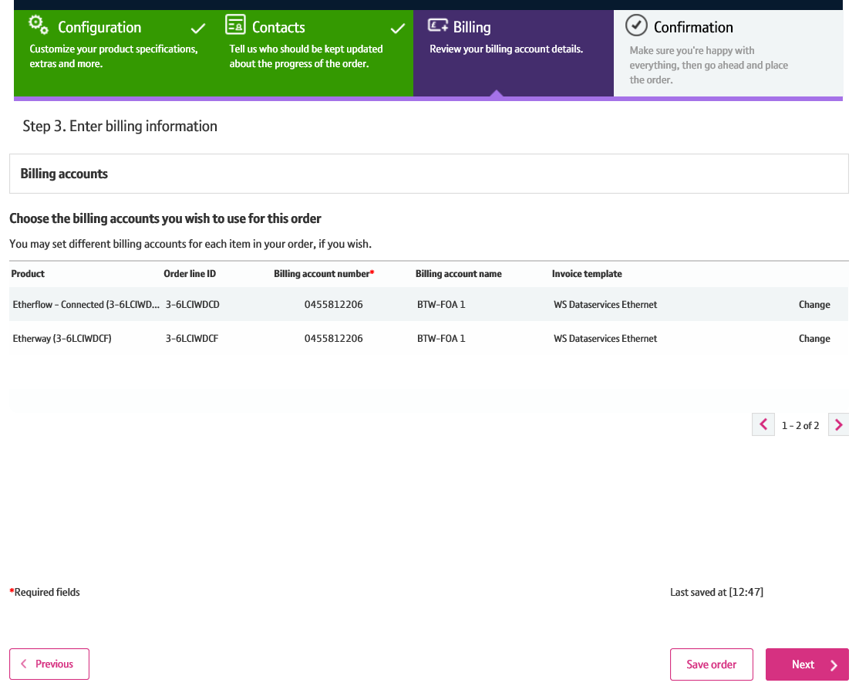
How to place an Etherway Fibre and Etherflow Connected order
Step 13: Billing
In this section you can select the billing account associated with the Etherway and Etherflow orders.
The billing account details will be auto –populated. But you have the option to change them if you wish.
Click ‘Next’ to continue.
1
2

Slide 40
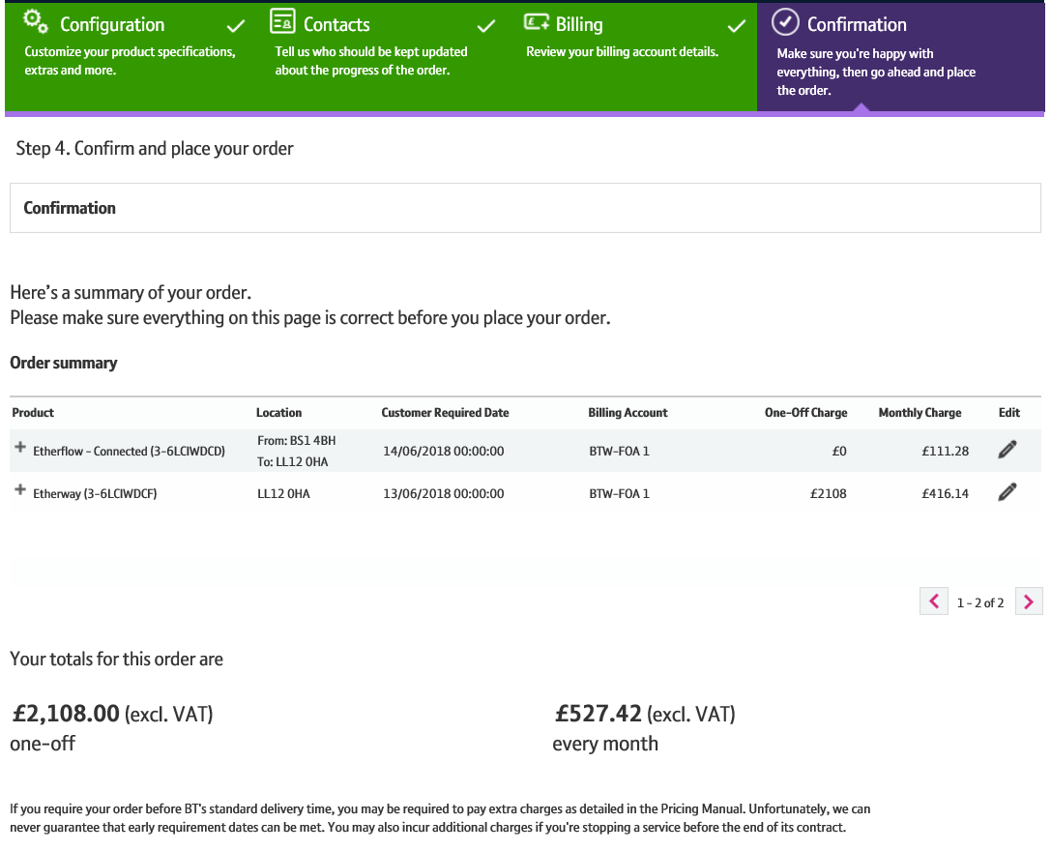
How to place an Etherway Fibre and Etherflow Connected order
Step 14: Confirmation
The confirmation page gives you a summary of the order.

Slide 41
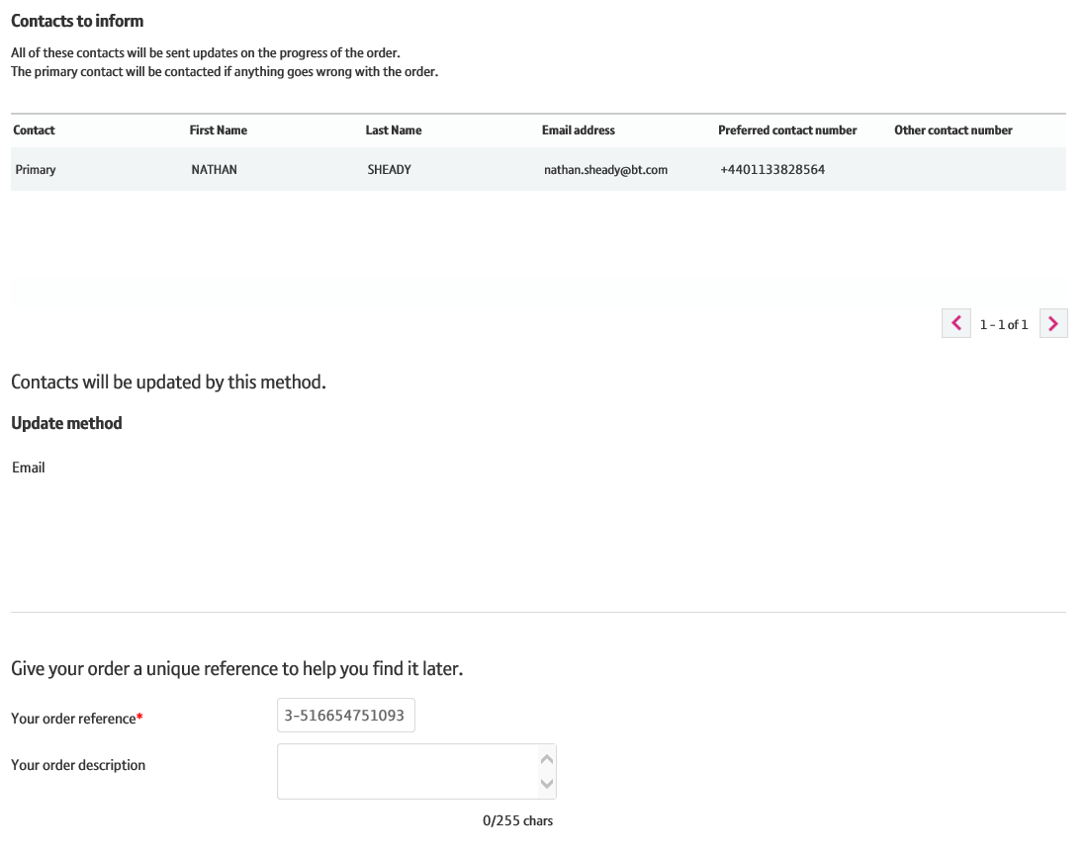
How to place an Etherway Fibre and Etherflow Connected order
Step 14: Confirmation
Update method is shown.
You are required to enter a reference for the order. We default this to the order number, but you can overwrite this with your own reference and add a description if you wish.
1
2

Slide 42
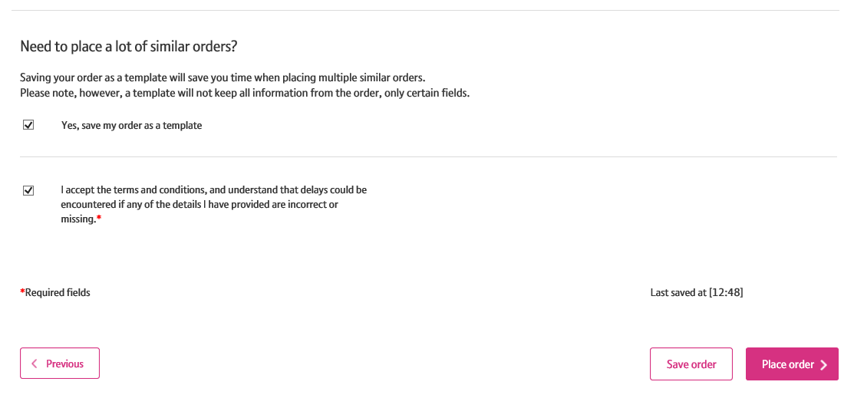
How to place an Etherway Fibre and Etherflow Connected order
Step 14: Confirmation
If you wish to save your order as a template, tick the relevant checkbox.
Then, click the confirmation checkbox.
Click ‘Place Order’ to enter the order.
1
2
3

Slide 43
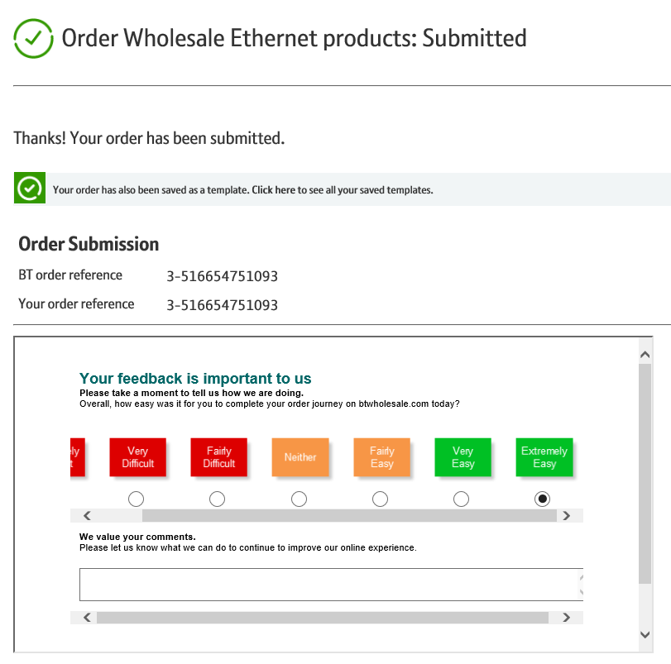
How to place an Etherway Fibre and Etherflow Connected order
Step 14: Confirmation
You’re order has now been placed!
We’ll send you confirmation of your order details via email in addition to showing them on the screen.
If you want to comment on the journey, or wish to provide feedback such as suggestions for improvements, you can do so via the feedback section.

