Slide 1

An Introduction to the Business Zone Ethernet Order Journeys
BT Wholesale Online
V2
LEGAL NOTICE: The information contained in this briefing is confidential information as per your terms and conditions with BT. Please do not forward, republish or permit unauthorised access. The content is accurate at the time of writing and is subject to change.

Slide 2
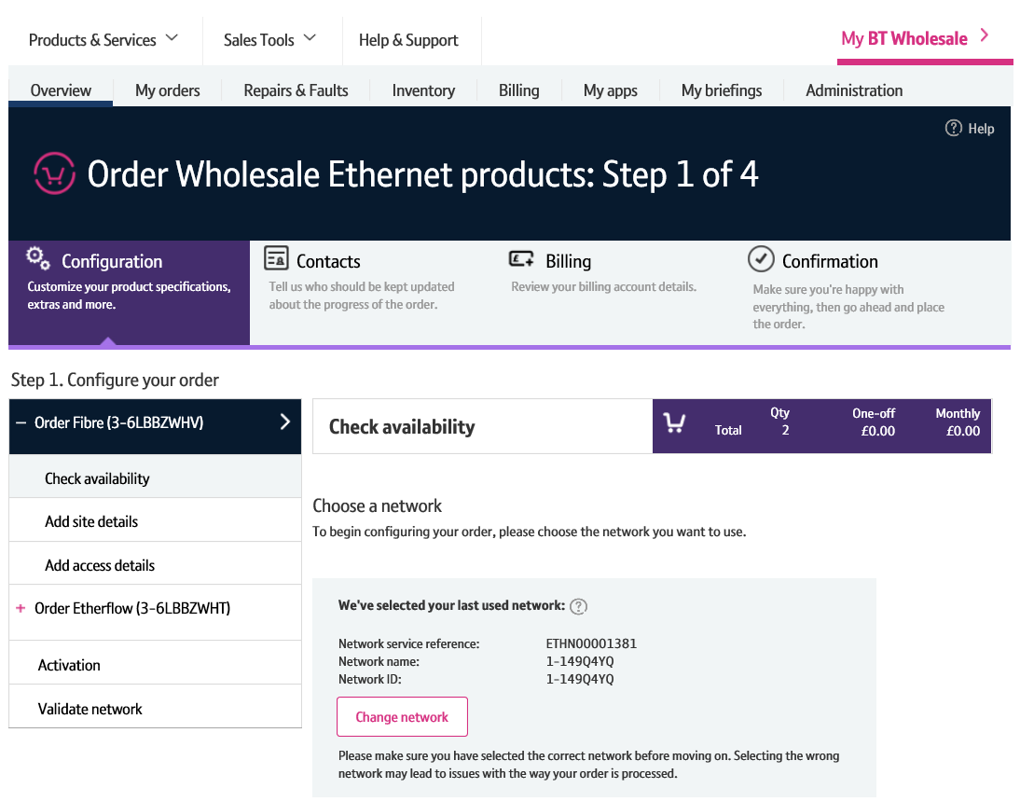
Contents
What’s in this User Guide?
p3 - Introduction
p6 - Pre-requisites
p7 – Order journey layout

Slide 3
Version Control
Date | Change | Version
11/07/16 | User Guide Published. | 1
06/01/17 | New journeys added | 1.1
30/04/18 | Re-branded | 2

Slide 4
Introduction
What is the Business Zone Ethernet Order Journey?
We’ve replaced Eco Plus with an improved online order journey for Ethernet.
Accessed via Business Zone, this journey will allow you to enter Ethernet orders faster and easier.
The new journey is compatible with modern browsers, is more stable and removes many of the irritants experienced on Eco Plus.

Slide 5
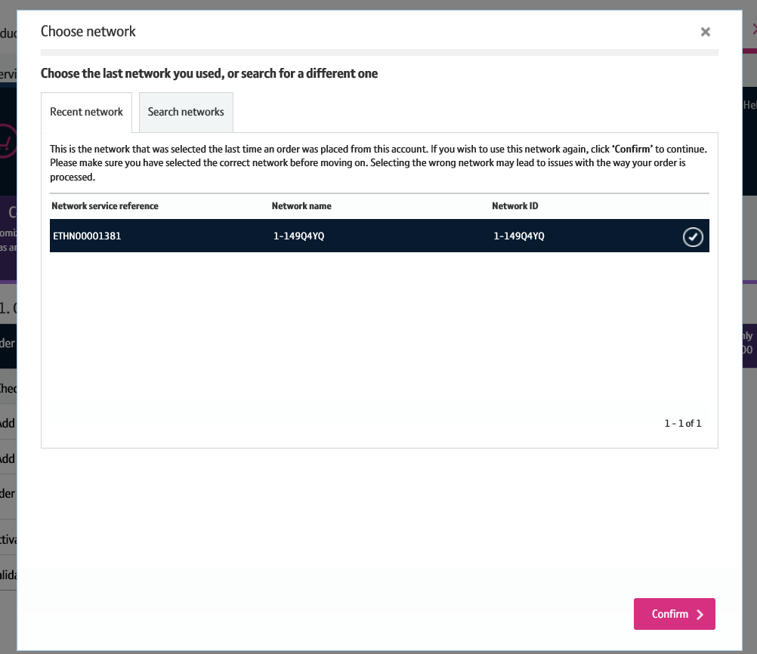
Introduction - continued
What are the benefits?
Entering Ethernet orders online is much easier
It provides a more intuitive ordering experience
Common options are pre-populated
Validations are run up front, meaning you don’t need to go back through the journey to make amendments
There’s fewer pages to navigate, a real simple ordering experience
All of the above contributes to you being able to enter your orders faster than doing so via Eco Plus

Slide 6
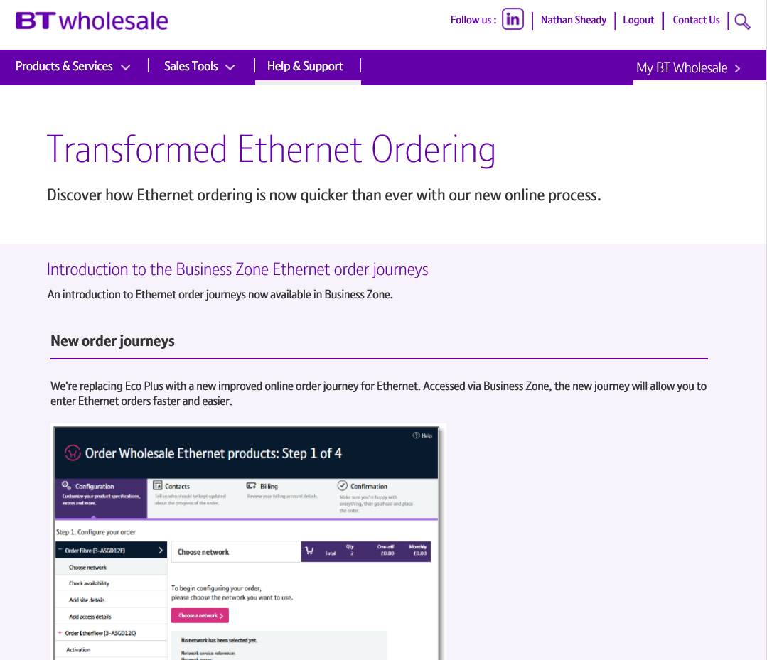
Pre-Requisites
What do you need to enter an Ethernet order via the new journey?
You need correct access and privileges, including Business Zone. If you don’t have this, please contact your company administrator to action.
Please visit our Transformed Ethernet Ordering page to learn about what order journeys are available.
You must be using a Windows machine and using the latest version of Internet Explorer, Chrome or Firefox.
Mobile devices, Mac and Safari are not supported.

Slide 7

Order journey layout
1. Order Progress Tracker
The order progress tracker tracks your progress when placing the order.
There’s four key steps:
Configuration: Where you’ll be configuring your Etherway and Etherflow orders
Contacts: Where you’ll add KCI Contact details
Billing: Where you’ll confirm the billing details
Confirmation: Where you’ll confirm all details are correct and place your order.
2. Left Hand Menu
The left hand menu shows you the process you’ll follow when configuring and enter your order. Progress will be tracked as you complete each step.
3. Order Basket
The order basket keeps track of the costs associated with your order as you are configuring it.
4. Navigation Buttons
The navigation buttons allow you to move forward and backward throughout the ordering process. You can also save your orders from here.
1
2
3
4

