Slide 1
Reading Fault Notes and Viewing Engineer Status Version 1

Slide 2
Contents
What’s in this User Guide?
P3 – Version Control
P4 – Logging In
P10 – Reading BT Wholesale Notes
P13 - View Engineer Status and Notes

Slide 3
Version Control
Date | Change | Version
June 18 | User Guide Published | 1

Slide 4
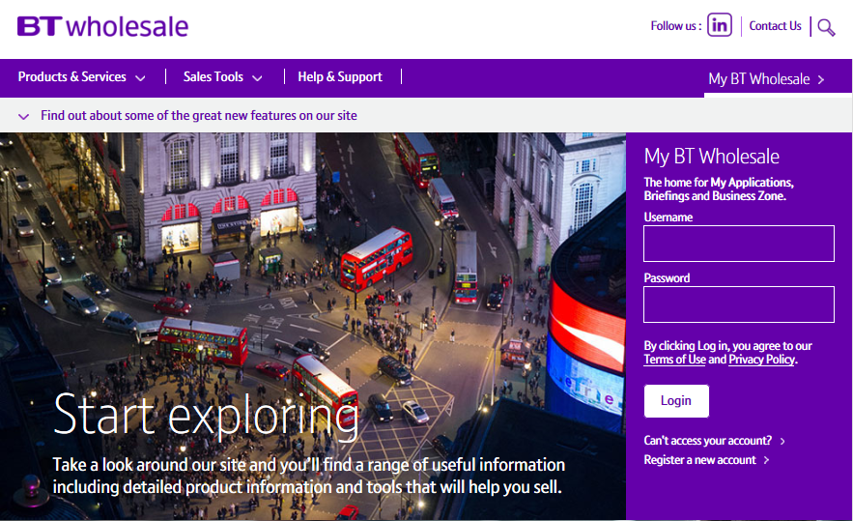
Logging In
Step 1: Logging In
Go to www.btwholesale.com
Enter your Username and Password
Click ‘Login’

Slide 5
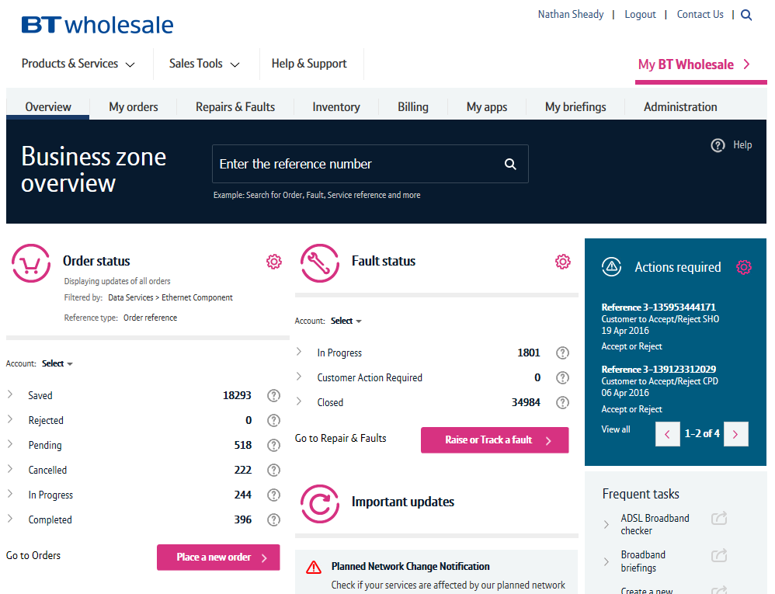
Logging In
Step 2: Accessing the journey
Once logged in, you’ll be taken to Business Zone.
If you aren’t taken to Business zone, you’ll need to you speak with you Administrator
To access the new journey:
Click ‘Raise or Track a fault’

Slide 6
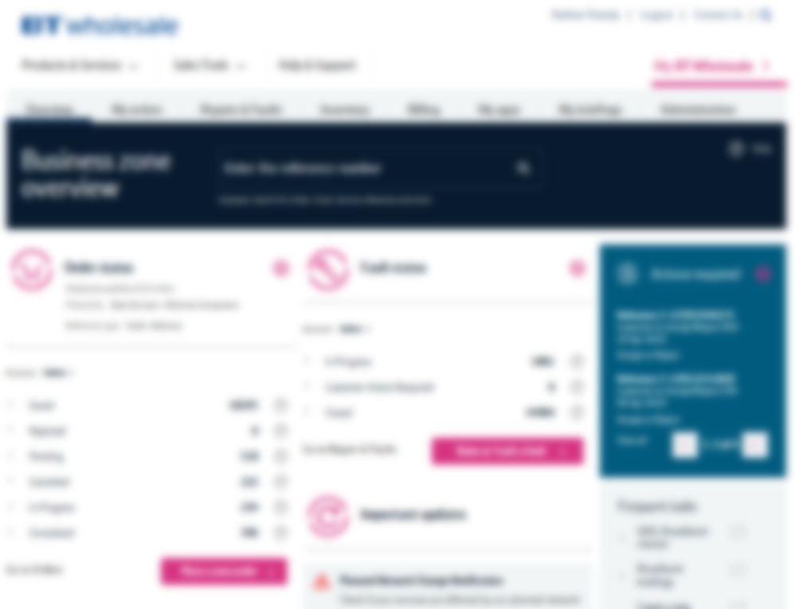
Checking your Fault Status
Step 2: Search for your fault
A pop up box will appear asking to enter BT Fault, Customer, Service Reference or Directory Number
1) Enter the Service ID (normally a BBIP or BBEU) or the Directory Number
2) Click on magnifying glass icon
1
2

Slide 7
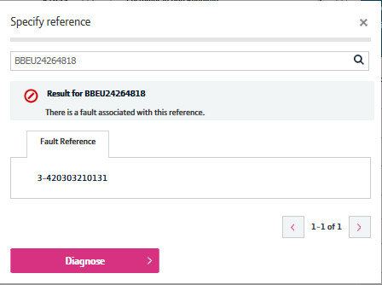
Checking your Fault Status
Step 2: Search for your fault
We’ll confirm if we’ve been able to find an open fault against the reference you have provided.
If there is an open fault, it will be displayed under the Fault Reference tab

Slide 8
Checking your Fault Status
Step 2: Search for your fault
1) Click on the Fault Reference Number
1

Slide 9
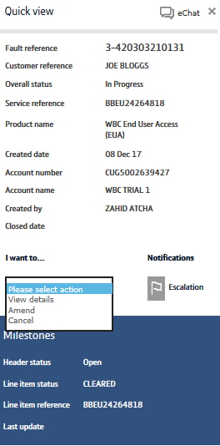
Checking your Fault Status
Step 3: Viewing the fault details
1) Click ‘View details’
1

Slide 10
Reading BT Wholesale Notes

Slide 11
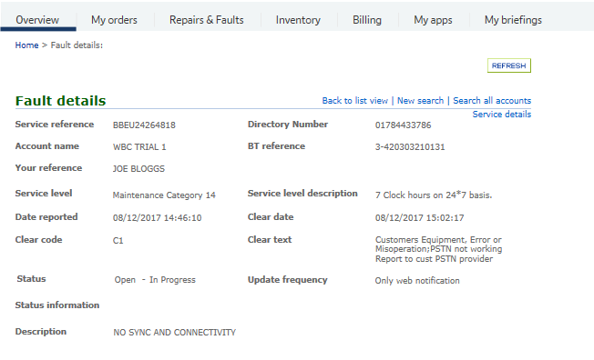
Reading BT Wholesale Notes
Step 4: Reading BT Wholesale notes
Screen scroll on the Fault Details page

Slide 12
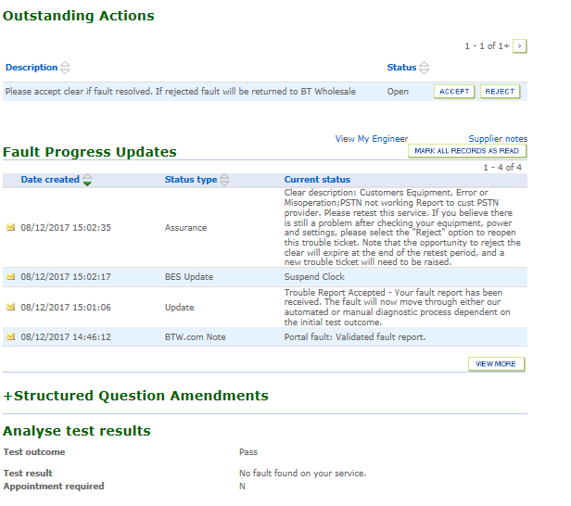
Reading BT Wholesale Notes
Step 4: Reading BT Wholesale notes
Under the ‘Fault Progress Updates’ section you can view the notes sent by BT Wholesale
If you want to view older notes, click on ‘View More’
1
2

Slide 13
View Engineer Status and Notes

Slide 14
Engineer Status
Step 5: Engineer Status
If your fault has an Appointment booked or a Non-Appointed engineer visit you can view the status of the engineer visit by using ‘View My Engineer’ and ‘Supplier Notes’.
1) View My Engineer – Only becomes available to view when the current status (under the Fault Progress Update section) shows ‘Trouble Report Accepted’ or confirms an appointment has been booked.
2) Supplier Notes – You can view the engineering notes following an appointment
1
2

Slide 15
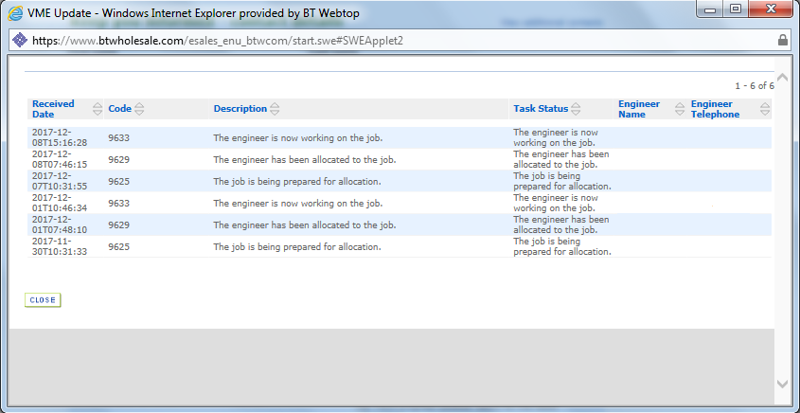
Engineer Status
Step 6: View My Engineer
Once you’ve clicked in the ‘View my Engineer’ link, a pop up box will appear.
This gives you the status of the engineer visit along with the engineer’s name and telephone number should you need to contact them.

Slide 16
Engineer Status
Step 7: Supplier Notes
1) Click ‘Supplier Notes’
1

Slide 17
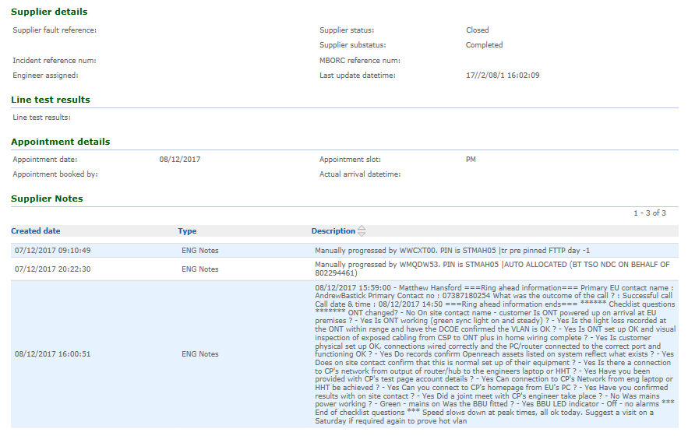
Engineer Status
1
Step 7: Supplier Notes
1) Supplier Details – gives you the status of the engineer task.
2) Appointment details – provides the appointment date and time
3) Supplier Notes – shows you the notes added by the engineer on completion of the appointment
2
3

