Slide 1
Raising a Customer Controlled SFI (CCSFI) fault Version 1

Slide 2
Contents
What’s in this User Guide?
p3 – Version Control
p4 – Best Practice: KBD (Knowledge Based Diagnostics
p5 – Best Practise: CCSFI
p6 – Logging In
p9 – Raising a CCSFI Fault

Slide 3
Version Control
Date | Change | Version
June 18 | User Guide Published | 1

Slide 4
Best Practice: KBD (Knowledge Based Diagnostics)
What is KBD?
New Knowledge Based Diagnostics (KBD) is a diagnostic tool for 21C copper and fibre broadband. It uses a combination of BT Wholesale network tests, Openreach Copper Line test/ GEA service test and Service Layer data and brings it all together in one place. It can identify and locate faults, or show the End Customer's service is working if no adverse results are found. The results screen gives additional measures and data to help support the decision-making process for local access and End User environment diagnostics.
Do I need to run KBD?
Yes, KBD is mandatory and needs to be run within 2 hours prior to raising a fault. The KBD outcome will advise you next course of action. However on certain outcome will not allow you to raise a fault into BT Wholesale. During Fault raising, the System will check for KBD Results and will let you proceed in completing the Fault Reporting Journey. If the System is unable to find the latest KBD Results you will be ask to run KBD.
Where do I run KBD?
You can run KBD by logging into www.btwholesale.com > My apps Tab:
To run KBD on 20CN product select 20C Knowledge Based Diagnostics
To run KBD on 21CN Copper and Fibre Product select New Knowledge Based Diagnostics.
Where can I learn more on KBD?
Please login to www.btwholesale.com and then click on the link below for all information around KBD.
https://www.btwholesale.com/pages/static/help-and-support/broadband/faults-diagnostics-repair.htm

Slide 5
Best Practice: CCSFI
What is CCSFI?
CCSFI stands for Customer Controlled Special Faults Investigation. This allows you to directly request a SFI visit when KBD has identified there is no fault found/line test ok, on BT Wholesale Network.
How do I request CCSFI?
All you need to do is to ensure KBD has been carried out. Once this is completed follow the normal process of reporting a fault which will give you an option to take CCSFI. This guide shows you how this is done.
Recommendation
Please ensure all checks are carried out with the Customer including the recommendations made by KBD before raising a CCSFI fault as there are charging implications for customer domain clears.

Slide 6
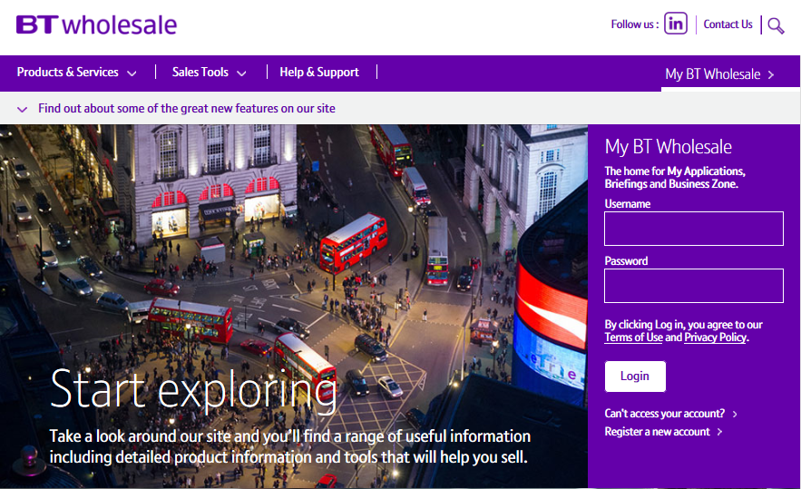
Raising a CCSFI fault
Step 1: Logging In
Go to www.btwholesale.com
Enter your Username and Password
Click ‘Login’

Slide 7
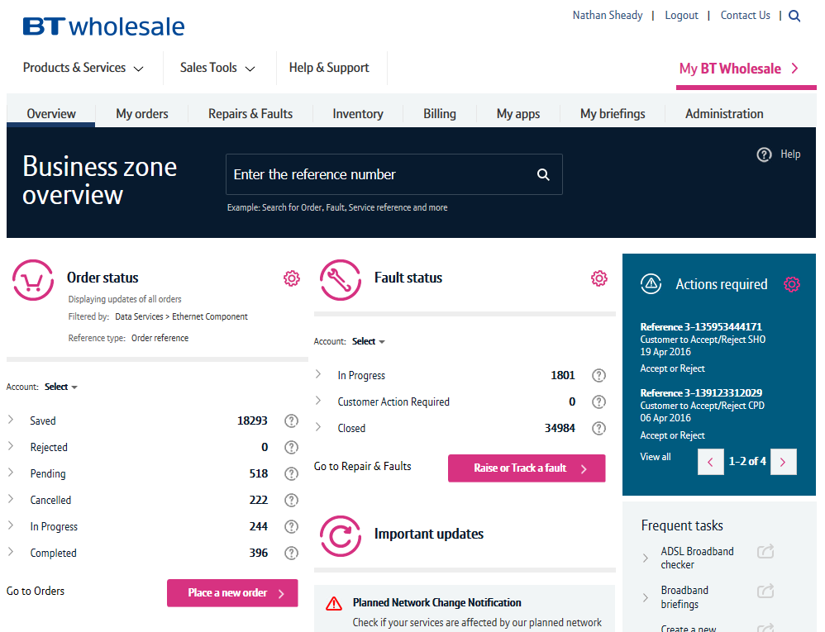
Raising a CCSFI fault
Step 2: Accessing the journey
Once logged in, you’ll be taken to Business Zone.
If you aren’t taken to Business zone, you’ll need to you speak with you Administrator
To access the new journey:
Click ‘Raise or Track a fault’

Slide 8
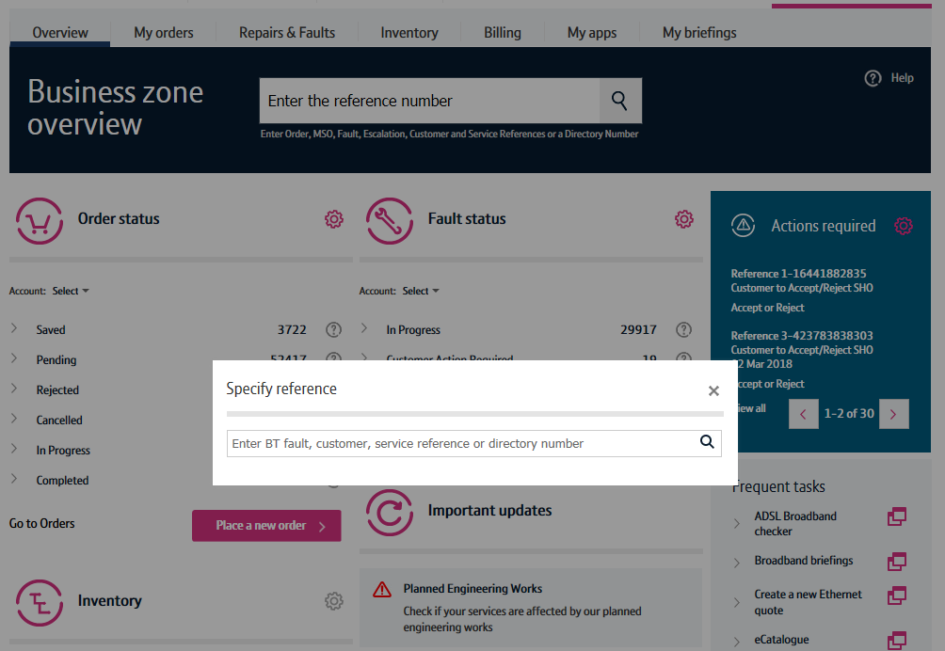
Raising a CCSFI fault
Step 2: Accessing the journey
A pop up box will appear asking you to enter the BT Fault reference, Customer, Service Reference or directory number.
1) Enter the Service ID which is normally a BBIP or BBEU or the Installation Number also known as Directory Number.
2) Click on magnifying glass icon.
1
2

Slide 9
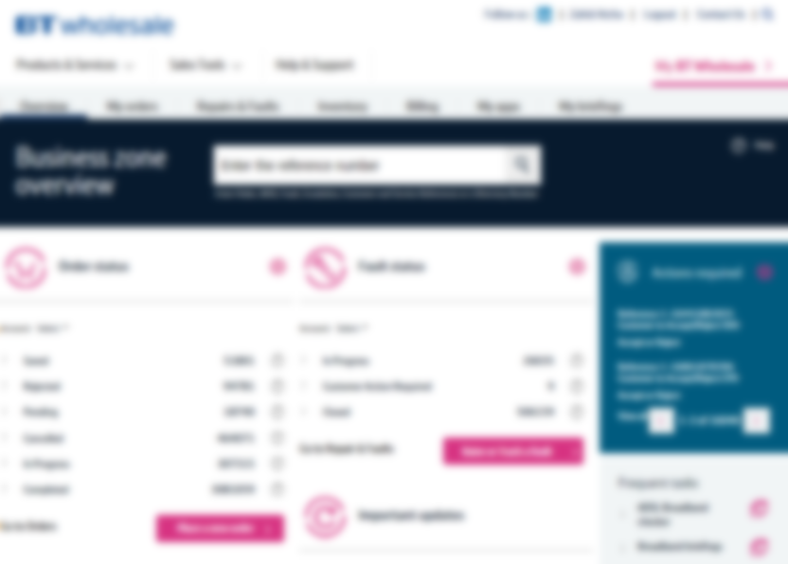
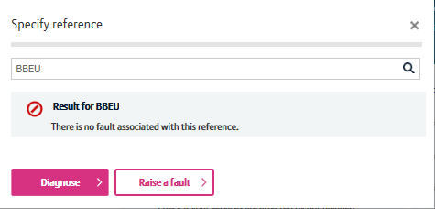
Raising a CCSFI fault
Step 3: Accessing Fault Journey
The System will advise you if there is an open fault reported. At this stage there isn't an open fault so you're given 2 options.
1) Diagnose - To raise a fault a KBD (Knowledge Based Diagnostics) Test must be run. The KBD outcome will indicate the next course of action. You will not be able to raise a fault without KBD Test so this must be done before you raise a fault.
2) Raise a fault – If the KBD outcome recommends to raise a fault into BT Wholesale then click this option
1
2

Slide 10
Raising a CCSFI fault
Step 3: Raising a fault
After choosing to raise a fault you are asked to confirm that KBD has been run in the last 2 hours. This should have been done in the previous step.
1) Select ‘Yes’
2) Click ‘Next’
1
2

Slide 11
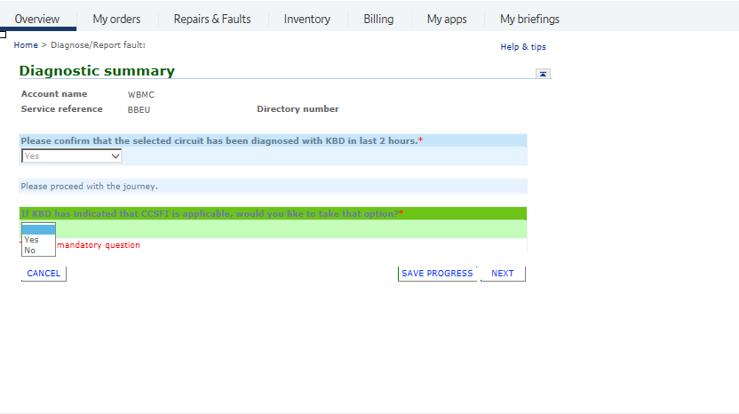
Raising a CCSFI fault
Step 4: CCSFI Option
If you want to book a CCSFI you can start the process on this screen.
1) Select ‘Yes’
2) Click ‘Next’
1
2

Slide 12
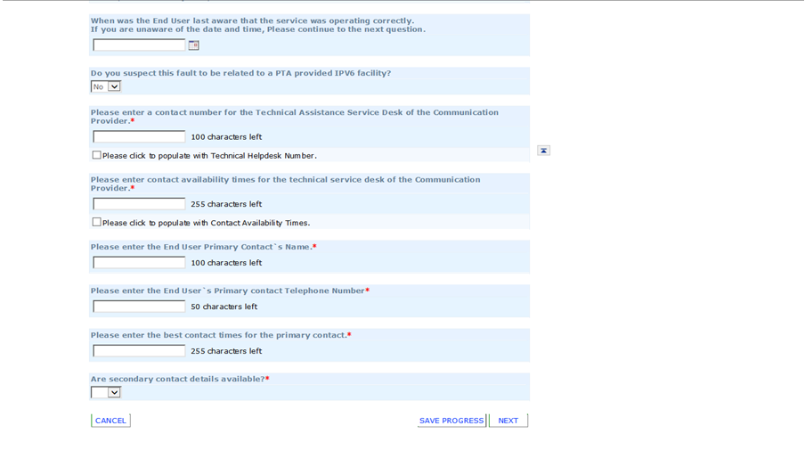
Raising a CCSFI fault
1
Step 5: Additional Information
Insert date and time the service was last operating correctly.
Select ‘No’ for IPV6 question
Enter your Technical helpdesk contact number
Enter the availability of the technical helpdesk
Enter your Customers full name
Enter you Customers contact number
Enter the Availability of your customer
Select either ‘Yes’ or ‘No’ as this will allow you to add additional contact details
Click ‘Next’
2
3
4
5
6
7
8
9

Slide 13
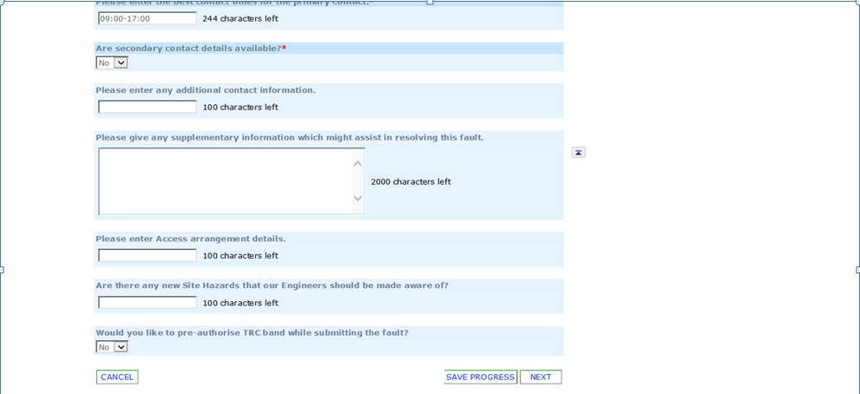
Raising a CCSFI fault
Step 5: Additional Information
Enter any additional contact information you may want to provide
Enter any information you would like to give to BT Wholesale that might help resolve the fault quicker
Please provide as much information as possible such as:
What is the End Users issue e.g. dropping connection
Any useful Diagnostics information e.g. BRAG/ Service layer data etc
What do you want the engineer to achieve during the visit? E.g. check Internal wiring and correct and Star Wiring/Bridge Taps to improve the lines performance
Please note – what you enter in this field will be made visible to Openreach, however, if you edit this later in the fault cycle, the update won’t be passed on.
3. Enter the Contact Name and Number of whom will be available to receive a call from Engineer.
4. Enter any known Hazards for example “beware of dog”
5. Select ‘No’
6. Click ‘Next’
1
2
3
4
5
6

Slide 14
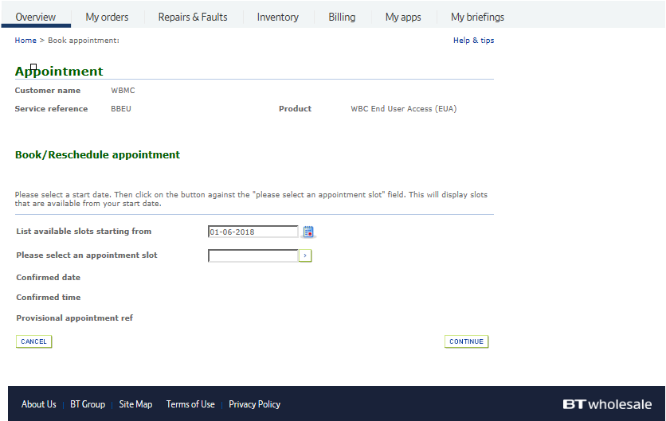
Raising a CCSFI fault
Step 6: CCSFI Appointment Booking
You will now be presented Appointment booking screen
1) Click on the Calendar icon
1

Slide 15
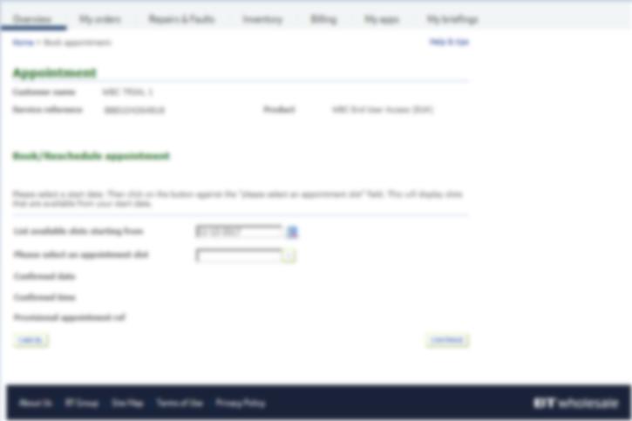
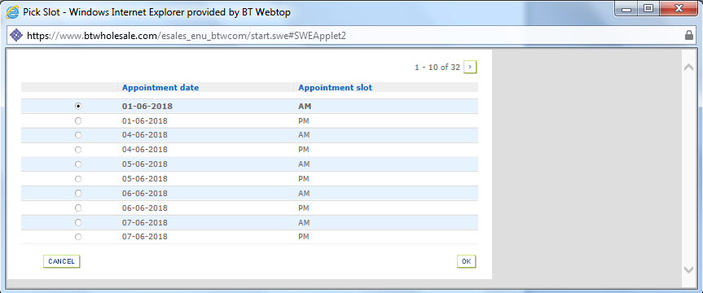
Raising a CCSFI fault
Step 6: CCSFI Appointment Booking
1) Select the Appointment date and slot
2) Click ‘OK’
1
2

Slide 16
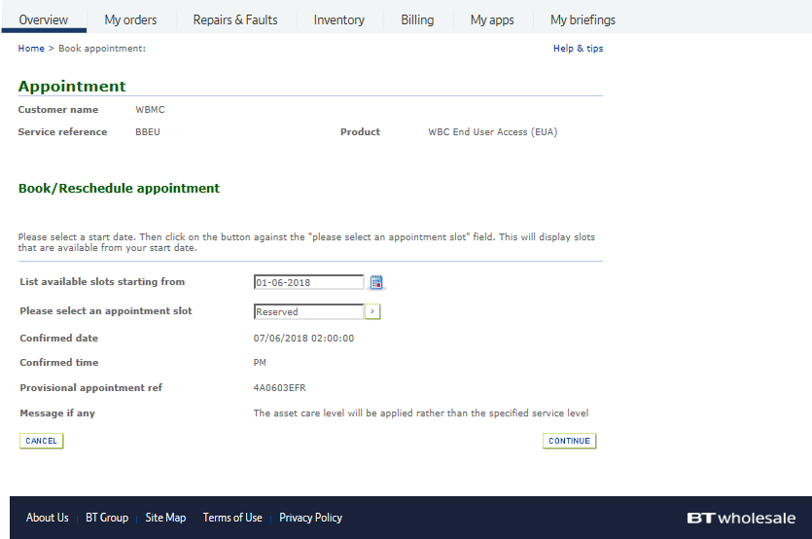
Raising a CCSFI fault
Step 6: CCSFI Appointment Booking
1) Click ‘Continue’
1

Slide 17
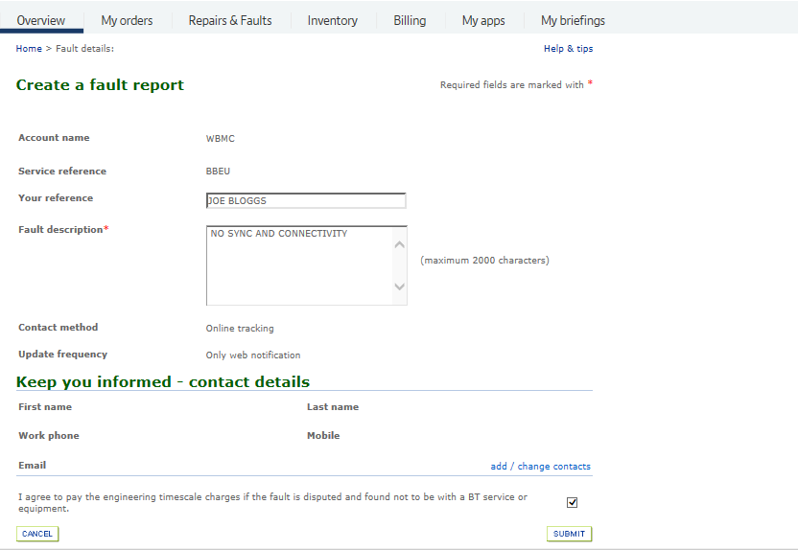
Raising a CCSFI fault
Step 7: Additional Information
1) Enter your Reference Number
2) Enter the description of the fault the customer is experiencing
Please provide as much information as possible such as:
What is the End Users issue e.g. dropping connection
Any useful Diagnostics information e.g. BRAG/ Service layer data etc
What do you want the engineer to achieve during the visit? E.g. check Internal wiring and correct and Star Wiring/Bridge Taps to improve the lines performance
3) Tick the check box once you agree with the statement about charges
4) Click ‘Submit’
1
2
3
4

Slide 18
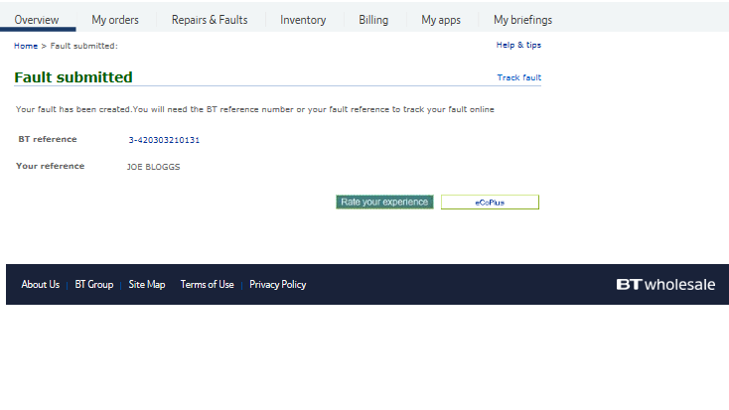
Raising a CCSFI fault
Step 8: Confirmation
Confirmation that your fault has been received and details of the BT Wholesale Fault Reference number.
When checking on your fault progression, you can use this reference or the circuit ID.
For advise on how to check the progress of your fault, please refer to the

