Slide 1
Placing a Provide DN FTTC order on Enhanced Eco+
Version 1
Notes:
Security classification options: – Public
– Internal
– Confidential
– Highly Confidential

Slide 2
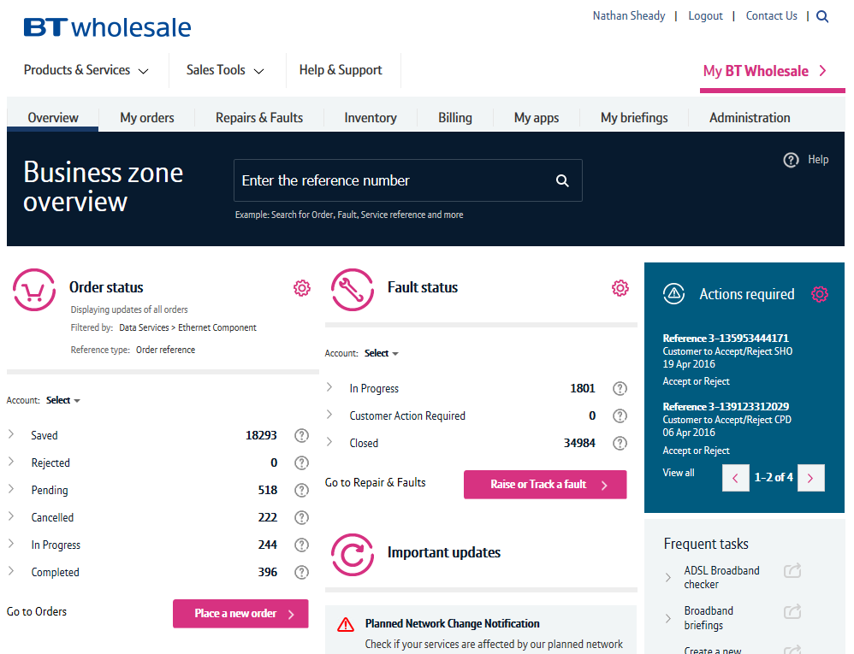
Guidance
This guide takes you through the step-by-step instructions to place a provide order on the Enhanced Eco+ system for FTTC. Other order types such as SIM’s follow very similar steps with some additional parameters to complete.
From 12th July 2020 you will have to use the new system to place all FTTC orders. The old journeys on eCo+ will be disabled on this date.
Please visit our Service Provider Price List page on BTWholesale.com for a full breakdown of the costs by product.
Further information can be found in the relevant Product Handbooks

Slide 3
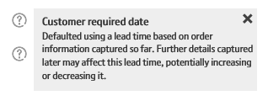
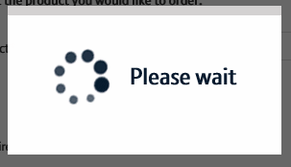
New System Guidance
We’ve designed the Enhanced Eco+ system to be intuitive and easy to use. You will notice that the information you input is largely the same but has been streamlined.
Benefits of the new system:
Quicker – the page loading time is significantly less than the previous system making it quicker to place your order. We’ve also streamlined the input needed so there are fewer clicks needed.
Helpful guidance - we’ve introduced Tool Tips against some of the order parameters. These are to help you understand what the parameter is for, the options that are available and how that will impact the service we provide. Simply click on the ? Icons.
Thinking time – when the system is progressing to the next page there is a clear symbol that tells you the page it updating. This will avoid the issues you had on Eco+ when the page was refreshing but you didn’t know that!

Slide 4
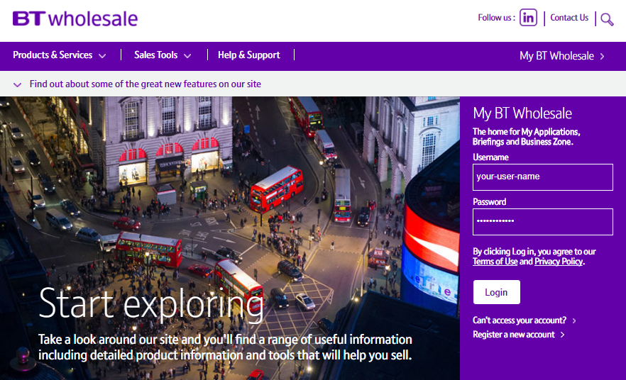
How To Place a FTTC Provide with DN
Step 1: Logging In
Go to www.btwholesale.com
Enter your Username and Password
Click ‘Login’

Slide 5
How To Place a FTTC Provide with DN
Step 2: Accessing the journey
Once logged in, you’ll be taken to Business zone.
If you aren’t taken to Business zone, you’ll need to arrange access via your company administrator.
To access the new journey:
Click ‘Place a New Order’

Slide 6
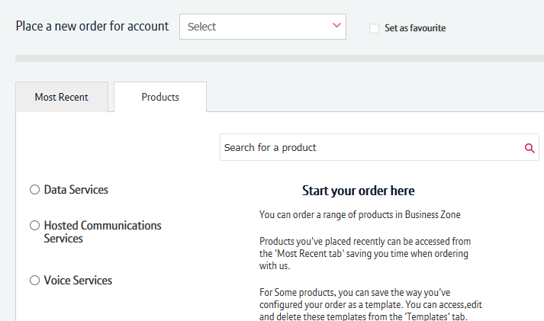
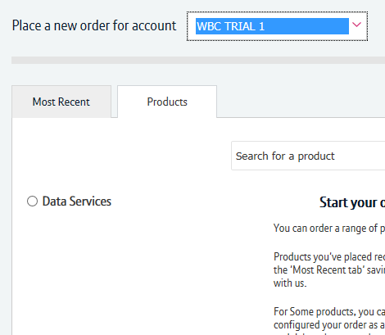
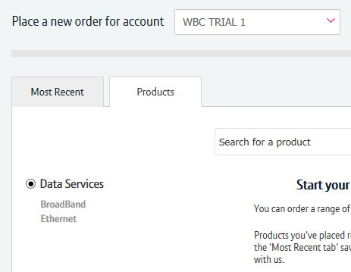
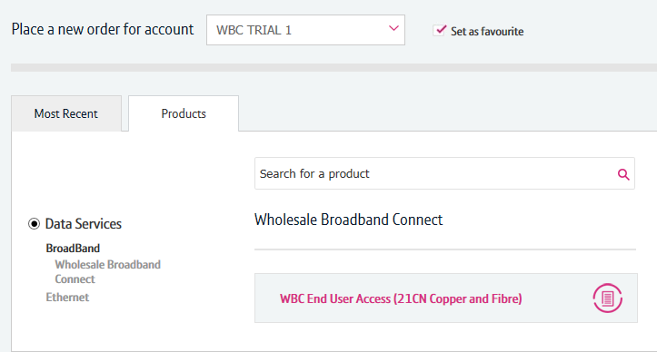
How To Place a FTTC Provide with DN
1
2
Step 3: Accessing the journey
If you have multiple accounts associated with your user id, you’ll need to select the applicable account from the dropdown.
If you have multiple accounts, select the account from the drop down menu. Tick the ‘Set as favourite’ box if you want this to be your default account
Click ‘Data Services’.
Click ‘Broadband’.
Select ‘WBC End User Access (EUA)’.
If you have performed these steps previously then the product will be listed on the ‘Most Recent’ tab
3
4
6

Slide 7
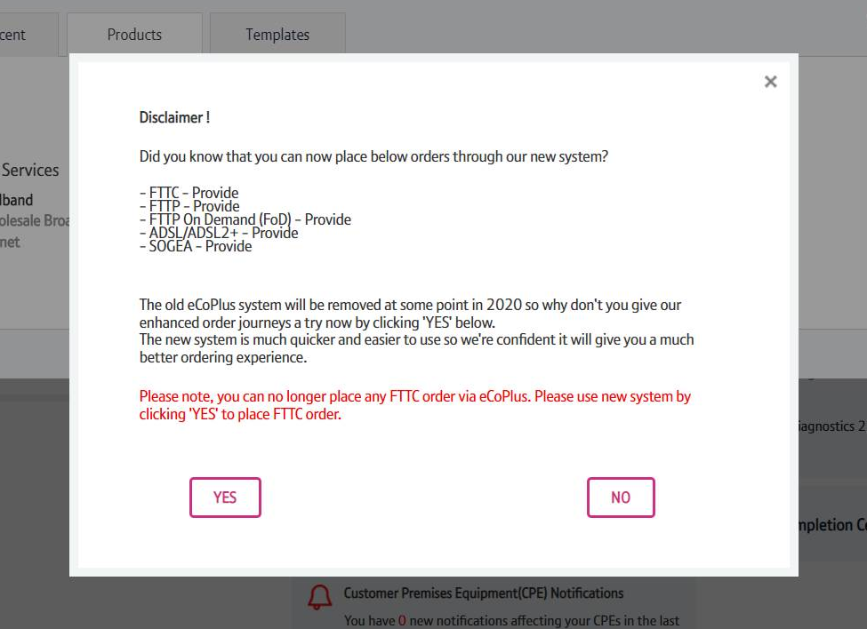
How To Place a FTTC Provide with DN
Step 4: Accessing the journey
You’ll see a Disclaimer message pop up. This message may be changed from time to time following releases as we add more journeys to the new system.
From here you have to click “Yes” to go to the new version of the system.

Slide 8
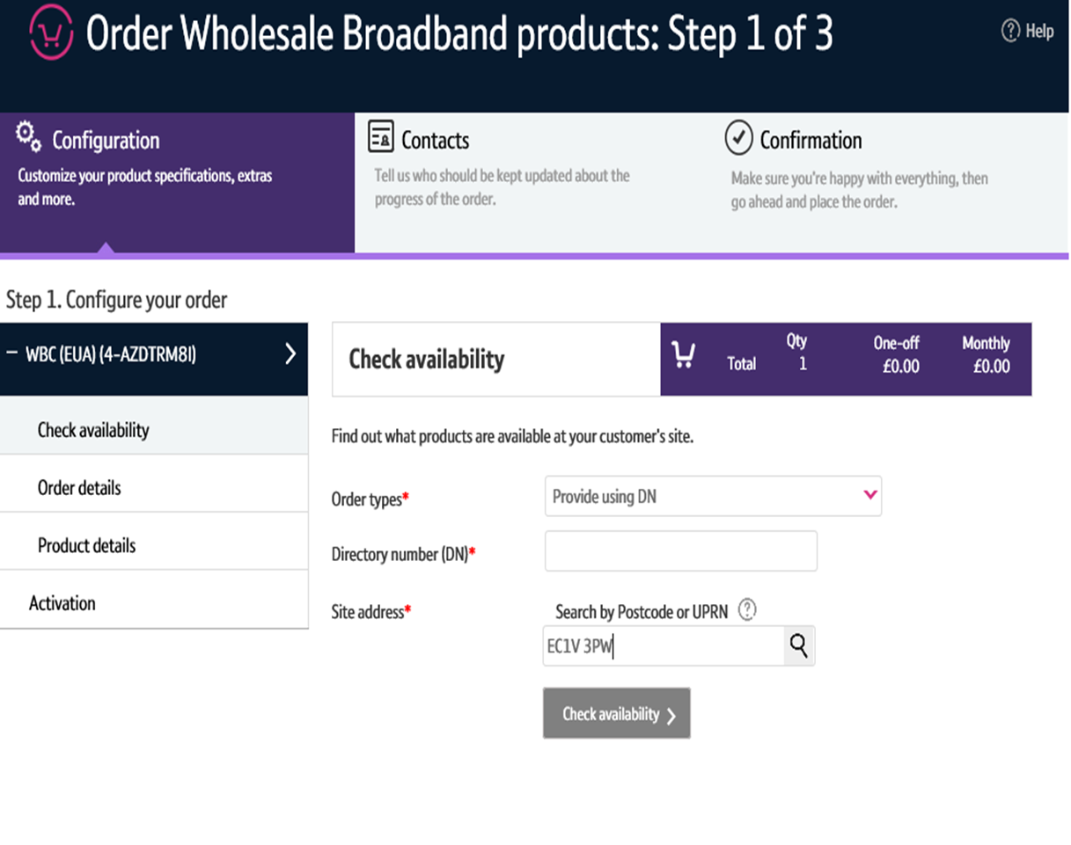
How To Place a FTTC Provide with DN
Step 5: Select the Order Type
Select ‘Provide using DN’
Enter the post code and click on the magnifying glass.
1
1

Slide 9
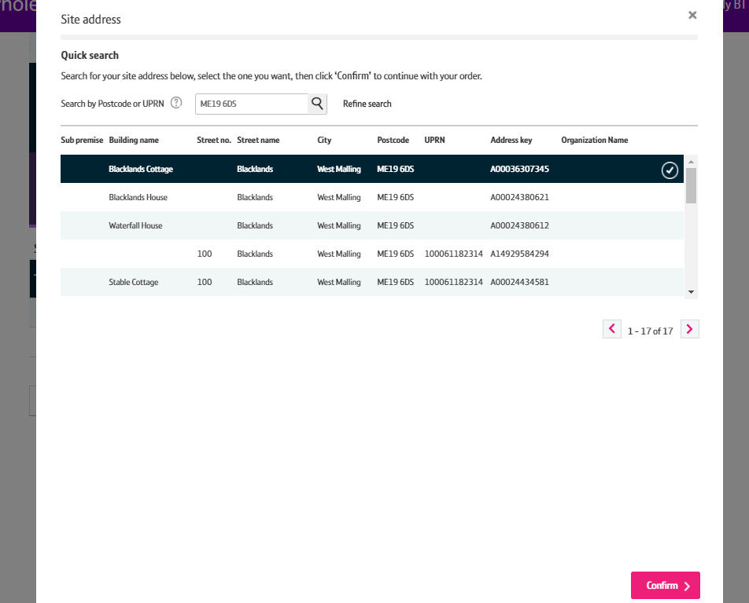
How To Place a FTTC Provide with DN
Step 6: Select the Address
Select the address from the list
Select ‘Confirm’ at the bottom of the page
Note: Use the scroll bar to see all addresses. Only 5 will show in the box.
1
2
2

Slide 10
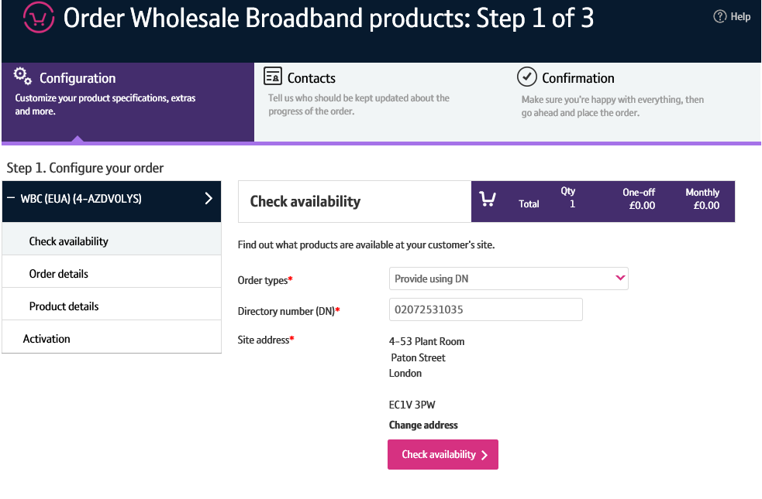
How To Place a FTTC Provide with DN
Step 7: Check Availability
Enter the telephone line number
Click on ‘Check Availability

Slide 11
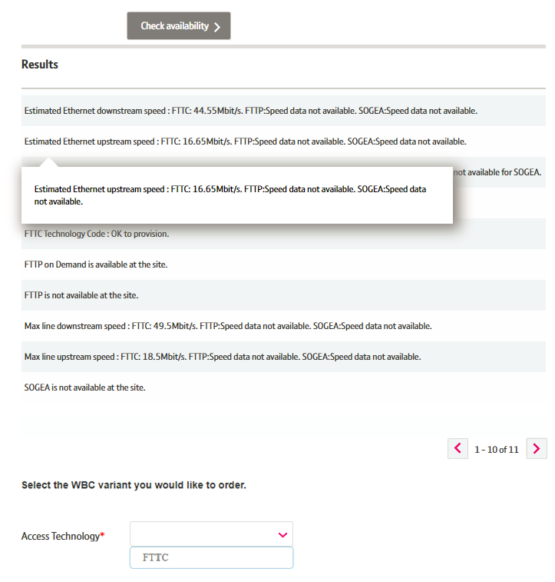
How To Place a FTTC Provide with DN
Step 8: Check Availability
The available products will be shown in the Results table.
On the Product drop down select FTTC’
Click ‘Next’

Slide 12
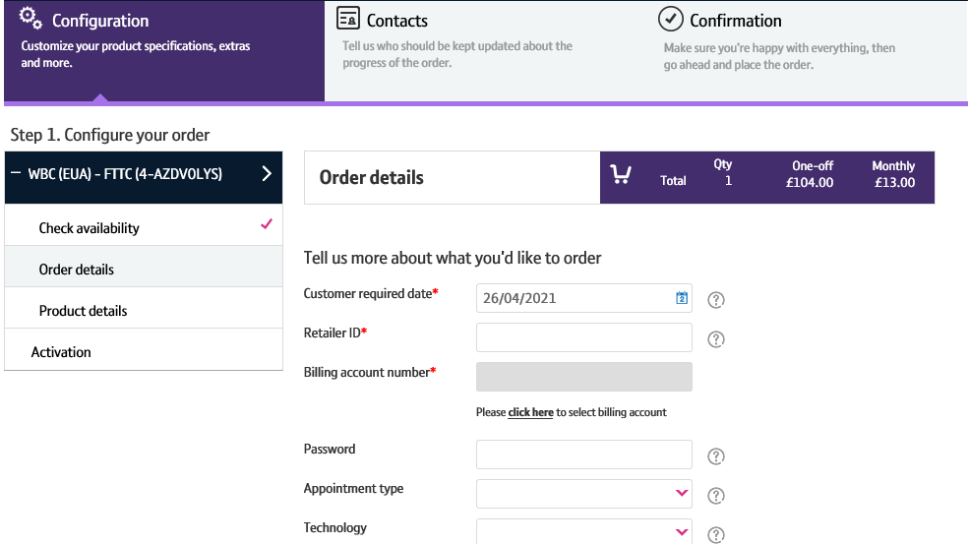
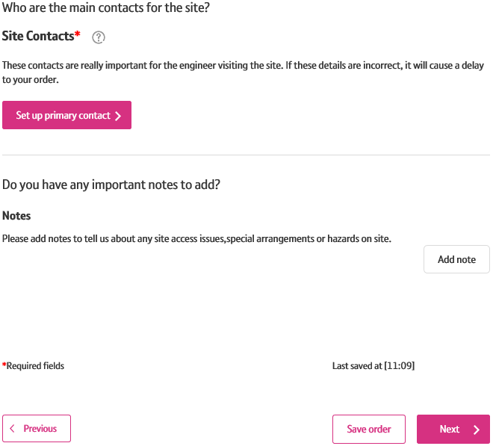
How To Place a FTTC Provide with DN
Step 09: Order Details
Customer Required by Date - will default to the standard lead time for the product and order type. If you want a date in the future, use the calendar icon to select the date you want.
Retailer ID – this is you RID ID supplied by Ofcom
Billing Account - use the click here link to select your billing account number
Password - optional
Appointment type – IMPORTANT leave blank if you require a standard All Day (non-chargeable) appointment.
If you want a chargeable AM/PM or More Focused Appointment slot pick the option from the list
Technology = ‘VDSL’ or ‘Gfast’
Site Contacts – select ‘set up primary contact’ to enter the details

Slide 13
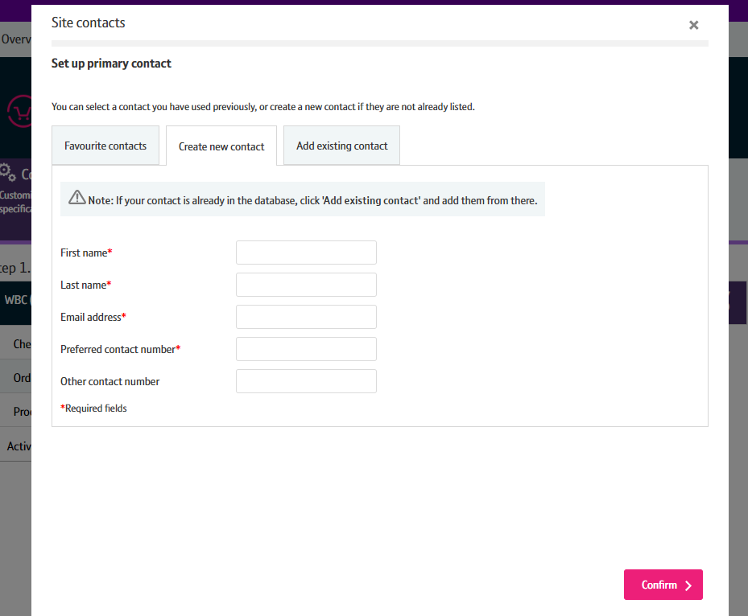
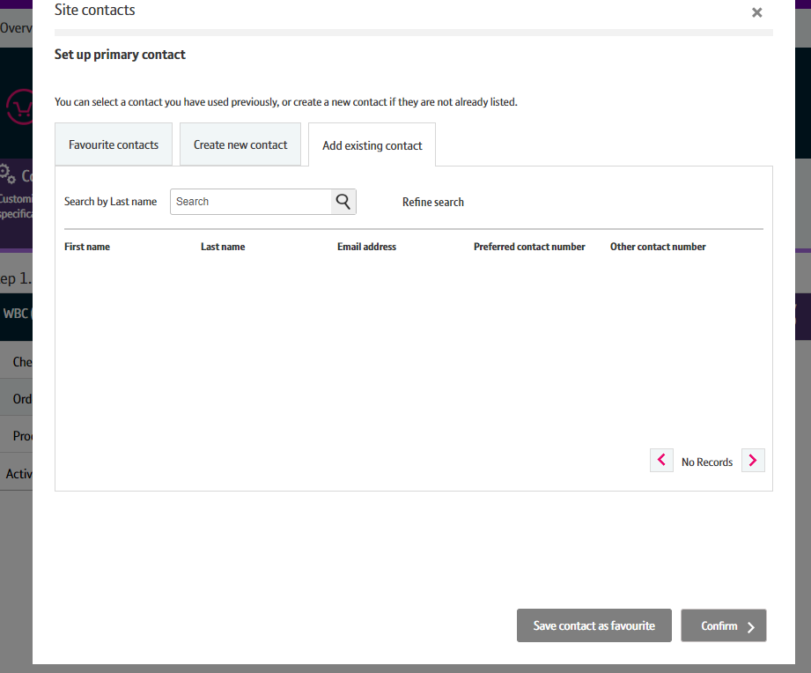
How To Place a FTTC Provide with DN
Step 10: Order Details
From here you can Create a New Contact. If you have a contact you use frequently, you can save their details as a Favourite contact to stop you having to enter the details every time.
Select ‘Confirm’ once you have entered all the details.
If you wish to change this after you have selected Confirm, you can go back and amend the details using an Edit option that will appear on the previous screen.

Slide 14
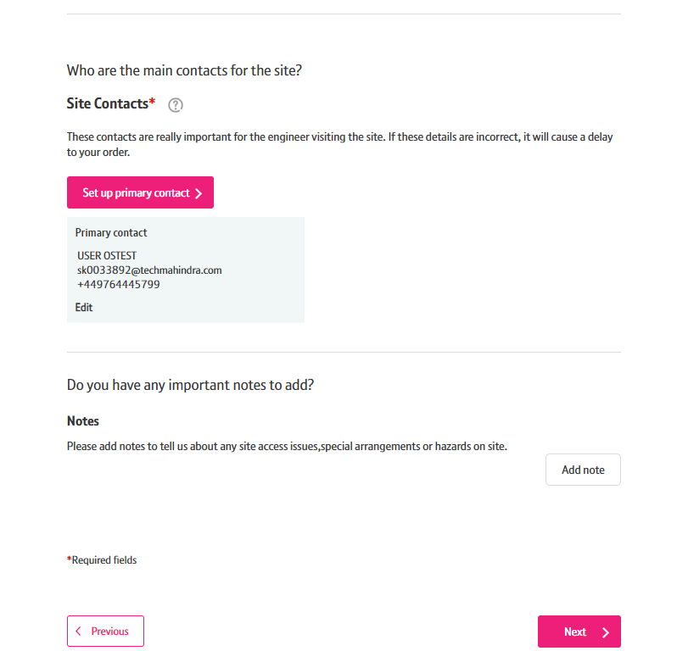
How To Place a FTTC Provide with DN
Step 11: Order Details
You can now add any notes to your order that may be important by clicking the Add note button. This is not a mandatory parameter.
You can add Hazard notes, Site Visit notes and Special Arrangement notes.
Once saved you will be given the option to Edit or Remove the notes if you wish to.

Slide 15
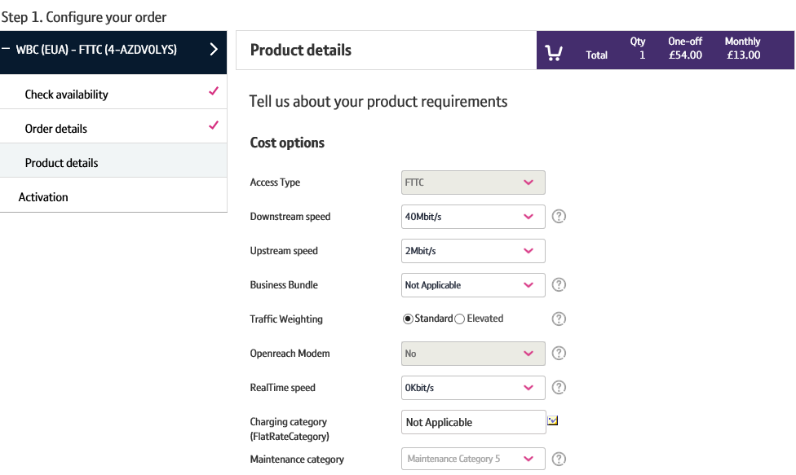
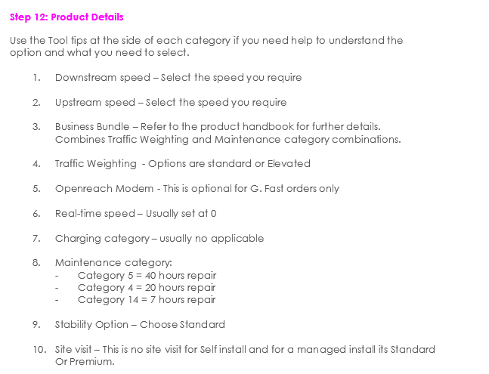
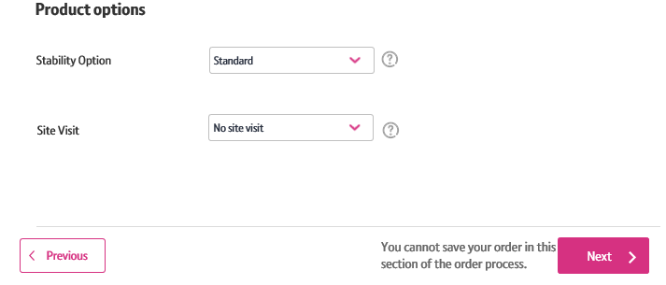
How To Place a FTTC Provide with DN
9

Slide 16
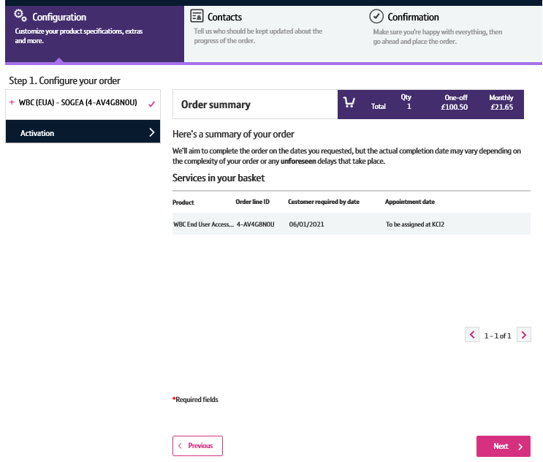
How To Place a FTTC Provide with DN
Step 13: Order Summary
Your order is summarised confirming the selected CRD and appointment date and the costs.
If you want to change the appointment date or time you can select the Change option.
When you are happy, select ‘Next’

Slide 17
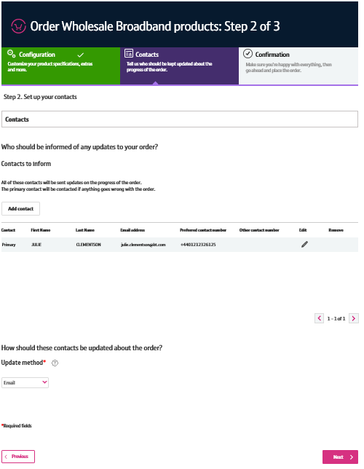
How To Place a FTTC Provide with DN
Step 14: Order Contacts
You can now add the details of who you want to be kept up-to-date on the progress of the order.
Your details will be automatically populated from your BTWholesale.com account details. You can edit these if needed.
You can also add any additional contacts.
You can also choose how you want to be updated; Email, Online Tracking or Critical emails only.
Click ‘Next’
2
3
4
17

Slide 18
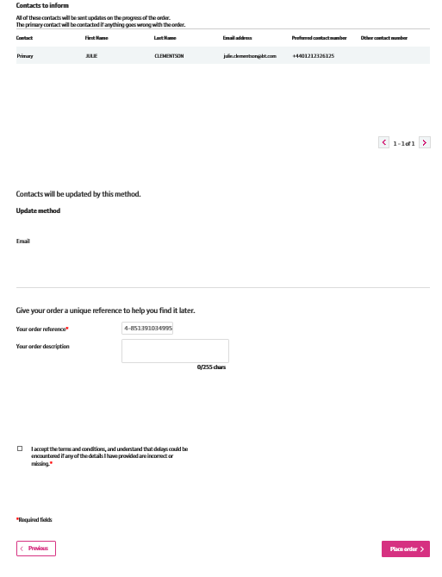
How To Place a FTTC Provide with DN
Step 15: Order Contacts
You can now add the details of who you want to be kept up-to-date on the progress of the order.
This is your order reference.
You can also add your own order description.
You need to accept the terms and conditions with a tick in the box.
Click ‘Place Order’
2
4
18

Slide 19
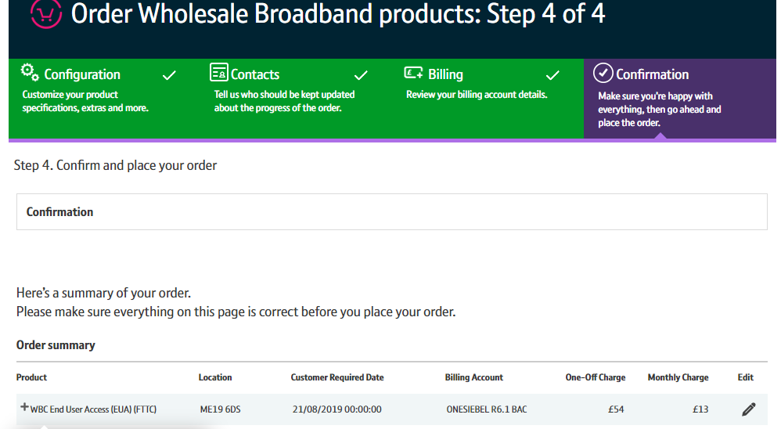
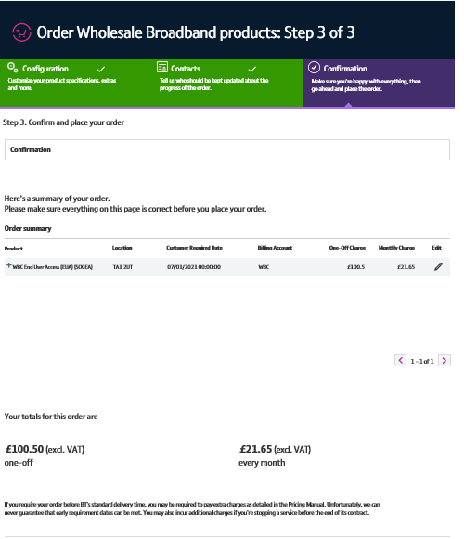
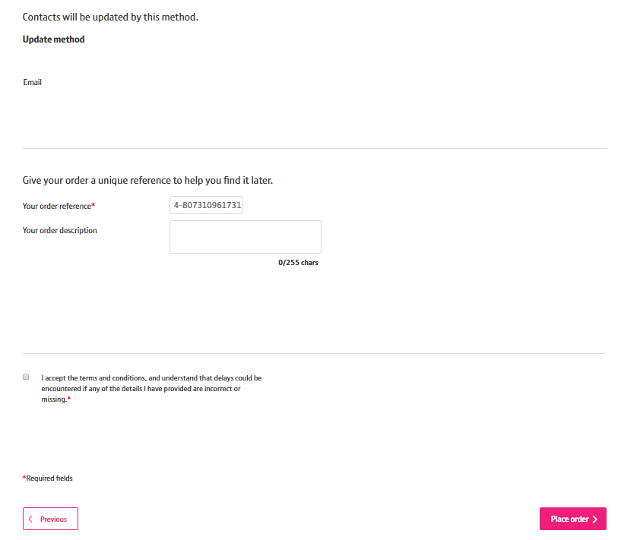
How To Place a FTTC Provide with DN
Step 16: Confirmation
This screen summarises your order before submission. You can use the Edit option or the Previous box at the bottom of the page if you need to make any changes.
The following details are confirmed:
What product you have ordered and the options you have selected.
The monthly and one off costs
Who needs to be kept updated on the progress of the order and how.
You can also add your own order reference and description
Select the tick box to accept the Terms and Conditions
Select ‘Place order’
19

Slide 20
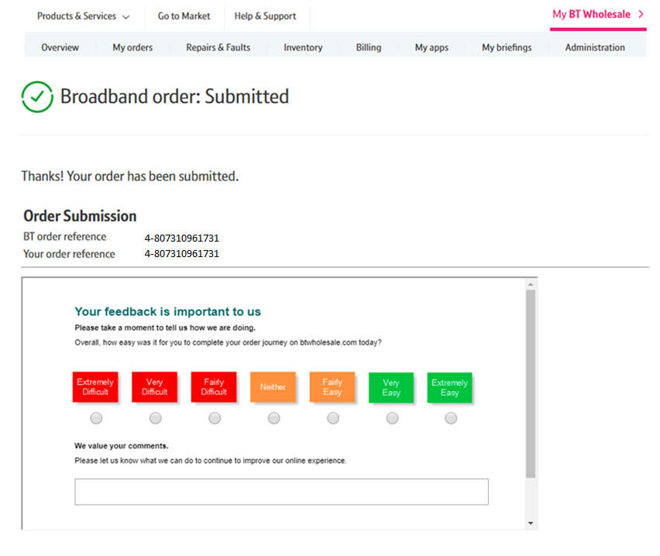
How To Place a FTTC Provide with DN
Step 17: Confirmation
Final confirmation that your order has been submitted successfully and what your BT Wholesale order reference is.
Please fill in the survey to tell us how easy it was to submit your order. We’re always looking to improve the systems so your feedback is really valuable to us.
20

