Slide 1
Guide to Broadband Ordering Options Version 1

Slide 2
Version Control
Date | Change | Version
Nov 17 | User Guide Published | 1

Slide 3
Contents
What’s in this User Guide?
p2 – Version Control
p4 – General Guidance
p5 – FTTC Options
p9 – FTTP Options
p12 – ADSL and ADSL2+ Options
p16 – Technical Information and Useful Links

Slide 4
Guide to Ordering Options
There are many options available when placing your order. This guide aims to give you an overview of what those options mean and how this will impact your Customers service.
Please be aware that there are cost implications when choosing various options. The monthly rental and one off charges will be calculated as you select the various parameters.
Please visit our Service Provider Price List page on BTWholesale.com for a full breakdown of the costs by product.
Further information can be found in the relevant Product Handbooks

Slide 5
FTTC Options

Slide 6
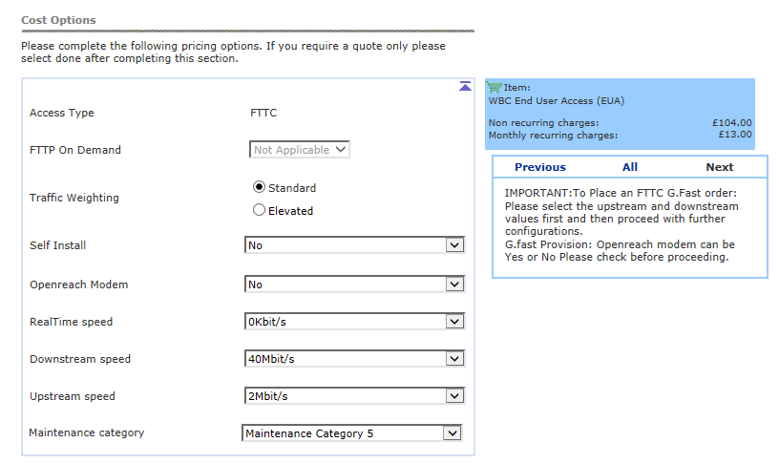
FTTC Ordering Options
Step 1: Cost Options
After you have entered the address details and provided the appointment information, you will be prompted to select the Cost Options you require.
1. Traffic Weighting – Selecting Elevated will prioritize your traffic. This tends to be used for Business customers
2. Self Install –
‘Yes’ means the End User will be required to plug their CP supplied modem into the NTE on the day of activation – The engineer will visit the PCP only
‘No’ is for the Managed Install option. An appointment will be made for an engineer to attend and install the CP provided modem for the End User
3. Openreach Modem – select ‘N’ (only applicable for speeds in excess of 100 Mbps)
4. Real Time speed *– this relates to the protection of the voice traffic. For most orders this is set to 0, unless the EU is using VOIP services then a level of protection is selected.
5. Downstream speed – select depending on the speed variant you are ordering
6. Upstream speed - select depending on the speed variant you are ordering
7. Maintenance Category – relates to the speed of repair should the line go faulty;
Category 5 = 40 hour repair
Category 4 = 20 hour repair
Category 14 = 7 hour repair
1
2
3
4
5
6
7
* See slide 17 for additional technical information

Slide 7
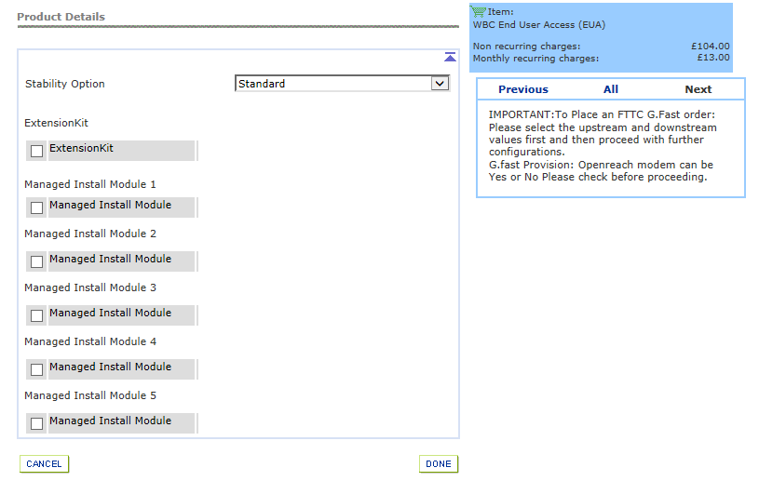
FTTC Ordering Options
Step 2: Product Details
1. Stability Options;
BT Wholesale Broadband Connect FTTC Stability Options
Stability Option | Description | Application
Standard | Allows a CP to offer a higher line rate, by allowing the line to have a lower stability target than the Stable Option provides. | This is the default level of stability, which would be more suitable for best efforts type applications.
Stable | This setting - aims to keep the line working with only a few errored seconds and retrains each day. | Offers a higher level of stability and error performance.
Super Stable | This option allows CPs to offer a higher level of stability by using increased error protection. The line will work at a lower speed than the Stable option and at times it may give rise to increased latency. | Offers the maximum level of stability and is more suitable for applications which require very good error performance and a higher level of line stability (e.g. video).
1
Increased Speed
Increased Stability

Slide 8
FTTC Ordering Options
Step 2: Product Details
Extension Kit – select if this is needed, or you can choose to Authorize for it to be used if it’s found to be needed on the day of install
The Data Extension Kit provides the ability to have the modem sited remotely from the master socket in the home. The service is included within the installation charge, but does need to be authorised on the provide order to allow the engineer to be able to do the work.
2. Managed Install modules - only applies when you have selected Self Install ‘N’ in the Cost Options section i.e. you want a Managed Install
The number of modules selected reflects how many devices the End User needs connecting when the engineer visits the premises on the appointment date.
At least one module must be selected to avoid your order being rejected.
Module 1 is a standard connection to 1 PC/Mac and is the most common option in this scenario.
You will need to make sure that the end user has received their CPE in time for the appointment so that the engineer can connect it and make sure the service is working.
1
2

Slide 9
FTTP Options

Slide 10
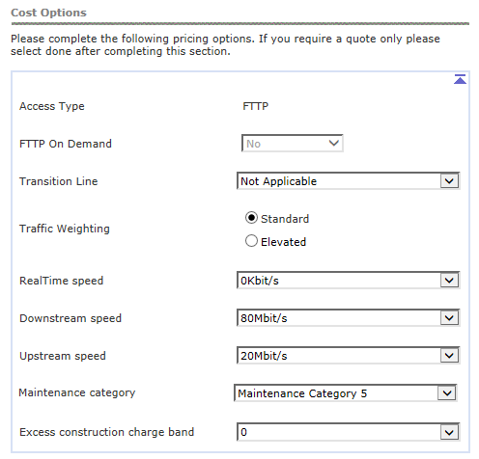
FTTP Ordering Options
Step 1: Cost Options
After you have entered the address details and provided the appointment information, you will be prompted to select the Cost Options you require. These are similar to the FTTC journey with a few additions;
FTTP on Demand - greyed out if N/A. Select if you want to order FTTP On Demand rather than Fibre to The Premises
Transition Line – Select BT Provided Copper Telephone Line if there is one at the premises (this reduces the monthly cost)
Traffic Weighting – Selecting Elevated will prioritize your traffic. This tends to be used for Business customers
Real Time speed * – this relates to the protection of the voice traffic. For most orders this is set to 0, unless the EU is using VOIP services then a level of protection is selected.
Downstream speed – select depending on the speed variant you are ordering
Upstream speed - select depending on the speed variant you are ordering
Maintenance Category – relates to the speed of repair should the line go faulty;
Category 5 = 40 hour repair
Category 4 = 20 hour repair
Category 14 = 7 hour repair
8. Excess Construction Charge Band – usually leave as 0. If the charge band needs to be changed, Openreach will send a delay and you can amend the order to the required charge band.
1
2
1
3
2
4
5
6
7
8
* See slide 17 for additional technical information

Slide 11
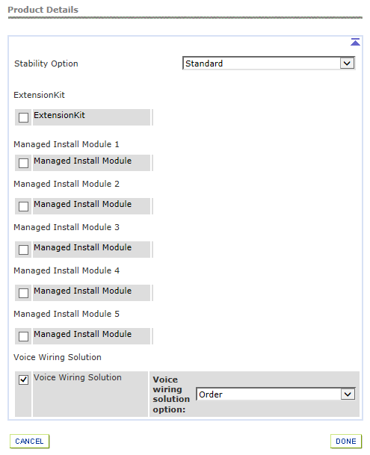
FTTP Ordering Options
Step 2: Product Details
Stability Options – Leave as Standard, other options don’t apply
Extension Kit – select if this is needed, or you can choose to Authorize for it to be used if it’s found to be needed on the day of install
The Data Extension Kit provides the ability to have the modem sited remotely from the master socket in the home. The service is included within the installation charge, but does need to be authorised on the provide order to allow the engineer to be able to do the work.
Managed Install modules – Not Applicable
Voice Wiring Solution –is used to connect the existing copper extension to the ATA port on the ONT for when FVA is provided. Do not select this if FVA isn’t required.
1
2
3
4

Slide 12
ADSL and ADLS2+ Options

Slide 13
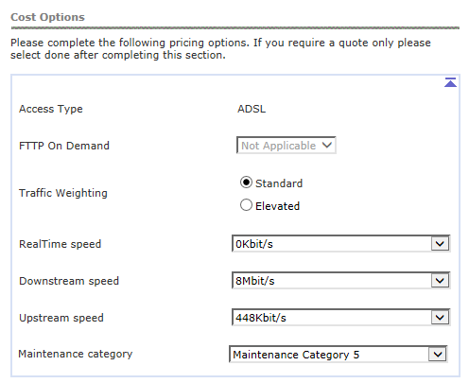
ADSL Ordering Options
Step 1: Cost Options
After you have entered the address details and provided the appointment information, you will be prompted to select the Cost Options you require.
1. Traffic Weighting – Selecting Elevated will prioritize your traffic. This tends to be used for Business customers
2. Real Time speed * – this relates to the protection of the voice traffic. For most orders this is set to 0, unless the EU is using VOIP services then a level of protection is selected.
3. Downstream speed – select depending on the speed variant you are ordering
4. Upstream speed - select depending on the speed variant you are ordering
5. Maintenance Category – relates to the speed of repair should the line go faulty;
Category 5 = 40 hour repair
Category 4 = 20 hour repair
Category 14 = 7 hour repair
1
2
3
4
5
* See slide 17 for additional technical information

Slide 14
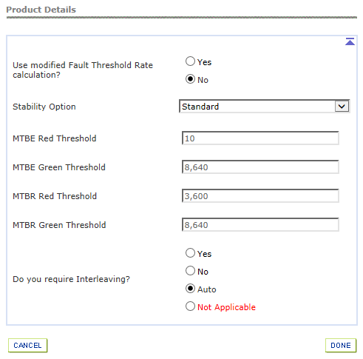
ADSL Ordering Options
Step 2: Product Options
After you have entered the address details and provided the appointment information, you will be prompted to select the Cost Options you require.
Modified Fault Threshold Rate (FTR) Calculation *– the FTR is calculated within the first 10 days of the circuit being activated. If you are migrating from IPStream to WBC please select “Yes” to make sure the minimum performance level is maintained from the previous IPStream service.
Stability Option – as per slide 7 with an additional option of ‘Custom’ for ADSL and ADSL2+. If selected, you can specify the Mean Time Between Errors (MTBE) and Mean Time Between retrains (MTBR). Red limits tell DLM when to slow the line down to aid stability and Green limits tell DLM when to speed it up as the line can afford to lose some stability.
Interleaving – this is a form of error correction. This increases latency (due to buffering the data at the DLSAM), but increases stability without the need to add more margin (which would result in a drop in speed).
Yes means interleaving will always be applied
No means interleaving will never be applied
Auto means interleaving will be applied when needed (default option)
1
2
3
* See slide 17 for additional technical information

Slide 15
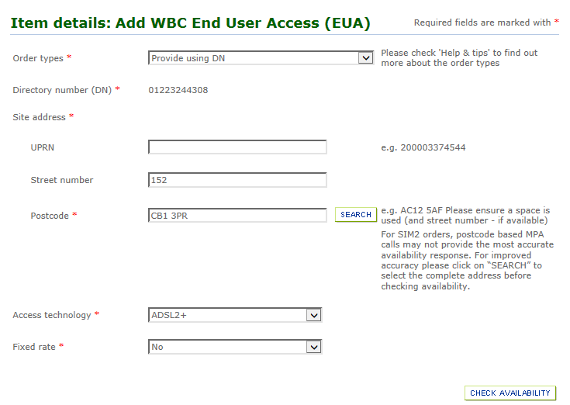
ADSL 2+ Ordering Options
ADSL2+ Options
Cost and Product options are the same as with ADSL (see slides 13 and 14) with the addition of the Fixed Rate choice on the Check Availability page.
Fixed Rate – Options are Yes or No. If you select Yes, this limits the speed of service and removes any interaction by DLM. Providing the end users line can support the speed of service selected, the service should experience very few re-synchronisation events.
Note: If you choose to use Fixed rate, then the Stability option on the Cost page would be N/A
1

Slide 16
Technical Information and Useful Links

Slide 17
Technical Information and Useful Links
Real Time Speed
Real time speed allows for some of the bandwidth to the end user to be prioritised over other traffic between Wholesale’s core network and the DSLAM to which the user is connected. This has the effect of lowering the latency and potentially reducing the packet loss for the priority packets (provided the service is used correctly). It is mostly used for VOIP, can be used for other things (video conferencing for instance, or if even online gaming if latency is important). The CP needs to configure their network to mark the priority packets so that they can be distinguished and handled differently from all the best efforts traffic.
Modified Fault Threshold Rate (FTR) calculation
Only applies for migrations from 20C. If you select ‘Yes’, it copies the FTR value for the IPStream service over to the new WBC service. Because the FTR is factored into decisions made by the Wholesale RAMBo-DLM platform (RAMBo will try not to add margin / stability to a line if it thinks it will reduce the speed below the FTR) this has the effect of “propping up” the WBC line speed on poor performing lines i.e. it reduces the chance that the user will get a slower service on WBC compared to their old IPstream service.
This doesn’t happen often, for most migrations even if this is set to ‘Yes’, the WBC service will operate at a higher speed using ADSL2+ and recalculate a higher FTR (if the option is set to ‘Yes’ the algorithm ensures the new WBC FTR will never be lower than the FTR on the old IPstream product but it can be higher). If set to ‘No’, FTR is calculated as normal for a new WBC service in the first 10 days.
Useful links:
Broadband Product Handbooks – accessed from the links at the bottom of the page. The Product Handbooks provide in depth, technical information on all of the options covered in this guide
https://www.btwholesale.com/pages/static/products-services/broadband.htm
Broadband Help and Support – links to product pages, reporting, assistance with fault diagnostics and other contact points
https://www.btwholesale.com/pages/static/help-and-support/broadband.htm

