Slide 1

Business Zone – User Guide
BT Wholesale Online
V3
LEGAL NOTICE: The information contained in this briefing is confidential information as per your terms and conditions with BT. Please do not forward, republish or permit unauthorised access. The content is accurate at the time of writing and is subject to change.

Slide 2
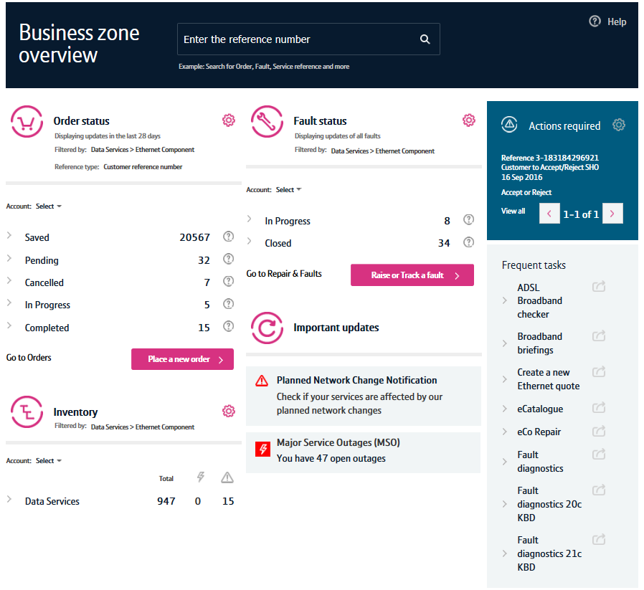
Contents
What’s in this User Guide?
p3 - Introduction
p5 – Accessing Business Zone
p6 - Search
p7 - Navigation and Layout
p8 - My orders
p9 - Repairs and faults
p10 - Inventory
p11 - My apps
p12 - My briefings
p13 - Major service outages (MSOs)
p14 - Planned network change requests (PNCNs)
p15 - Actions required
p16 – Help

Slide 3
Version Control
Date | Change | Version
07/11/16 | User Guide Published. | 1
08/12/16 | Update made to search feature. | 2
30/4/18 | New BT branding | 3

Slide 4
Introduction
What is Business Zone?
Business Zone is our one-stop shop for you to do business with us online.
Accessed via btwholesale.com, Business Zone gives you a consolidated view of all your BT Wholesale orders, faults and inventory. And our improved search facility and filters make it easy to find the information you’re looking for.
In addition, you can see all your services that are affected by Major Service Outages (MSOs) and Planned Network Change Notifications (PNCNs) from Business Zone.

Slide 5
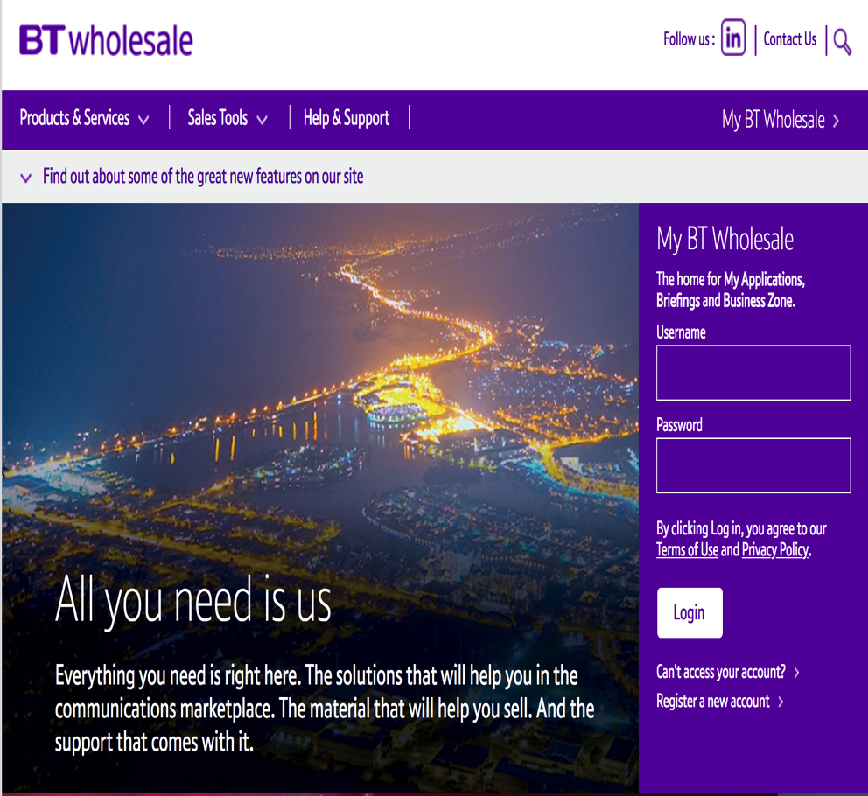
Accessing Business Zone
Accessing Business Zone is easy. Simply login to btwholesale.com. If you have the correct privileges and accesses, you’ll be taken directly to My BT Wholesale.
If you aren’t taken to Business Zone on login, you’ll need to contact your company administrator to provide you access.

Slide 6
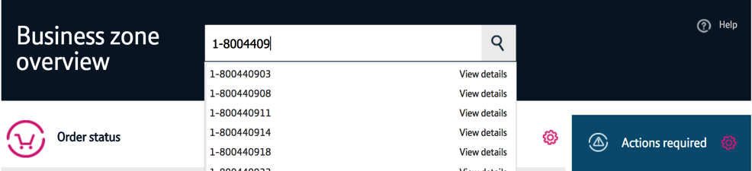
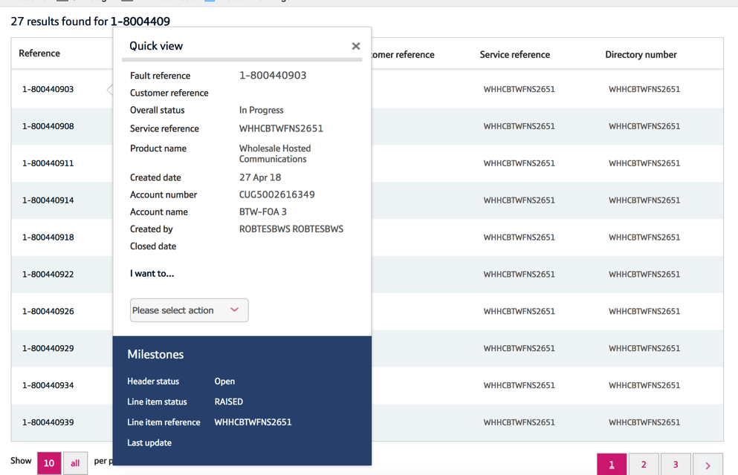
Search
Did you know?
You can use our search facility to find your orders, faults and assets.
Simply enter the service reference, order number, customer reference or friendly name.
As you’re typing, we’ll make suggestions.
Either click on the magnifying glass to access the Business zone quick view, or click ‘view details’ from the results list to be taken to the applicable associated journey.

Slide 7
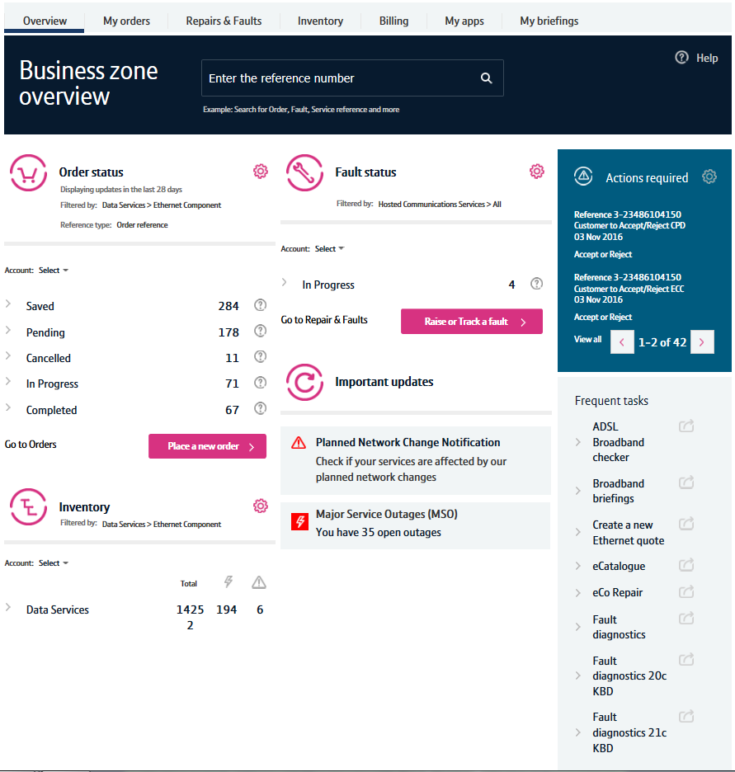
Navigation and Layout
1
Using Business Zone is easy. Here’s the basics:
The Menu Bar: You can access different areas of the site using the menu bar. This includes a place where you can find applications and briefings.
Search: Our search facility lets you find your orders and faults easily.
Order Status: Allows you to view your orders.
Inventory: You can see all the services you have with us here.
Fault Status: Lets you view all the faults you have with us.
Important Updates: Gives you an overview of planned network change notifications and major service outages associated with your services.
Actions Required: Actions that you need to complete, such as accepting welcome backs or excess construction charged can be done from here.
Frequent Tasks: Links to applications to support frequent tasks.
Help: If you need any help when using Business Zone, click the help icon. You’ll be able to access our user guides from there.
9
2
3
5
7
6
8
4

Slide 8
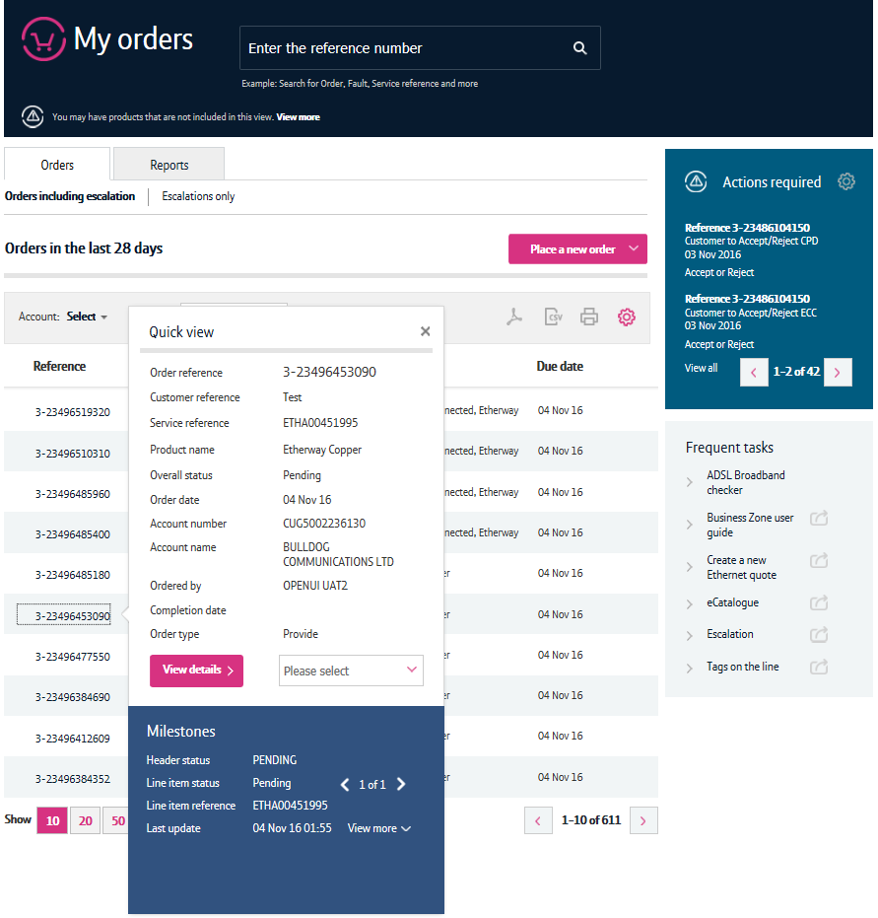
Orders
My orders gives you a complete overview of your orders. You can view the latest information on all your orders by clicking on ‘Orders including escalations’. If you want to track orders that you have escalated, you can click ‘Escalations only’
On the ‘Reports’ tab, you can view reports for your orders and filter by order status
Place a new order allows you to place orders with us. Choose what you want to order here, and you’ll be taken to the relevant order journey. You can use the ‘Recently Ordered’ tab here to quickly access the last product you ordered cutting the time it takes to re-order with us
You can filter the orders you are viewing here by account (if you have multiple accounts) and order status
Additional filters, such as the date and product, can be applied using the settings icon
Clicking on an order reference will open the quick view. You will see a summary of your order here. To see more detail, click ‘View Details’. You’ll also be able to perform actions here such as amending or cancelling your order
You can download the information displayed in the table into a CSV, PDF or print using the icon within the grey bar
2
1
3
4
7
5
6

Slide 9
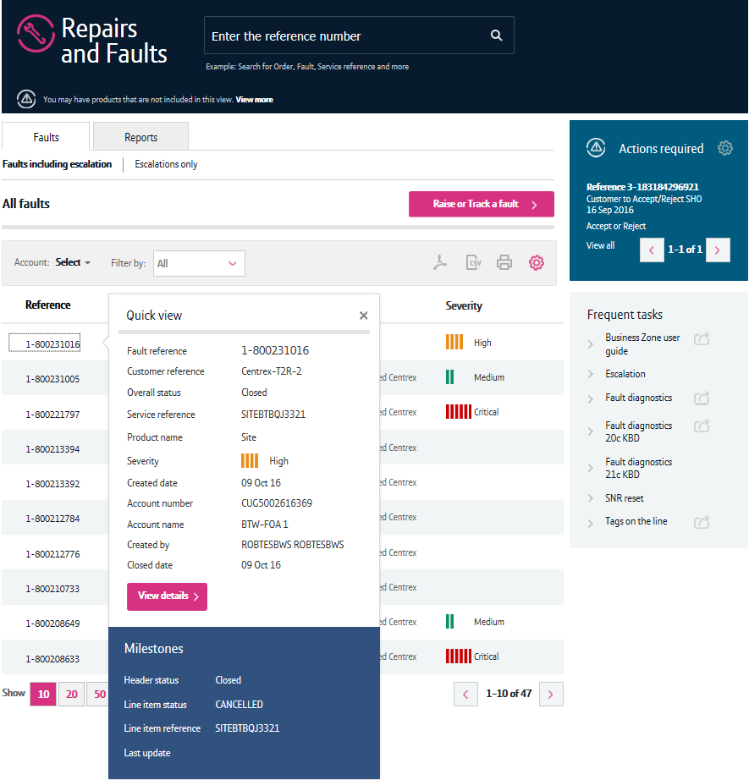
Repairs and faults
My repairs and faults gives you a complete overview of your faults. You can view the latest information on all your faults by clicking on ‘Orders including escalations’. If you want to track faults that you have escalated, you can click ‘Escalations only’
On the ‘Reports’ tab, you can view reports for your faults and filter by fault status
Raise or Track a Fault allows you to search for a specific fault using the BT reference, service ID, your reference or installation telephone number. If no fault exists, you’ll be given the option to raise a fault. If a fault exists, you’ll be able to access details of the fault
You can filter the faults you are viewing here by account (if you have multiple accounts) and fault status
Additional filters, such as the date and product, can be applied using the settings icon
Clicking on a fault reference will open the quick view. You will see a summary of your fault here. To see more detail, click ‘View Details’. You’ll also be able to perform actions here such as amending or cancelling your fault using the dropdown
You can download the information displayed in the table into a CSV, PDF or print using the icon within the grey bar
2
1
3
4
7
5
6

Slide 10
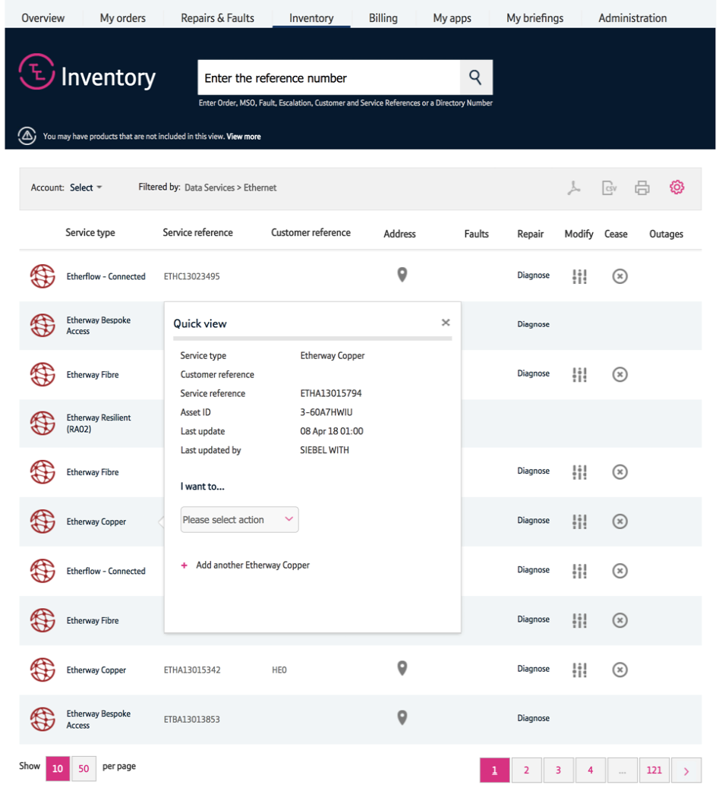
Inventory
In the table, you can use the applicable icons to:
See the address associated with the service
View fault details if a faults has been raised against the asset
Diagnose a fault
Modify the service
Cease the service
View details of outages affecting the service
Clicking on the service type will open the quick view. You will see a summary of your asset here. To see more detail, click ‘Please select action’. You’ll also be able to see information on any faults and outages, as well as being able to cease, modify or raise a fault on the service.
1
2
3
4
5
6

Slide 11
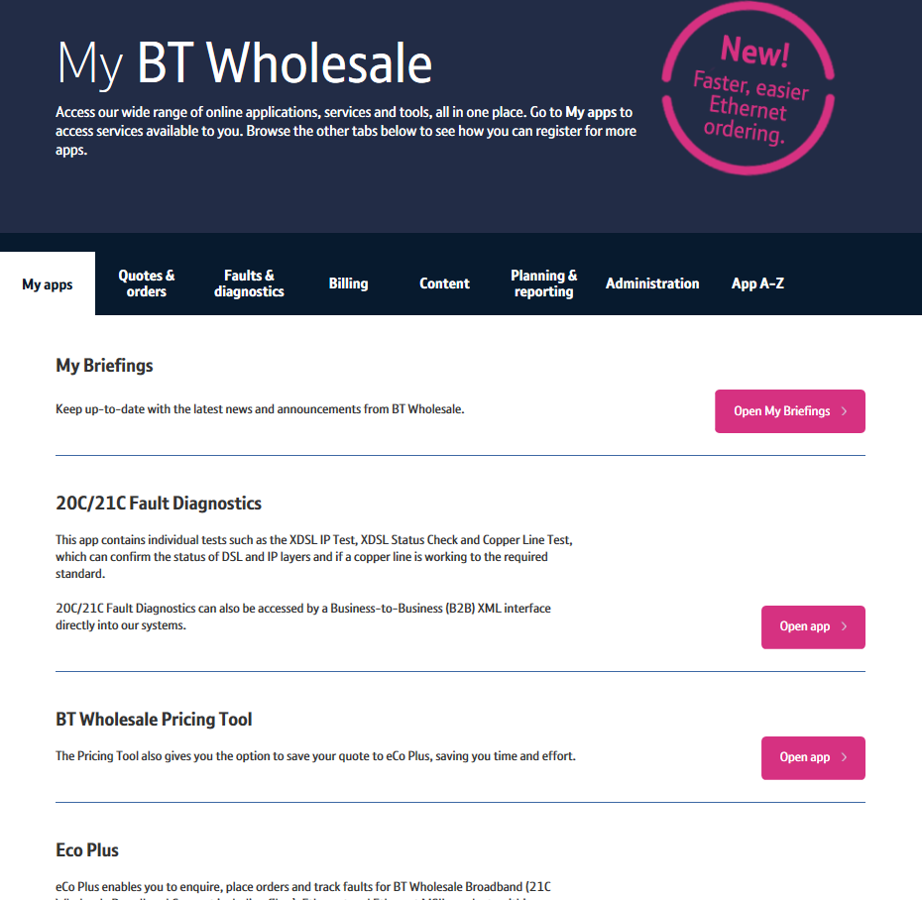
My apps
Our online applications are available to you via the ‘My apps’ page.
Here, you can launch applications you have access to or request access to our online applications. Please note, It can sometimes take 7-14 days to authorise access to some applications
You can also use the tabs to access applications associated with tasks you are performing. If you want to search for all available applications, use the ‘Apps A-Z’ tab
2
1

Slide 12
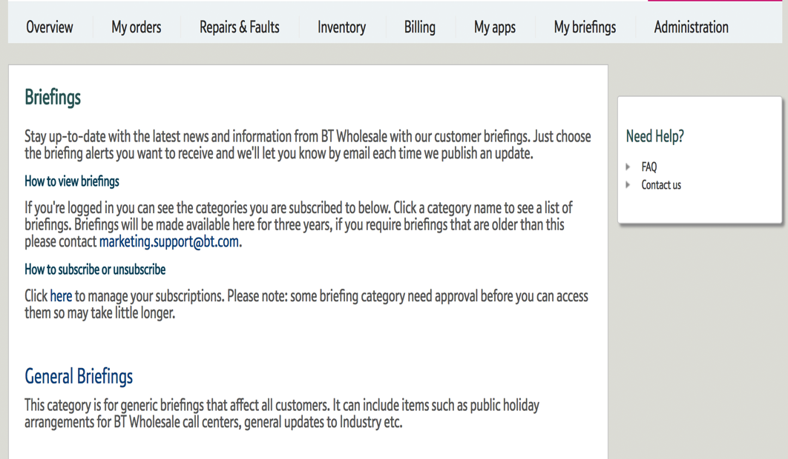
My briefings
Our online My briefings is a great way to keep up to date with improvements and changes we are introducing.
From here, you can view all present and past briefings in one place and set up your preferences so that you only get the updates relevant to you.

Slide 13
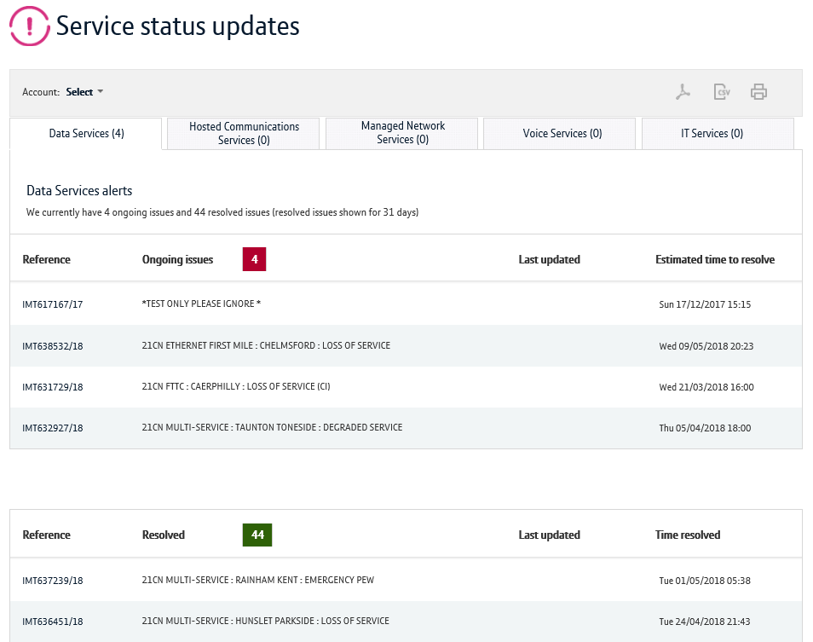
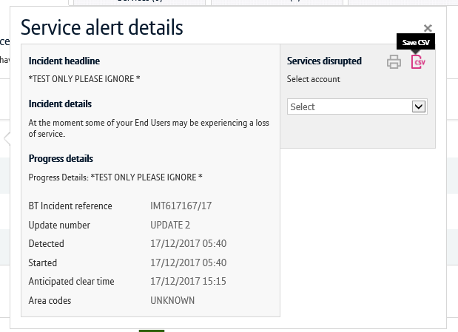
Major service outages (MSOs)
You can check for any Major Service Outages via a dedicated hub page or by checking an asset in your inventory. There’s two tables displayed on this screen. The table located to the top of the screen shows on-going MSOs. The table located to the bottom of the screen shows historic MSOs that have been resolved.
On the hub page, you can select the references to see details of the notification
You can also filter MSOs by product using the tabs
You can select the account to see the services affected
2
1
3

Slide 14
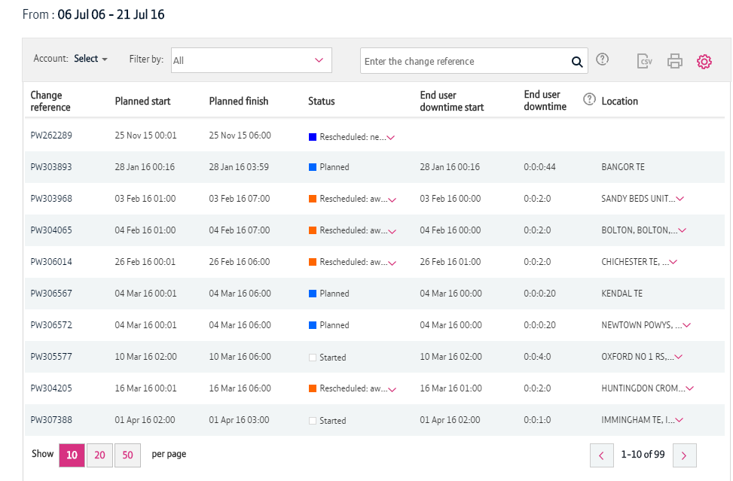
Planned Engineer Works (PEWs)
You can check for any planned engineer works (PEWs) via a dedicated hub page or by checking an asset in your inventory.
You can download the information displayed in the table into a CSV, PDF or print using the icon within the grey bar
You can filter the information by the status of the asset using the dropdown
Additional filters, such as the date and product, can be applied using the settings icon
Clicking on the Change Reference will open up the quick view. This gives you more details about the PEW
2
1
3
4

Slide 15
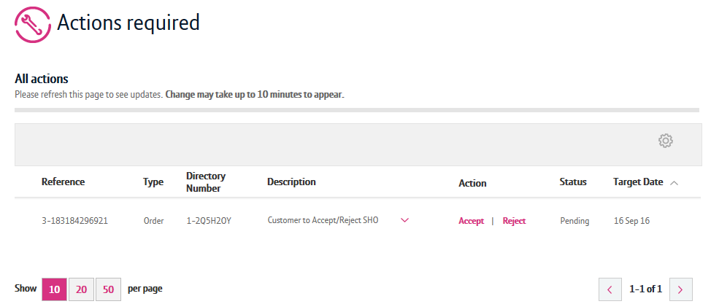
Actions required
You can access the Actions required page from the Overview and My orders page. Here, you’ll be able to see all the actions that you need to perform against you orders and faults including accepting welcome backs and excess construction charges.
You can quickly accept or reject an action associated with your order or fault clicking the ‘Accept’ or ‘Reject’ links
Additional filters, such as the date and product, can be applied using the settings icon
2
1

Slide 16
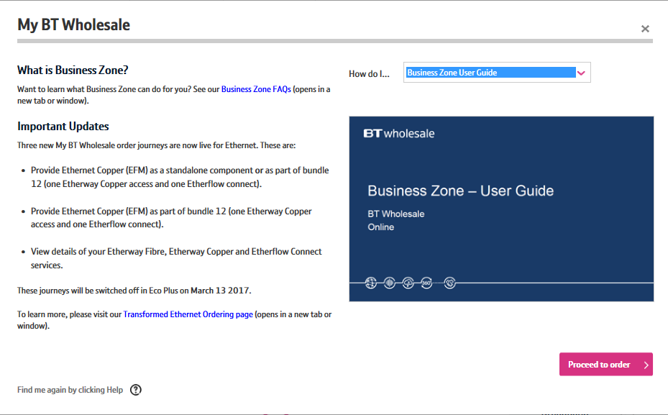
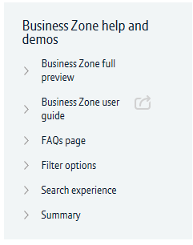
Help
There’s a dedicated area where can watch and download material to help you use Business Zone.
You can also view materials via the ‘Help’ link located to the top-right of the Business Zone Overview screen. You’ll be able to download this guide again from here.

