Slide 1
Business Zone - Raising a Fault for an Online Application
BT Wholesale Online
V2
LEGAL NOTICE: The information contained in this briefing is confidential information as per your terms and conditions with BT. Please do not forward, republish or permit unauthorised access. The content is accurate at the time of writing and is subject to change.

Slide 2
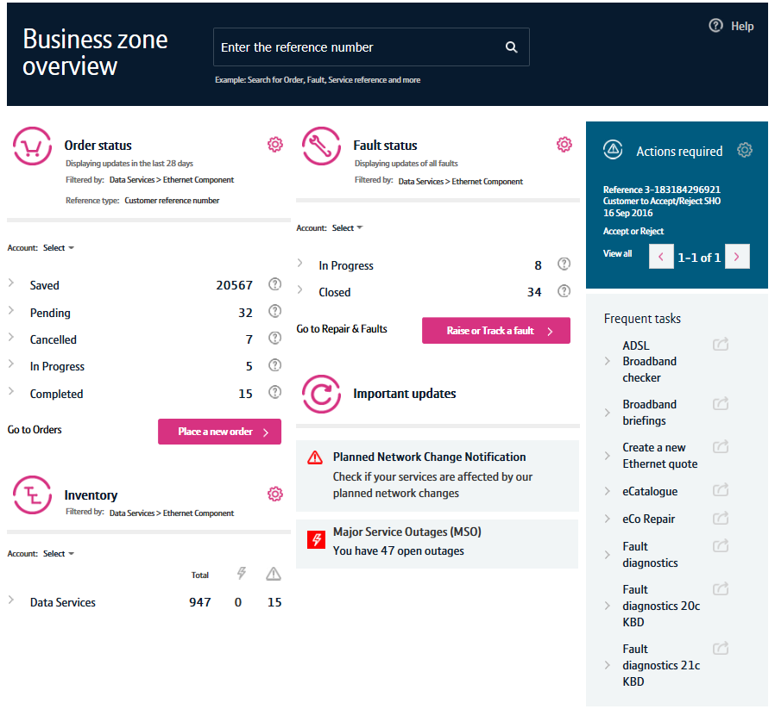
Contents
What’s in this User Guide?
p4 - Introduction
p5 – Raising a fault
p6 – Once your fault has been raised

Slide 3
Version Control
Date | Change | Version
16/01/17 | User Guide Published. | 1
30/04/18 | Rebranded. | 2

Slide 4
Introduction
Having a problem with an Online application?
Business Zone is our one-stop shop for you to do business with us online.
Accessed via btwholesale.com, Business Zone gives you a consolidated view of all your BT Wholesale orders, faults and inventory. And our improved search facility and filters make it easy to find the information you’re looking for.
Please note: Before raising a fault, please check any recent communications from us. There might be a common issue that we’re currently working on fixing. We’ll keep you informed on the progress of any fault we’re working on.

Slide 5
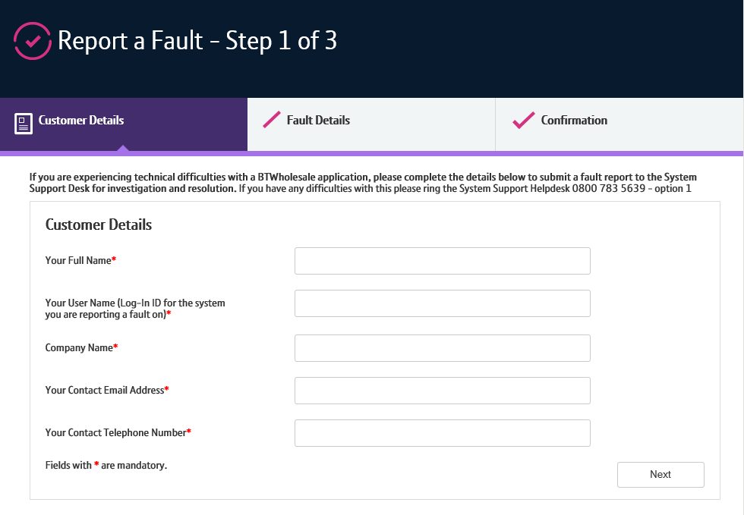
Raising a fault
To raise a fault, you first need to login to btwholesale.com.
Click ‘Contact Us’ from the top-right of the screen
Scroll down to ‘System Support Helpdesk’ and click ‘Report a fault’
Fill in the details on the E-Form and submit
It’s really important that you provide as much information as possible when submitting the fault.
Once the fault has been submitted, you’ll receive a ‘HD Reference’ you can use to track the fault.
We’ll be in touch to keep you updated on the progress of the fault.
1
2
3

Slide 6
Once your fault has been raised
Once your fault has been raised, you might be contacted by one of our System Support Helpdesk team.
They’ll often need to speak to you to understand the fault in more detail.
Please make sure you have the following to hand:
Screenshots of when the error occurred
The time and date the fault happened
The browser you were using
Example service IDs
Access to a computer where we can perform a screen share

