Slide 1
SIP Trunking
The market, the product and the opportunities
Notes:
The aim of this slide deck is to give you an overview of SIP trunking, what it does, the market drivers, our own SIP product for the UK wholesale and reseller market and the great opportunities ahead.

Slide 2
Contents
What is SIP?
Market Trends
Business Opportunities
What is SIP Trunking?
Benefits for your customers
Notes:
These are the main areas covered by the full presentation.

Slide 3
What is SIP?
For
voice,
video
and
Unified Communications
Notes:
SIP stands for Session Initiation Protocol. It’s a standard that’s become extremely popular for voice, video and unified communications. It’s a secure IP solution that helps customers to move gradually from ISDN to a fully hosted unified communications solution.

Slide 4
SIP has a key role in an evolving market
Legacy
SIPT
IP Voice
Notes:
The world of communication is changing – and SIP Trunking has a key role to play in some of the changes that are taking place. ISDN is gradually disappearing and SIP Trunking is a very attractive solution that fills the gap between legacy systems and the IP world.

Slide 5
SIP trunks are overtaking ISDN in the UK market
Notes:
So why has this gap appeared? Incumbent providers throughout the world are gradually phasing out ISDN as customers increasingly want to migrate towards IP and cloud-based solutions. As you can see from this chart, the UK is now moving towards SIP as the standard replacement for ISDN.
The SIP Trunking market grew by 232,070 trunks in the last six months of 2015. This equates to 453,131 Trunks added annually (31%).
The latest figures show that there are some 1.9 million trunks, but there are still over 2 million ISDN lines to replace. That’s about 50% of the market to still transition

Slide 6
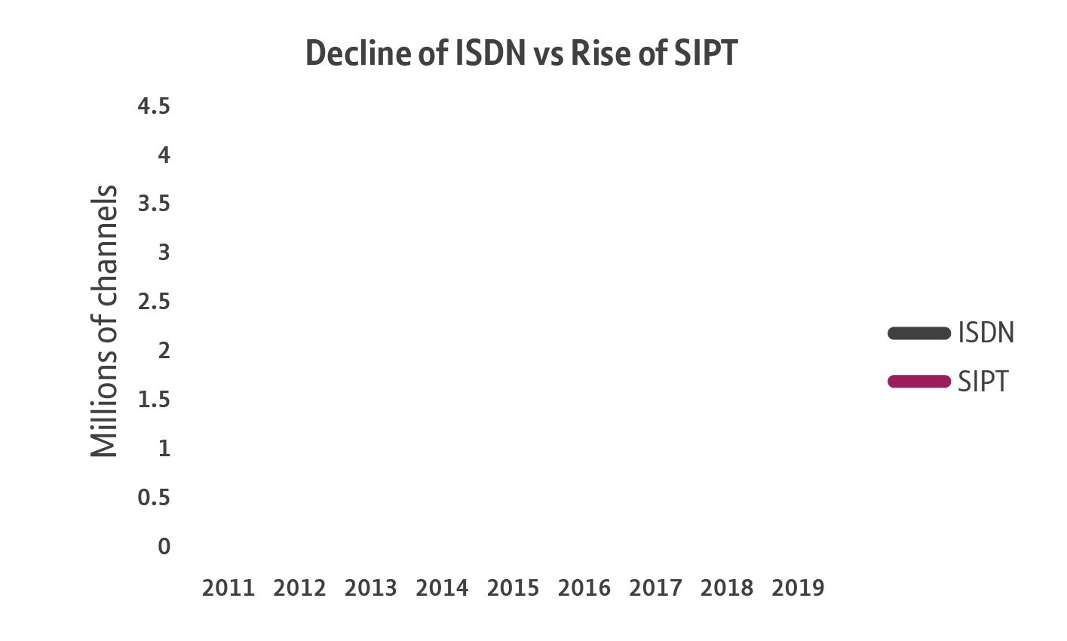
Market opportunity
£560million
and growing
at
per year
Notes:
In the UK, the SIP Trunking market is worth about £560 million and is expected to reach over £800 million in the next two or three years. That’s a lot of revenue to win – which can then grow further with the addition of more applications.

Slide 7
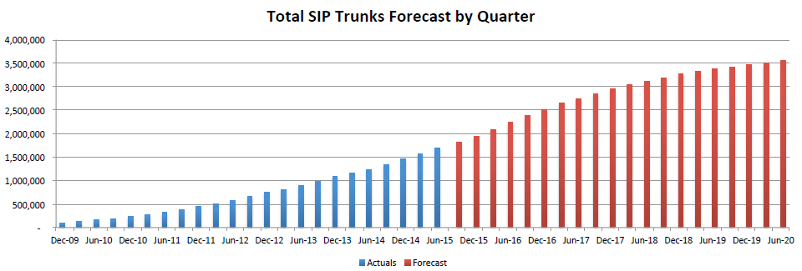
Market growth to 2020
The SIP opportunity is even more pronounced
Notes:
This chart shows why you need to act NOW – it gives the predicted growth to mid 2020. If you think of it as a product life cycle, we are now at the stage of acceleration into maturity.
So, now is the time to take advantage of SIP - 50% of the market will be up for grabs over the next three years. If you wait until 2017/18, the market will be less about net adds, and more about churn.

Slide 8
Business opportunities provided by SIP
ISDN replacement
First step to UC
Access options
Apps & capacity
Factors affecting growth in the SIP market
Notes:
So, what are the business opportunities provided by SIP?
SIP Trunking is primarily seen as a replacement for ISDN, as it represents much greater value for money and has far more features and offers more flexibility..
Meanwhile, more and more customers are using SIP as the first step towards unified communications. However, there will also be a key differentiation in terms of the access options and the applications available. With access, there are three points:
Firstly, confidence in access speeds and options creates an interest in services such as SIP. Data providers are now seeing this from their end users.
Secondly, this leads to new bundle propositions of connectivity and SIP. One can drive the other in bringing unified communications, with voice and data.
Thirdly, there is the commercial access model – how do you add more value as a data provider?
In terms of capacity, SIP is much more easily scalable than ISDN. For example, if you reach capacity on ISDN 30, you’d need to buy another eight channels, whether you need them or not. And of course, SIP enables more cloud-based applications.

Slide 9
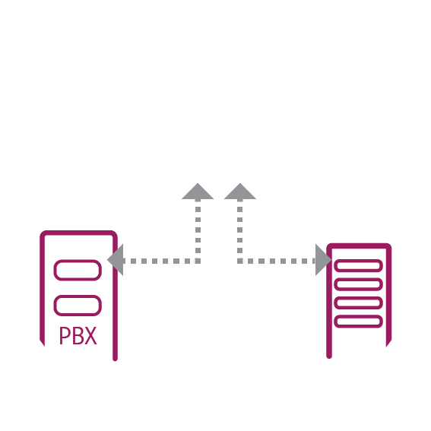
Three key opportunity areas
2m+ channels
Private Cloud
Contact centres
Notes:
Overall, there are three key areas that represent changes in customer behaviour and needs that lead to business opportunities for resellers.
The first is when SIP Trunking is used as a direct replacement for ISDN. SIP Trunking removes a large amount of the complexity associated with ISDN 2 and ISDN 30 technology. And there’s massive potential for sales here – the UK still has over two million unconverted ISDN channels.
The second opportunity is a private cloud solution, which enables enterprise customers to continue maximising or centralising their existing PBX investments in a data centre environment. An example would be a supermarket that previously might have had 500 stores, and therefore 500 PBXs. Now, they would have three private cloud PBXs serving the same 500 stores.
The third area involves customers who want a new way of meeting the needs of high-capacity environments. Our SIP Trunking solution is versatile and can handle anything from one to 10,000 channels per trunk group and supports high call rates. It enables business lines to manage at least 50 calls a second, with uninterrupted service, so it’s perfect for automated diallers and contact centres.

Slide 10
SIP Trunking
Overview
Notes:
So, let’s take a closer look at SIP Trunking and how it works.

Slide 11
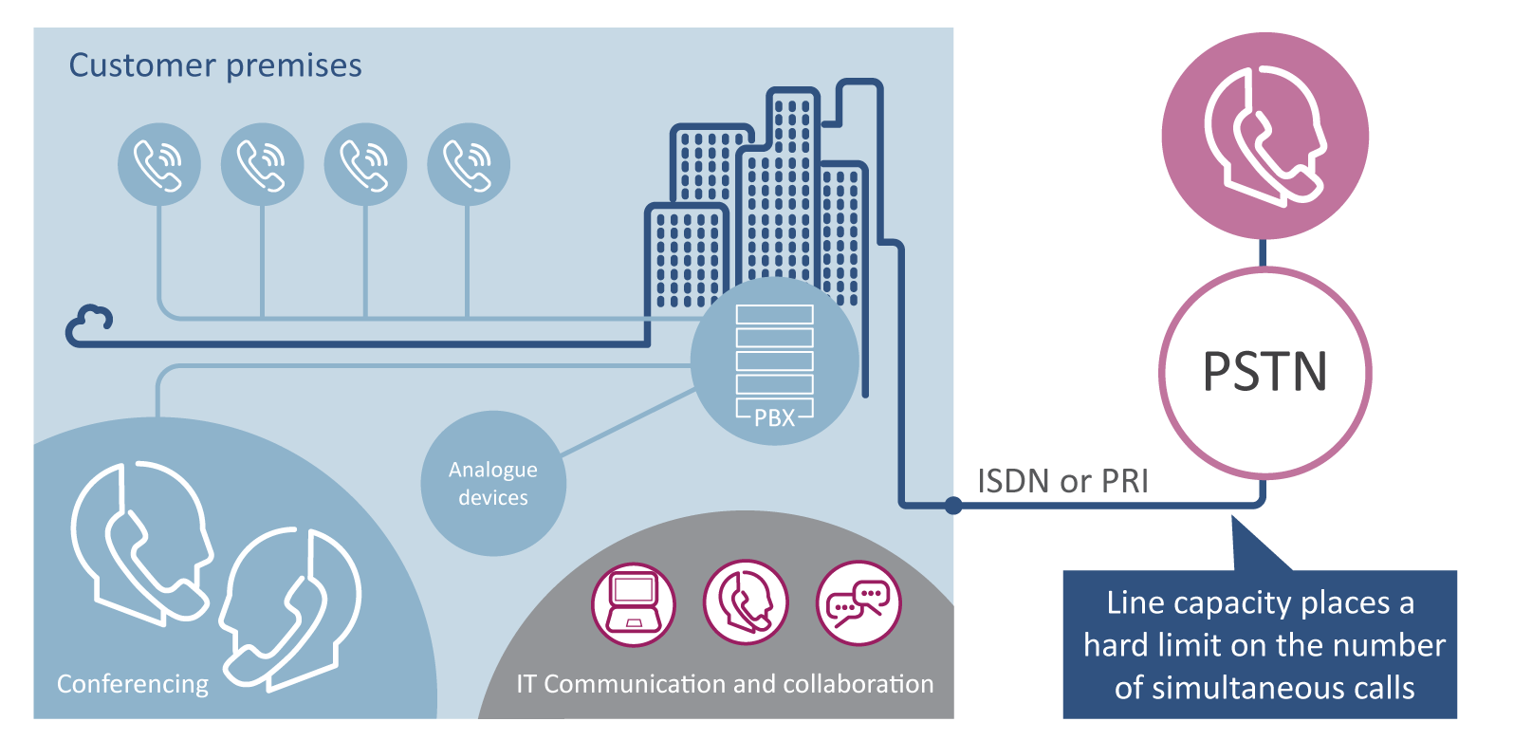
Traditional communication equipment scenario
Notes:
Traditionally, businesses of all sizes have tended to opt for an onsite PBX. This allows multiple internal phones to be connected to the PSTN via a limited number of external lines - which are often bundled as ISDN (or for larger offices, a Primary Rate Interface or PRI). The number of simultaneous external calls is limited by the capacity of the line. Incoming calls can be routed initially to an operator or can go directly to users who have a Direct Dial In (DDI) number. The PBX also allows internal calls between users. Another important feature is audio conferencing.
The customer might also have other devices connected to the PBX. They will also have IT and mobile communication devices and ad hoc software facilities such as instant messaging, presence and desktop sharing. However, there ‘s no integration between their mobile communications, fixed communications and IT communications features. This results in very fragmented, inconsistent and inefficient communications and working practices.

Slide 12
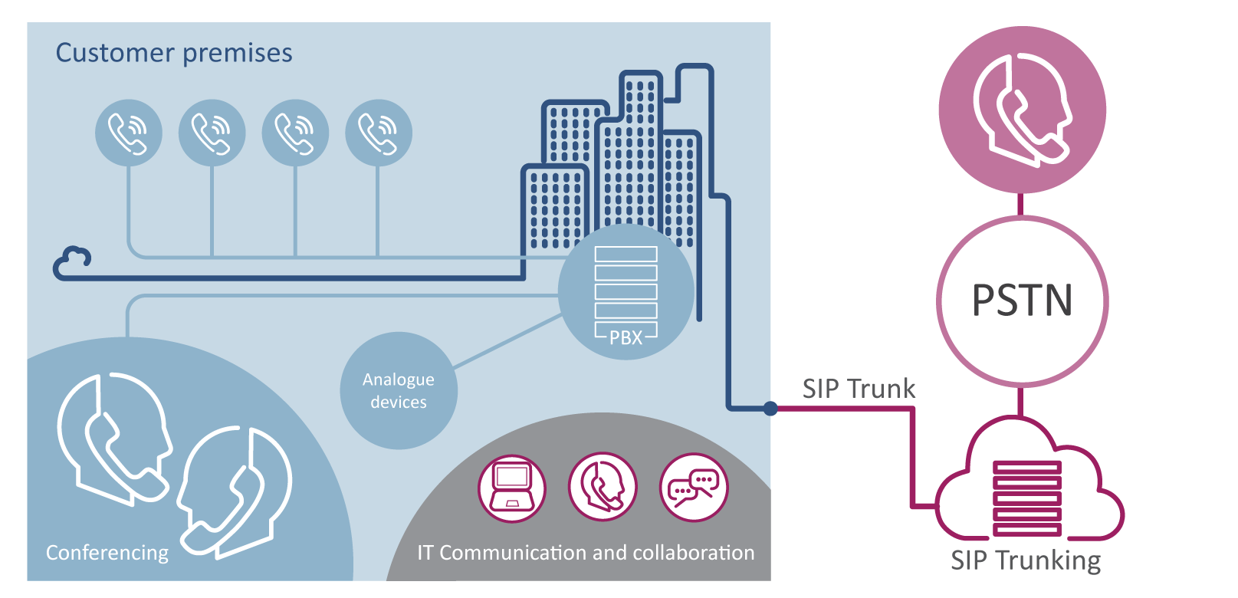
Same environment now delivered by SIP
Notes:
With SIP Trunking, the end user won’t notice much of a change - we just replace ISDN with SIP. SIP Trunking removes the inconsistencies and inefficiencies caused by ISDN . It includes all of the standard features delivered by a PBX as well as unified communications features delivered by the cloud. As SIP is cloud-based, there’s no need for any upfront investment. Users can start small and build up over time.

Slide 13
A new approach
SIP Trunking is a secure, cloud-based IP Voice solution that enables end users to bridge the gap between their existing call solutions and next-generative IP voice technology. Customers keep their PBX on-site.
Currently, it’s one of the fastest growing products
Carrier class VoIP
The future voice service
Notes:
So, what is it? SIP Trunking is a secure IP solution that helps customers to move gradually from ISDN to a fully hosted unified communications solution. As mentioned earlier, it fits in the gap between legacy systems and cloud-based IP solutions. And it’s suitable for businesses of virtually any size.
As a carrier class VoIP service, it replaces ISDN: it’s lower cost and more flexible. SIPT removes complexity, for example, by eliminating the need for older ISDN2 and ISDN30 technology. As the voice service of the future, it also provides a gradual migration path to a fully hosted Unified Communications (UC) solution. And it’s relevant for virtually all of our customer base.

Slide 14
Why SIP Trunking?
Lower costs
Business continuity
Easy to scale
Future ready
Notes:
SIP Trunking significantly reduces cost – both in comparison with ISDN and also in terms of rationalising your estate. It provides peace of mind through business continuity. It can be easily scaled up and down according to changing needs and it’s also ready to meet new future demands.

Slide 15
Why use our company for SIP Trunking?
Pay-as-you-grow
Service assurance
diagnostics
1 - 10k channels
SIPT
4 channel types
Business continuity
Peace of mind 21C core network
Dialler
support
Interop support
Notes:
Why use our company for SIP Trunking?
Pay as You Grow – we have a flexible, scalable commercial model. We offer competitive wholesale call rates and licences are available on a pay-as-you-grow basis, so you can build business profitably.
From 1 to 10,000 channels – up to 5,000 channels can be configured as standard per service (additional channels subject to planning).
Business continuity – we provide in-built resilience options. Users can also configure call diverts on individual number ranges.
Dialler support - up to 50 calls per second can be supported as standard.
Interoperability support- all devices on the Wholesale SIP Trunking authorised equipment list have undergone detailed testing to ensure complete interoperability.
Peace of mind – our solution is a white label comms service, based on a core network which ensures the service is always available.
Four channel types – these are shown in the next slide. There are three core channel types – Basic for occasional use, typically smaller satellite offices; Standard to provide the throughput for normal business use; and Premium for heavy-duty SIP channels.
Service assurance diagnostics – this is the BT strategic fault diagnostics capability, which enables resellers to triage faults and give in-depth insight into their end user traffic behaviour (e.g. MOS SCORE and SIP ladder diagrams)

Slide 16
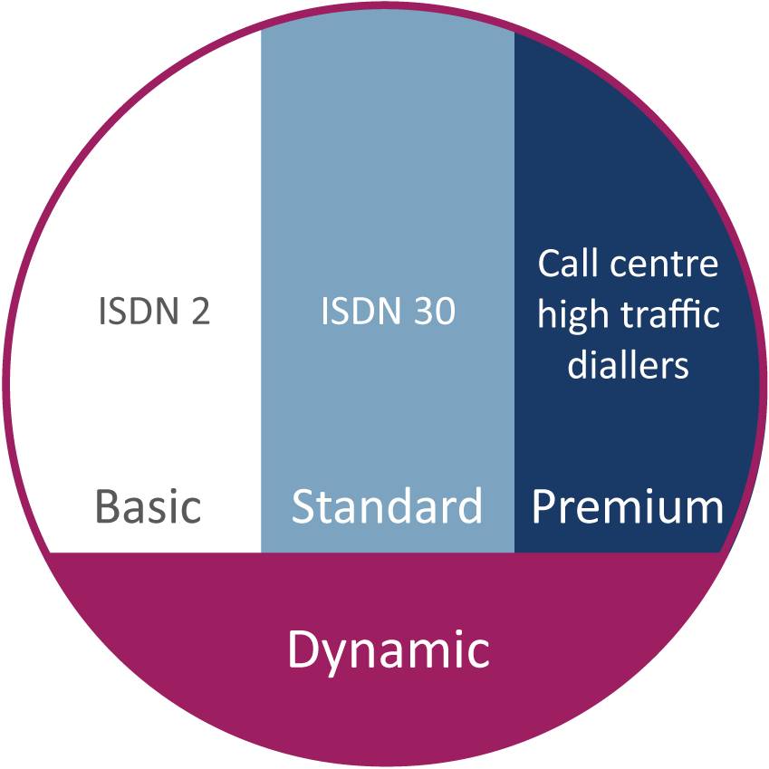
A choice of four licence types
Notes:
We offer a choice of four channel licence types to meet your customers’ needs. Basic, Standard and Premium have a minimum 1 year term. Dynamic is on a ‘per usage’ basis, with a small standby charge when it’s not being used.
The Basic channel is for ISDN 2 replacement, and Standard replaces ISDN 30. The Dynamic channel addresses seasonality, where there might be a need to flex up or down.

Slide 17
Business continuity via your choice of call routing options
20
20
15
55
55
20
20
15
20
20
15
Priority Routing
Use first trunk until no free channel then move to the next trunk, prioritising traffic on first trunk
Round Robin Routing
Alternate calls around each SIP trunk to share calls around network
Notes:
There are also different ways to prioritise how your calls are answered.
With Priority Routing, you can direct all of the calls from one number to an initial trunk (to one site), and they will go to that site until all the channels are used up. Subsequent calls will then be routed to a nominated second choice trunk (or site) until all of its channels used. And so forth…
With Round Robin Routing, instead of filling one trunk before moving to the next, calls are delivered alternately to the first, second, third choice trunks etc. in turn – which balances the incoming calls across the chosen sites.

Slide 18
Easy number management
or
New geographical telephone numbers for any UK area
Porting of existing user numbers
Or a mixture of both
Notes:
Number management is a challenge but at BT Wholesale, we’ll manage it for you – we’ll speed up the whole process. We have porting agreements with all of the other major carriers.
For telephone numbers, we provide businesses with new geographic numbers for the service from our own OFCOM range. They can have as few or as many as they want. Consequently, SIP Trunking eliminates geographical restrictions: users can effectively have any number, anywhere.
They can port any number to the service, so they can retain their existing users’ numbers.

Slide 19
Lower call pricing
Free calls inside reseller domain
Free calls in enterprise
Central Office
ETHERNET
Charged calls
Small Office
Cloud
DIA
Branch Office
OFF-NET CALLS VIA CLOUD
BROADBAND
Free calls in organisation
Central Office
Small Office
Branch Office
Notes:
And that’s not all. Reseller and Users can also benefit from highly competitive call rates and licences. They’re cheaper than TDM rates.
Calls are built in as standard to our platform and use our 21CN backbone and market-leading IPX platform.
We will manage the call capacity to ensure that users can always make calls.
On-net calls between users are always free of charge (i.e. fixed line calls between any of the PBX sites )
Calls are always free inside the reseller domain ( on- net to the reseller) the reseller can choose whether to charge for calls between their enterprises
Off-net calls will still be made over the same cloud platform, but are then passed out to the other network operators by our award winning IP Exchange

Slide 20
Our connectivity options
Copper broadband
Fibre broadband
Ethernet
Capacity
Notes:
Access options available from BT Wholesale include:
Managed Broadband – this is available from our Broadband Complete portfolio. We provide three different speeds:
ADSL = IP Stream
ADSL = WBC
FTTC = Fibre to the Cabinet
We also provide three different usage packages: 50GB, 100GB and Unlimited to support different calls usage.
Finally, there is Wholesale Ethernet, which includes E-line BGP and E-LAN

Slide 21
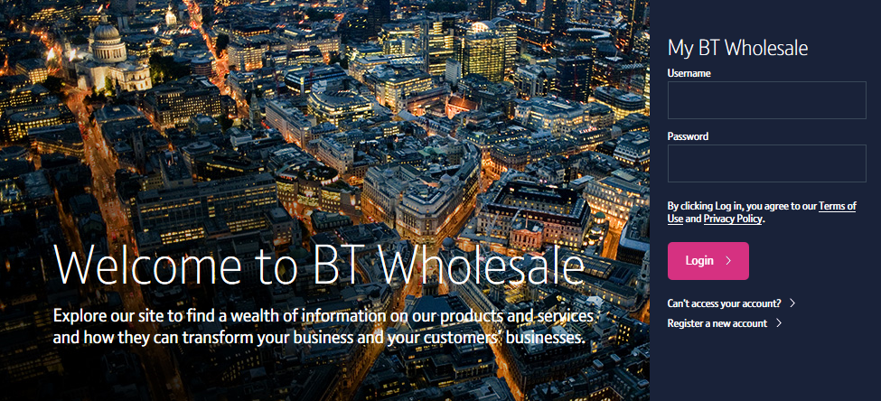
Simple ordering, stronger support
btwholesale.com
Ease of use
Dedicated support
Help and information
Notes:
We also make things easy for you - you can provision our services online at any time, using our simple ordering platform in Business Zone.
And it’s all supported by our dedicated service teams and Account Managers, who are there to help you. Depending on your needs, your Account Manager could also introduce you to a wealth of resources, such as Marketing and Sales Specialist support.
And there’s plenty of help available both online and offline – including our special SIP Trunking Welcome Pack, which will help to get you started on this new venture. Just ask your Account Manager if you’re not sure about anything or need further information.

Slide 22
Benefits for your customers More for less
Quality network
A local presence
Business continuity/flexibility
Notes:
Meanwhile, your customers will get more for less. They’ll enjoy fantastic call quality, delivered over our HD voice network, with their comms system (typically a PBX) connected to our network via broadband or Ethernet. They can reduce the number of PBXs and associated lines, saving up to 50% compared with a traditional ISDN. They can also enjoy free on-net calls; much cheaper calls to mobiles and international numbers; and free upgrades of features.
If your customers want a local presence, they can deliver numbers from multiple geographic areas of the UK to a single contact centre OR keep the same geographic number when moving or changing offices.
- They’ll also benefit from flexibility: SIP Trunking will give your customers vital business continuity, as they can automatically reroute calls to another number or site. Your customers can create the type of service that meets their needs. They can choose from three channel service types and can add or remove end-user licences with ease, as their business needs change. This flexibility enables them to cope with seasonal changes in demand (such as a calling campaign).

Slide 23
Benefits for your customers Greater business efficiency
Increased efficiency
Consistent reliability
Powerful flexibility
Notes:
Another advantage for end users is that SIP Trunking can boost both productivity and profitability by providing more efficient and richer communications, as well as giving the ability to deploy new applications and solutions quickly.
Because our SIP Trunking is part of the 21C UK BT backbone, and is backed by BT’s highly resilient voice network (which can be scaled to meet the needs of any size of deployment), your customers can enjoy the best voice quality and network reliability available. Business continuity is also built into our solution as standard. As all the services and features are in the cloud, this will minimise the potential impact of any disaster.
Your customers can create the type of service they want, choosing from three channel types. They will also benefit from the geographical freedom that SIP Trunking provides. Our fully flexible, ‘pay as you grow’ service includes the ability to add or remove end-user licences easily, in line with changing needs.

