Slide 1
[PRODUCT NAME] Company Details
Date
[INSERT LOGO HERE]

Slide 2
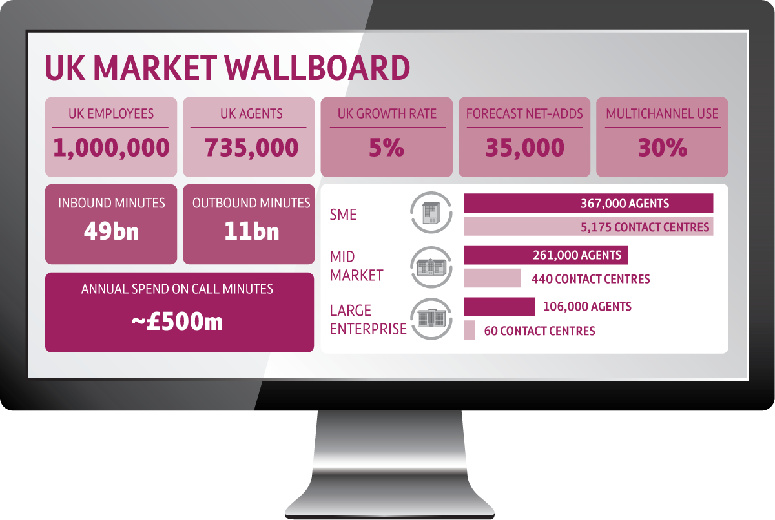
THE UK CONTACT CENTRE MARKET IS A HUGE OPPORTUNITY

Slide 3
[PRODUCT NAME] INCLUDES EVERYTHING YOU NEED TO RUN AN INBOUND OR OUTBOUND CONTACT CENTRE
Voice
SMS
Email
Chat
[PRODUCT NAME]
Dialler
IVR
Recording
Integration & Compliance
Reporting
24/7 Support

Slide 4
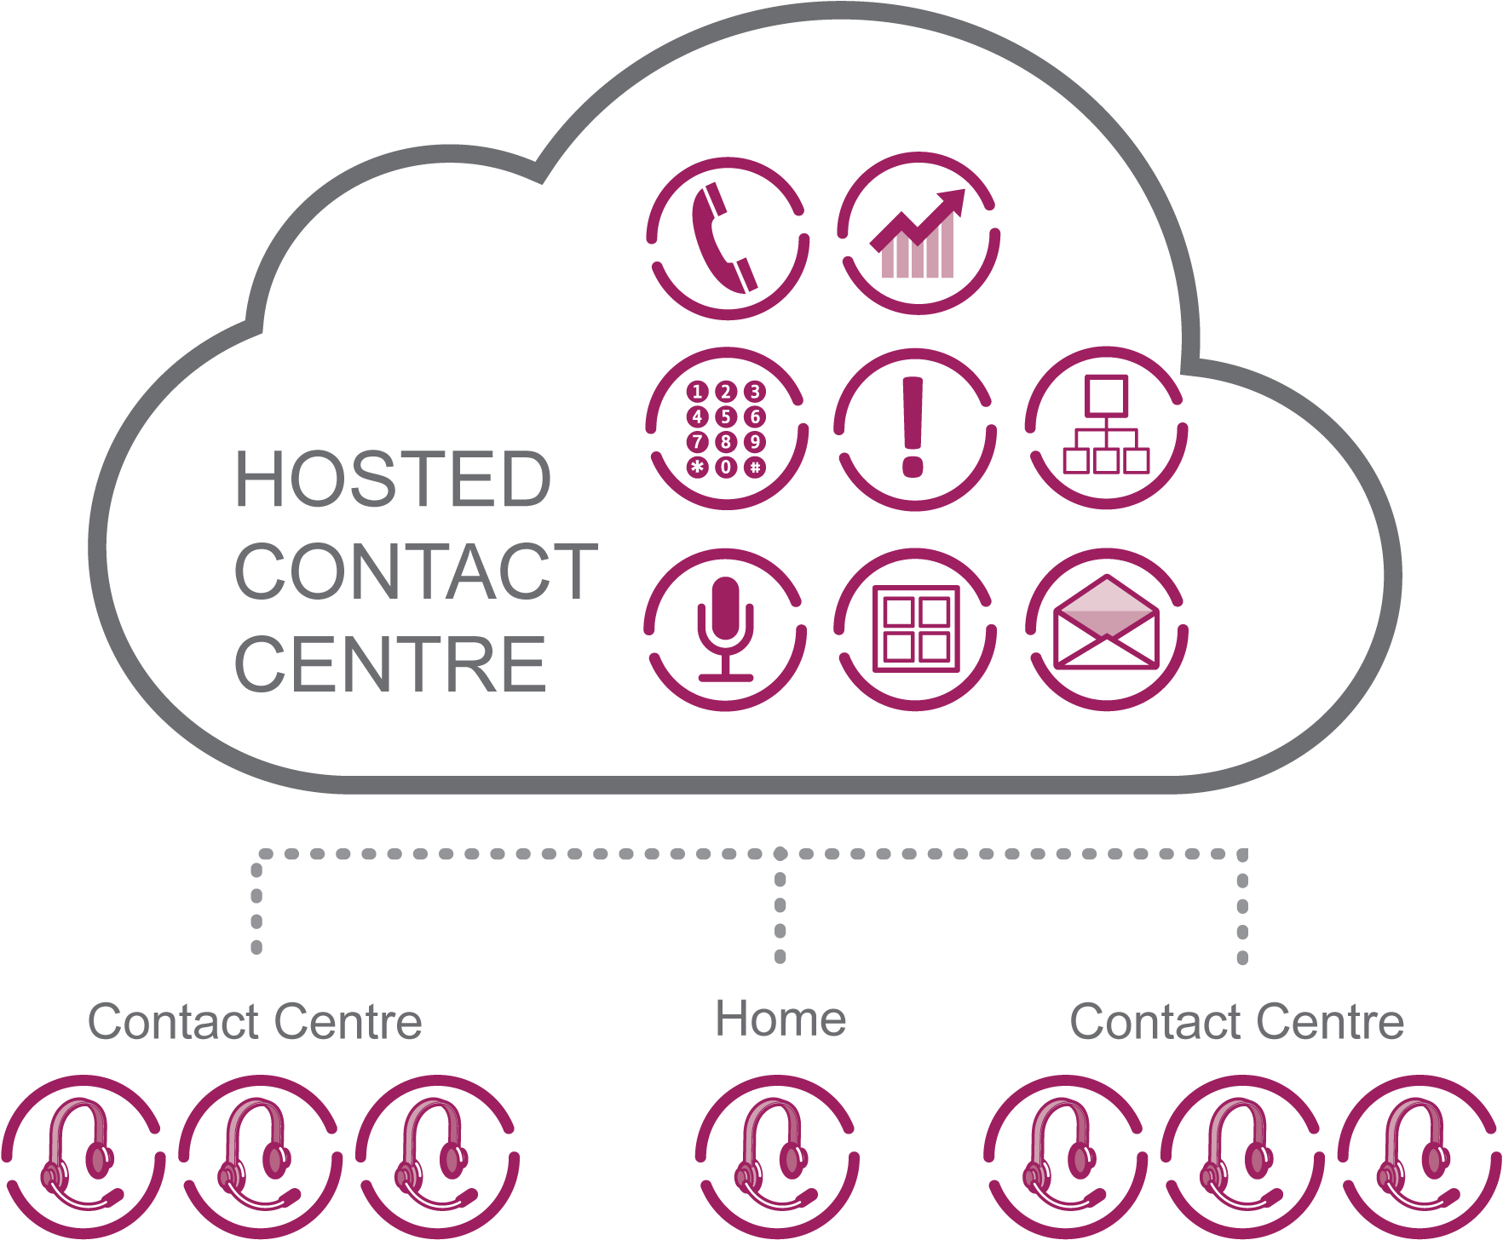
ALL FEATURES ARE ACCESSED FROM THE CLOUD

Slide 5
WHAT MAKES [PRODUCT NAME] UNIQUE?
What does this mean?
Business Benefits
Encompasses the latest innovations in virtualisation to separate software from platform
Links directly onto the network backbone.
Secure, two Tier 4 ISO27001 accredited Data Centres
Confidence in operational up-time
Best of breed call quality
Best of breed SIP call delivery
Lower call costs
Linked to BT Wholesale’s core network
What does this mean?
Business Benefits
Single licence for ALL features needed to run an Inbound or Outbound Contact Centre
Includes agent & supervisor access, wall boards, reports, Inbound, IVR, Dialler, CRM Integration
Financial clarity from day 1
No need to buy extra modules
No need to pay extra service costs
Only pay for what you use
Competitive pricing
One product.
One licence. One price.

Slide 6
WHY IS [PRODUCT NAME] GOOD FOR YOUR BUSINESS?
Secure, Cloud Innovation
Real Time Changes
One Licence. One Price.
100% PAYG Pricing
Linked to the BT core network
World class cloud innovation
Operational Stability
Intuitive interface enables you to make real time changes to any system feature
No 3rd Party Costs or delays
One licence for all Inbound and Outbound features
No extra costs for Reports, IVR, Recording or DR
No capital outlay upfront
Pay as you go pricing
No upgrades or other “hidden costs”

Slide 7
VOICE CAMPAIGNS
With [Product Name] you can set up or change inbound, outbound or Voice campaigns in minutes.
All features are delivered via a secure html link – no new hardware or software
Cloud delivers ‘stretch-to-fit’ capacity – scale up when you need extra agents or scale back when there’s less demand.
Pricing is 100% usage based – so you’ll only ever pay for what you use.
The intuitive web interface puts control at your fingertips – so you can add or rework campaign scripts, workflows and agent allocations in minutes - and be live as soon as you press ‘save’
All calls are recorded as standard and the Intuitive IVR allows your team to make changes to call flows in minutes
FEATURES
Interactive Campaign Management Tool
Intuitive single Agent Toolbar
Easy to use script designer
Drag and drop workflow / IVR builder
Voicemail/ Self Service / Call back function
Blended Campaigns – Inbound and Outbound
Preview, Auto Preview and Adaptive Predictive Dialler
Intelligent Call Routing
CTI and Real Time Screen Pop
Real time and historical reporting
Secure Cloud Platform
Call Recording
Interactive Campaign Management Tool
Intuitive single Agent Toolbar
Easy to use script designer
Drag and drop workflow/IVR builder
Voicemail/Self Service/Call back function
Blended Campaigns – Inbound and Outbound
Preview, Auto Preview and Adaptive Predictive Dialler
Intelligent Call Routing
CTI and Real Time Screen Pop
Real time and historical reporting
Secure Cloud Platform
Call Recording

Slide 8
EMAIL
With [Product Name] agents access, search for and respond to email contacts from a single toolbar - the same one they use for voice. This means they are more productive and can manage blended multi-channel campaigns quickly and more accurately.
[Product name’s] real-time control means you can regulate email campaigns second by second.
Email templates also deliver greater messaging control and improve agent productivity.
Supervisors can review email replies in real time and reallocate or amend as required.
FEATURES
Email Campaign Management Tool
Single Blended Agent Toolbar
Single Agent Queues
Agent and Campaign Prioritisation
Email Online Search Tool
Email history
Standard and customisable email templates
Real time and historical reporting

Slide 9
DIALLER
Your Outbound campaigns will be super efficient when you optimise campaigns in real time with one of [PRODUCT NAME’S] three Dialler settings
The innovative Predictive Adaptive Dialler aligns live outbound campaign call ratios to agent call answering ratios. So if your agents are busy it throttles back and if they’re super efficient, it accelerates to deliver more connected customers.
If you want to give your agents more control then simply set the Dialler to Preview Mode. The call information is presented to the agent first, and the agent initiates the call through the system once they are ready to speak to a customer
If you want to limit the time agents spend reviewing information before calling, use the Auto-Preview mode to set a pre-defined time before the systems calls a customer record.
FEATURES
Real time Performance Reports
Preview Dialler
Auto Preview Dialler
Adaptive Predictive Dialler
Multi-number dialling
List Loader
Answer Machine Detection
Call Back Scheduler
Lead Management
CLI Presentation

Slide 10
INTERACTIVE VOICE RESPONSE
With an intuitive visual control panel accessed via a secure web interface, any authorised supervisor or team member can set up and modify IVR templates, messages and call flows in real time.
No customer hears a busy signal as new voice files or emergency messages can be recorded and updated in minutes
Automated answering services can be activated when call volumes exceed capacity.
FEATURES
Create and edit IVRs in minutes
Easy to use interface
Upload sound files
Set time-bound rules (e.g. out of business hours)
Capture voice messages
Capture phone numbers
Request call-back functionality
Integrate data and contact centre workflows including queue management

Slide 11
LIVE & HISTORICAL REPORTS
[PRODUCT NAME’S] real time reporting suite with over 35 standard templates can be used to create Live Wall Boards which keep track of agent and multi-channel campaign performance.
These Wall Boards are URL based and can be displayed on any screen in the contact centre or sent to any mobile device with internet access.
Historical reports can be scheduled in line with business need and can be emailed to decision makers
[PRODUCT NAME’S] combination of live reporting with real time control means you can respond immediately to market or customer demands.
FEATURES
35 standard report templates for Live and Historical Reports
Unlimited custom report templates
Live wallboards
Schedule reporting updates
Threshold alerts
Export reports
Export raw data
URL based reports for any mobile device

Slide 12
VOICE RECORDING
PRODUCT NAME’S] Voice Recording files are available via a secure web site within seconds of call completion.
You can find, download and share voice records quickly, providing close to real-time accessibility for people working inside or outside the contact centre.
If required, the recording function can be disabled in minutes at an organisation, campaign or agent level.
You can even save a link to the recording on the contact record within a CRM database!
FEATURES
Record all calls as standard – no extra cost
Store for 3 months then archive
Access recordings seconds after the call is wrapped
Advanced online search engine
Send secure voice recording links to decision makers in seconds
Record associated call details e.g. agent, date/time, queue and call notes

Slide 13
DISASTER RECOVERY
Because you access [PRODUCT NAME] from the cloud, it’s available from any internet-enabled device.
So if something happens and your people can’t work from their desks, no problem – simply log in from another location. No need for expensive second ‘hot’ DR sites.
The traditional technology model of mirroring critical applications to another site is very expensive, can take hours to activate and does not always provide access to the latest client or database information.
In contrast, [PRODUCT NAME] can be activated in minutes at a fraction of the cost of a duplicate system.
For existing customers this is all delivered at no extra cost.
FEATURES
Activate Disaster Recovery in minutes from any remote office, home or mobile location
Agents immediately access the same live functionality and data from the new location
Agents and Supervisors retain core reporting and management functionality
Protect the customer experience with real-time changes to IVR messaging, call-flow and CLI-based routing.

Slide 14
API Integration
APIs enable resellers or even end customers to develop customised integrations with 3rd party applications such as CRM and WFM systems
API functions are split into 6 categories:
• User
• Agent
• Lead
• Campaign
• Organisation
• Event
FEATURES
An application-programming interface (API) is a set of programming instructions and standards for accessing a Web-based software application.
Provides a means to access contact centre data and functionality in a standardised, manageable way from other corporate systems (e.g. Customer Relationship Management, Work Force management)
API’s are available to enable third party systems to interact with [Product Name]

Slide 15
Help Centre
Fully comprehensive user guide to all features and functionality
First port of call for any issues and functionality queries
Online training and tutorials
Accessible through the workspace or via separate URL.
FEATURES
New online help centre which enables users to find extensive material on how to use [Product Name] and problem solve issues
Help centre is driven by Confluence Wilki which enables audio /visual material to be imbedded into articles to aid learning
Exceptional search abilities

Slide 16
WHY [COMPANY NAME] ?
Invested in the newest cloud-based technology
Excellent networks and infrastructure
XXXX
XXXX
XXXX

Slide 17
IF YOU WOULD LIKE TO FIND OUT MORE:
Speak to:
Email:
[ Insert URL of landing page]
[INSERT LOGO HERE]

