Slide 1
Ethernet – View Order
BT Wholesale Online
V2
LEGAL NOTICE: The information contained in this briefing is confidential information as per your terms and conditions with BT. Please do not forward, republish or permit unauthorised access. The content is accurate at the time of writing and is subject to change.

Slide 2
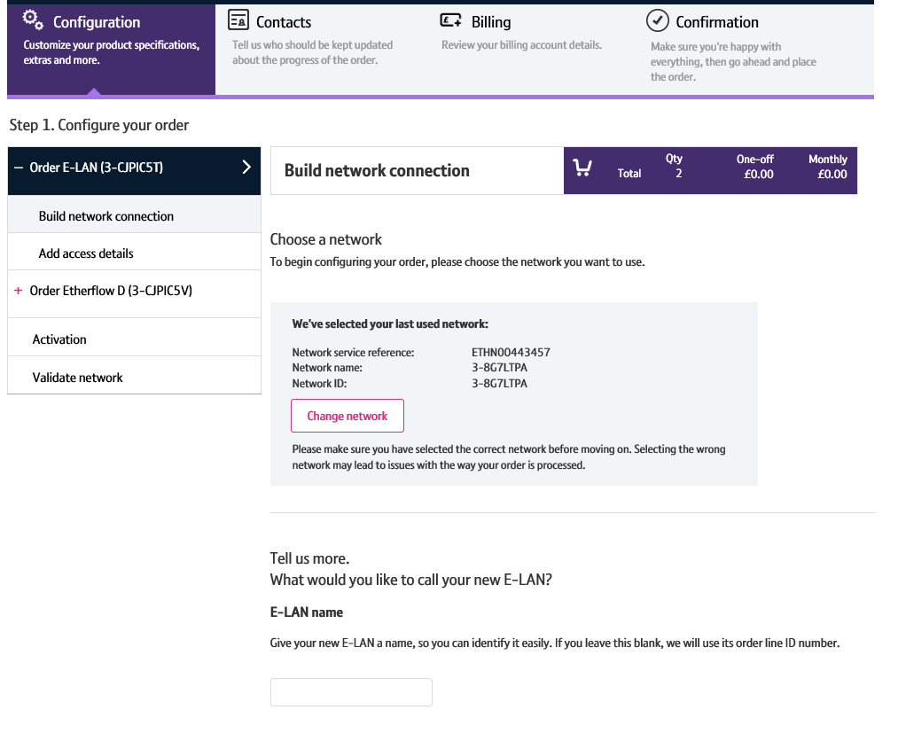
Contents
What’s in this User Guide?
p4 - Pre-requisites
p5 - How To Place an E-LAN and Etherflow Dynamic order

Slide 3
Version Control
Date | Change | Version
10/08/16 | User Guide Published. | 1
30/04/18 | Re-branded | 2

Slide 4
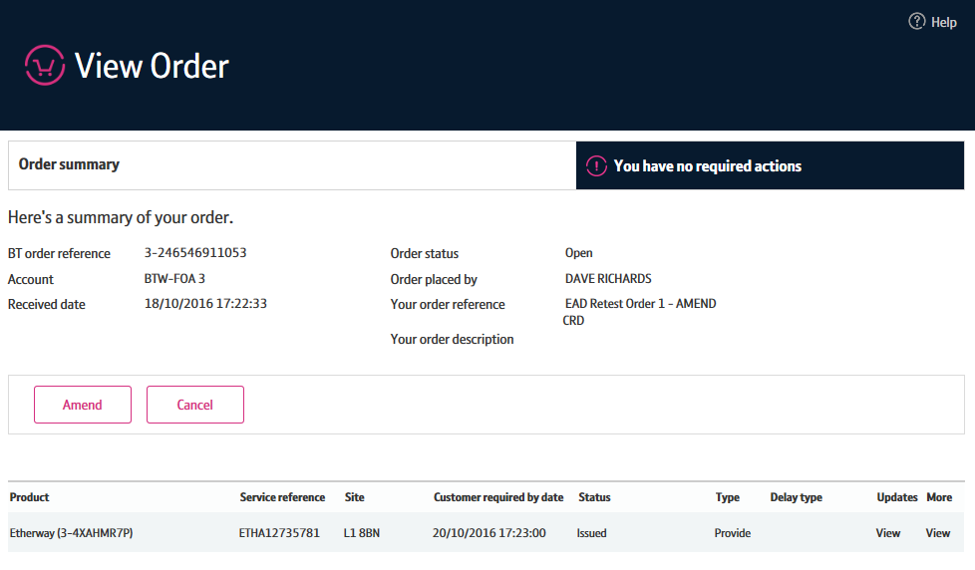
Pre-Requisites
What do you need to view an Ethernet order via the new journey?
You need correct access and privileges, including Business zone. If you don’t have this, please contact your company administrator to action.
Please visit our Transformed Ethernet Ordering page to learn about what order journeys are available.
You must be using a Windows machine and using the latest version of Internet Explorer, Chrome or Firefox
Mobile devices, Mac and Safari are not supported

Slide 5
Introduction
What is the new Ethernet View Order Journey?
We’ve replaced the Eco Plus view order journey with a new improved view order journey for Ethernet.
Accessed via Business Zone, the new journey will allow you to make it easier to
Track the progress of your order
Accept and reject actions such as Excess Construction Charges
Update KCI contacts
The new journey has improved navigation and layout, is compatible with modern browsers and is more stable and easier to use than Eco Plus.

Slide 6
View Order Layout
1. Order summary
The order summary gives you a view of the BT order reference and your customer reference if entered, the account it was raised for, when the order was raised, who by, what the overall status is and a description. From here you can
Amend the order
Cancel the order.
2. Order actions
You can see an alert on the top right hand side if you have any open actions on this order. From here you can directly accept or reject the action so that the order progresses.
1
2

Slide 7
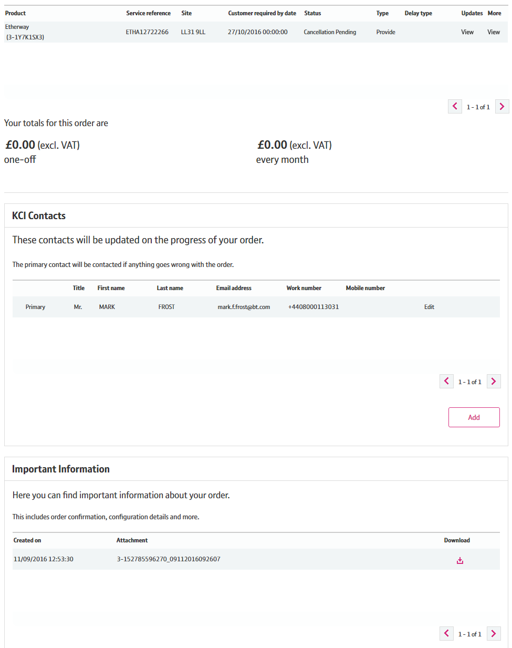
View Order Layout
3
3. Order details
The order details section gives you a breakdown of all the items in the order, their individual status and the one off and monthly charges for the whole order.
You can access the latest engineer updates and KCI updates on the order by clicking on View in the ‘Updates’ column.
You can also get a complete breakdown of the order summary by clicking on view in the ‘More’ column.
4. KCI contacts
You can now add, edit and remove KCI contacts for the order on this screen.
5. Important information
Here you can download important information on your order including order confirmation, configuration details and more.
4
5

Slide 8
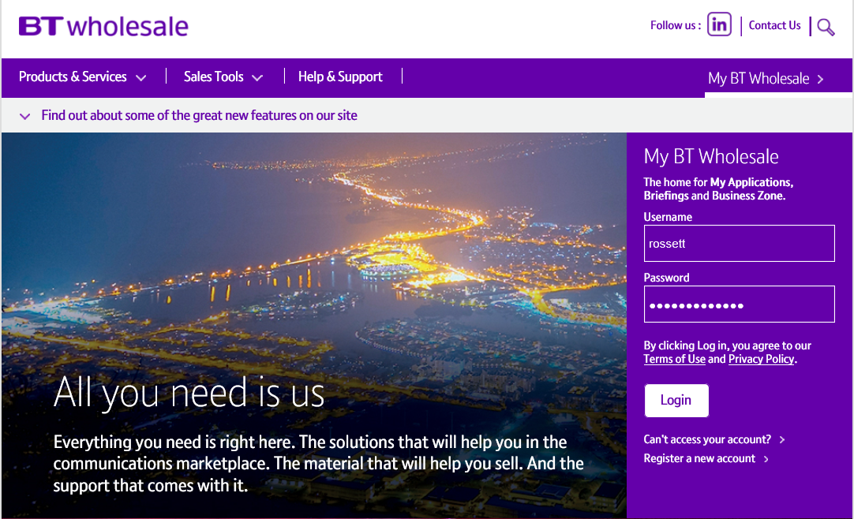
Searching for an order
To view an order, you first need to search for it on Business Zone.
Step 1: Logging In
Go to www.btwholesale.com
Enter your Username and Password
Click ‘Login’

Slide 9
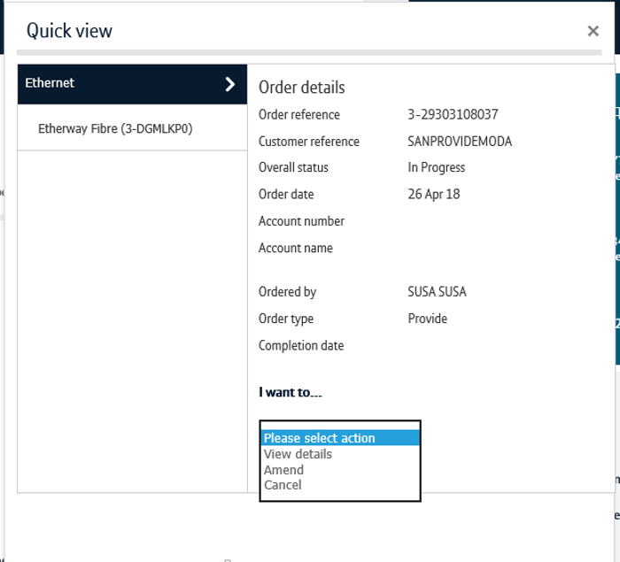
Searching for an order
Step 2: Searching
There’s a lot of different ways you can search for an order in Business Zone. The easiest way is by entering your order reference in the search bar.
Clicking ‘View Details’ will take to directly into the View Order journey
Alternatively, click on the reference number to see the order quick view
From the quickview, click ‘View Details’ in the actions dropdown.
You can also find the order by using the filters on the orders section of the Overview page and on My orders page. Please see the Business Zone guide for more details.
2
1
3

Slide 10
Viewing your order details
Updates and order component details
Below the Order Summary section, you’ll see a table listing the components (Etherways and Etherflows) that make up your order and their status.
If you would like to view the progress of the component, see notes added by our agents, and view KCI notifications, click ‘view’ in the updates column.
To see more details of your component order, including it’s configuration, click ‘view’ in the more column.
1
2

Slide 11
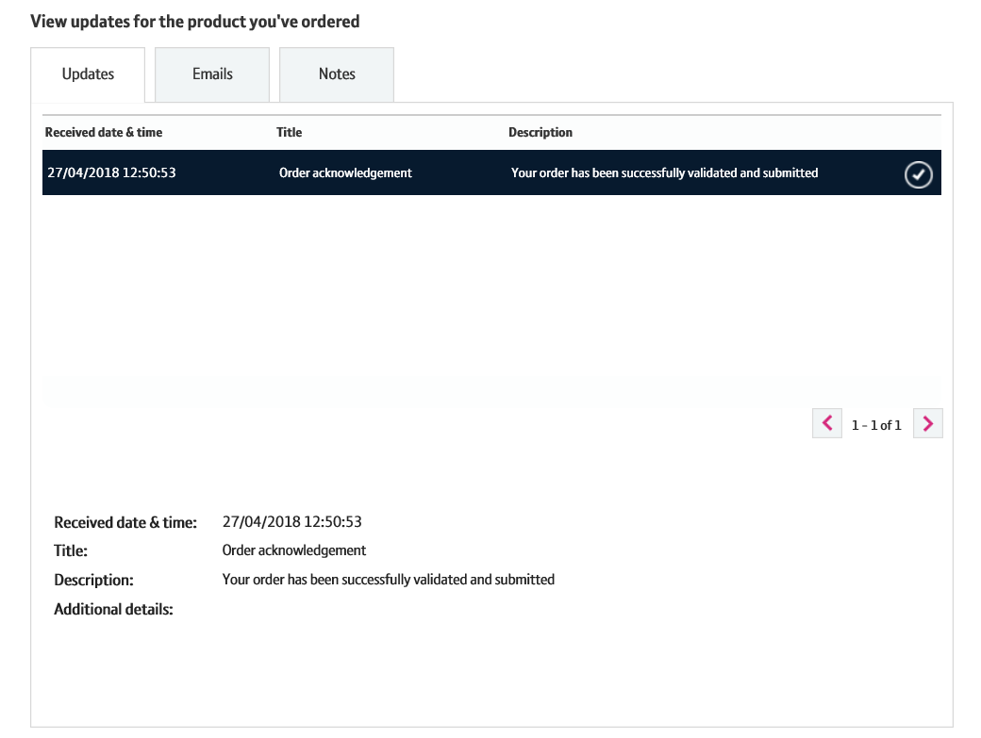
Viewing your order details
View Updates
There are three tabs in the ‘View Updates’ section.
The ‘Updates’ tab provides you updates on the progress of your order. This includes KCI details.
The ‘Emails’ tab will tell you what emails are sent to you and when they were sent.
The ‘Notes’ tabs will display notes entered on your order.
The notes in this section are clickable. Once selected, you can view the full note and details in the lower section of the box.
1
2
3

Slide 12
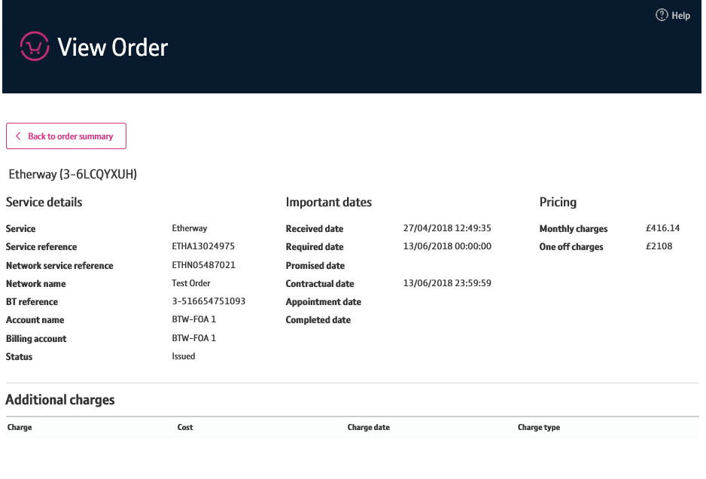
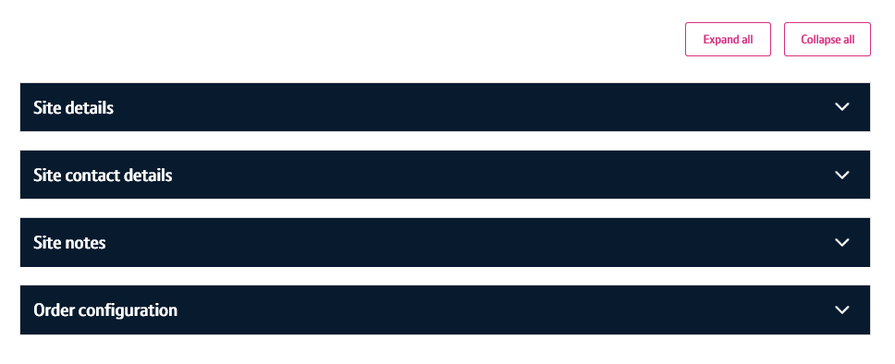
Viewing your order details
View More
In the ‘View More’ section, you’ll be able to see specific details for your Etherways and Etherflows. This includes:
References and identifiers
Account and billing details
Important dates
Pricing and charges (e.g. ECC)
Site details
Contacts
Hazzard and Access notes
How you’ve configured your order
2
3

Slide 13
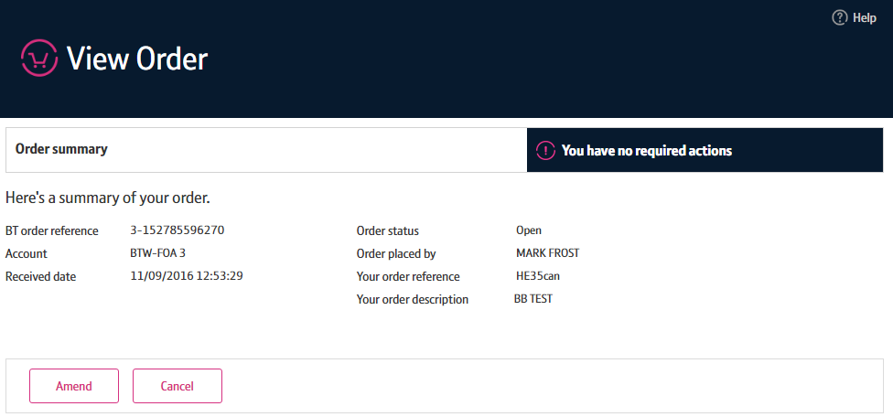
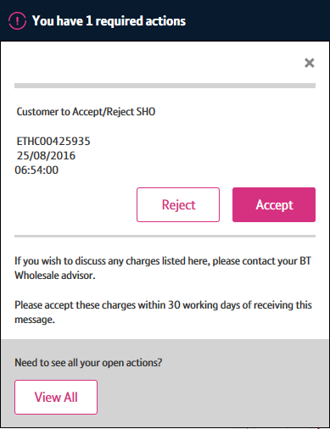
Viewing your order details
Actions
You can now see outstanding actions from the view order screen. This allows you to easily accept and reject actions relating to your order such as Excess Construction and Time Related Charges.
If you have any actions related to your order, an alert will be visible on the top right of the view order screen. To view these actions, click on the actions applet.
You will now see the oldest action related to your order. You can accept or reject the action from here.
If you wish to see all the actions related to your order, click ‘View All’.
If you don’t have the right permissions to accept or reject actions, a message will be displayed.
1
2
3

Slide 14
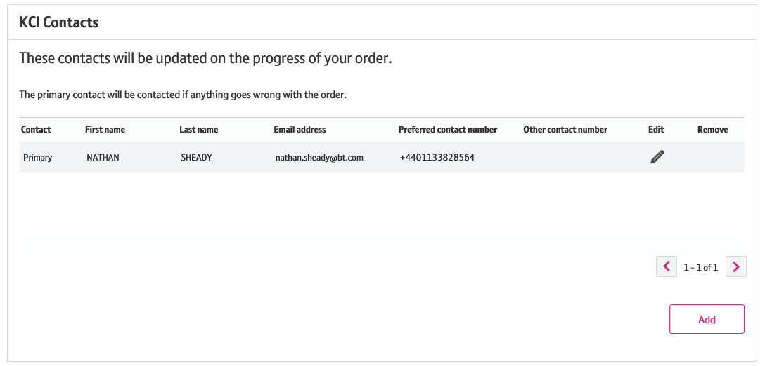
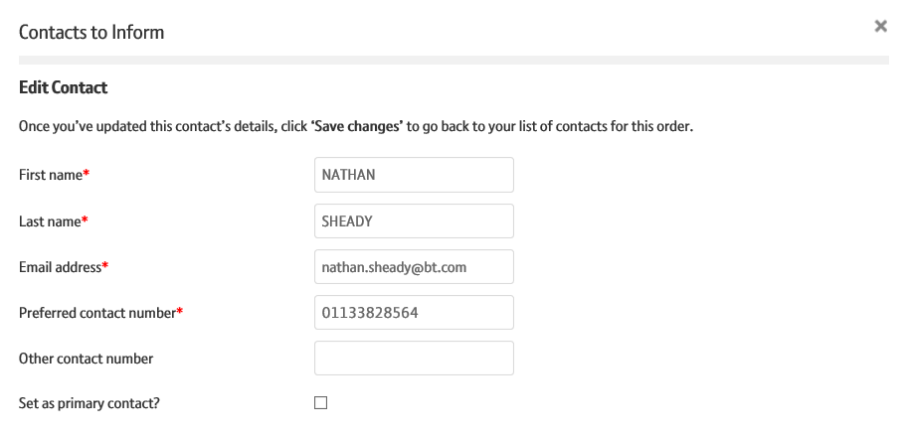
Viewing your order details
KCIs
You can now add, edit and remove KCI contacts for the order from the view order screen.
You must have at least one Primary contact for an order so that we may send updates about the order to them.
If you have more than one contact listed you can change the Primary contact by selecting ‘Edit’ within the table.
1

Slide 15
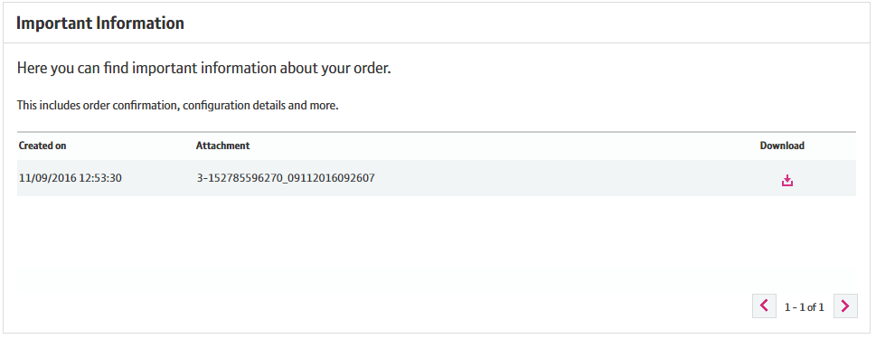
Viewing your order details
Important Information
In the important information section, you can download documents relating to your order. This includes details on order confirmation, configuration, handover and more.
This information can be downloaded easily by selecting on the download icon within the table.

