Slide 1
How to run the standalone diagnostics test
BT Wholesale Online
V1
LEGAL NOTICE: The information contained in this briefing is confidential information as per your terms and conditions with BT. Please do not forward, republish or permit unauthorised access. The content is accurate at the time of writing and is subject to change.

Slide 2
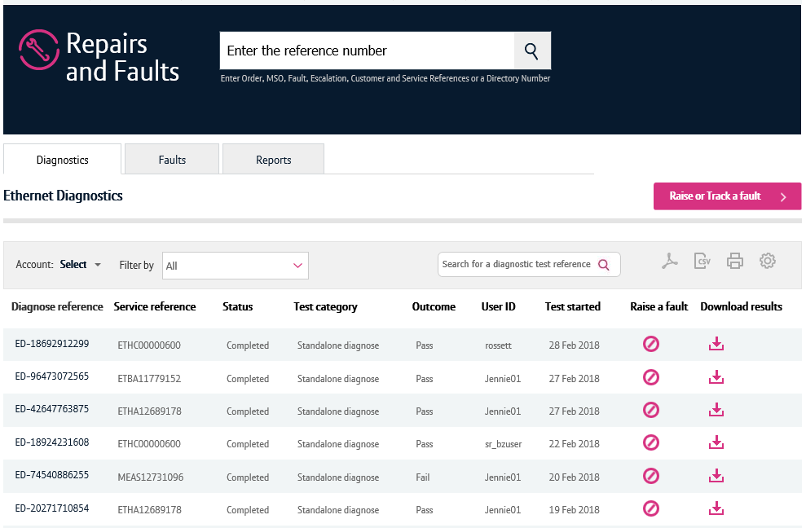
Contents
What’s in this User Guide?
p3 - Version Control
p4 - Introduction
p5 – How to launch the journey
p12 Running the standalone diagnostic test
p14 Diagnostic test results

Slide 3
Version Control
Date | Change | Version
11/03/18 | User Guide Published. | 1

Slide 4
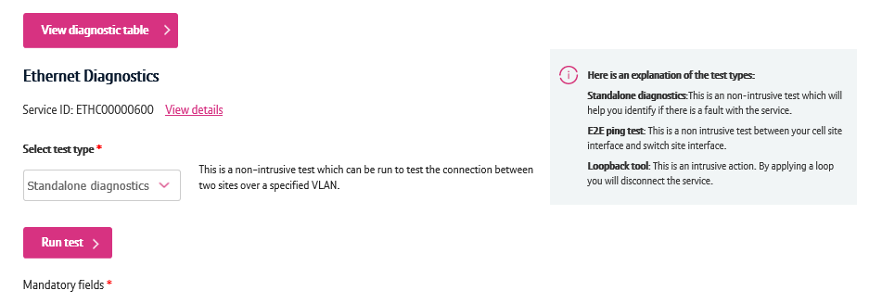
Introduction
Standalone diagnostics
For Ethernet and Mobile Ethernet, you can perform a standalone diagnostic test. This runs a series of non-intrusive tests on your service and provides you a result highlighting if a fault has been found.
If a fault was found, the results will also tell you the location of the fault.
This test can identify if your service is affected by issues concerning power, performance, BT Wholesale’s core network or the physical access from your premises to the Ethernet node.

Slide 5
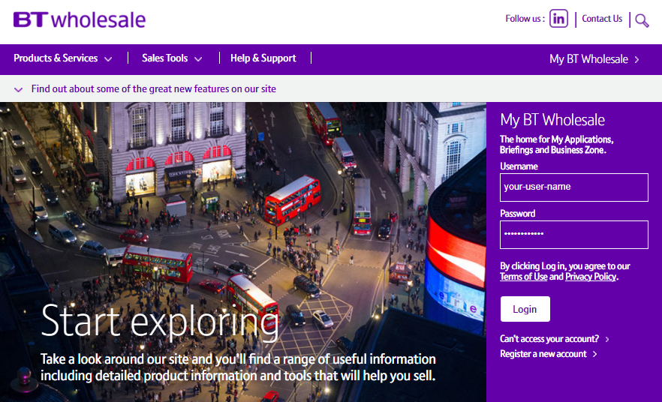
How to launch the diagnostics journey
Step 1. Login to BT Wholesale.com
To launch the diagnostics journey, go to www.btwholesale.com and login using your username and password.

Slide 6
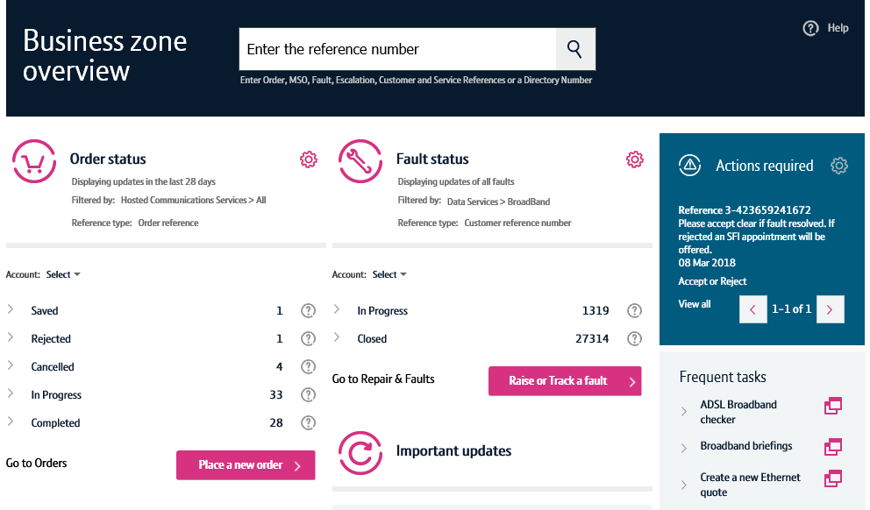
How to launch the diagnostics journey
Step 2. Search for your circuit
You’ll now see the Business Zone dashboard.
Please note, if you don’t see the Business Zone dashboard, you’ll need to contact your company administrator for access.
There are multiple ways to search for a circuit, but the easiest way is to enter the service ID (e.g. ETHC12345678) in the search field at the top of the screen.

Slide 7
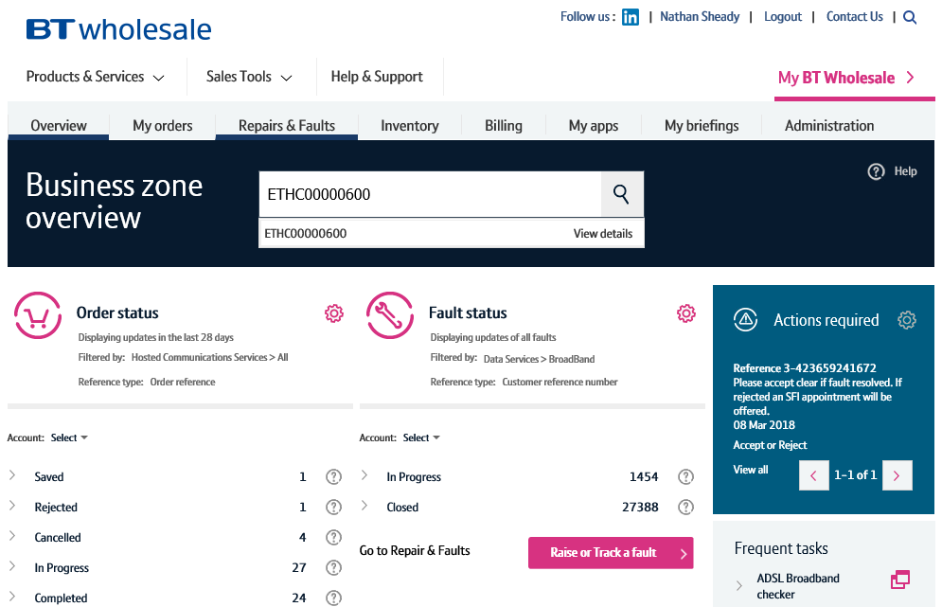
How to launch the diagnostics journey
Step 2. Search for your circuit
As you’re typing in the reference, the search will provide a list of assets matching your criteria.
Clicking the reference will show you the service quickview.
The view details option will take you to the view asset screen where you can see in-depth details of your service.
Clicking the magnifying glass will take you to the search results on Business Zone.
The fastest and easiest way to begin diagnosing a fault accessing the option from the quickview. So simply click on the reference.
3
1
2

Slide 8
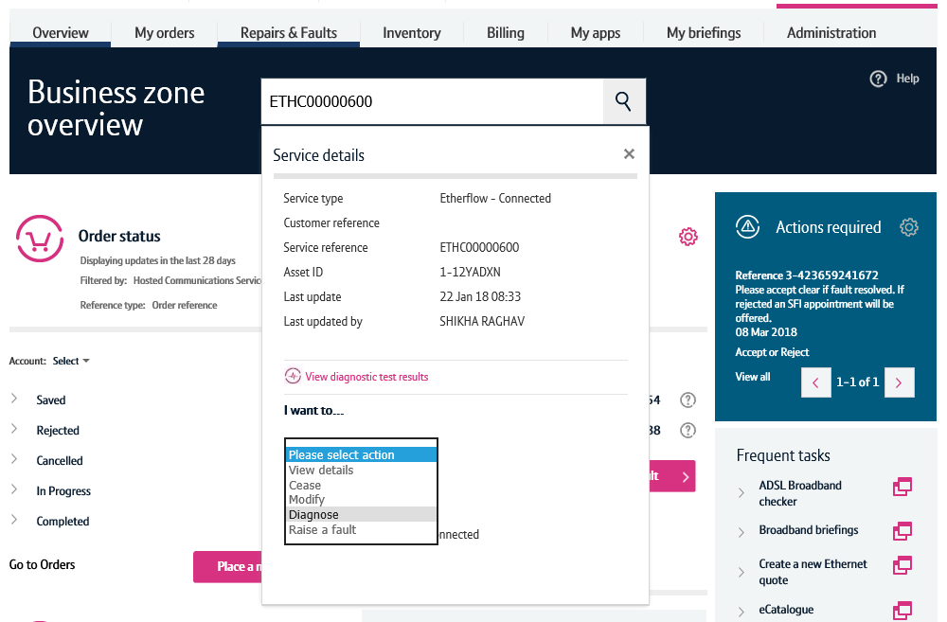
How to launch the diagnostics journey
Step 3. Diagnose action
Once the quickview is displayed, select ‘Diagnose’ from the dropdown.
This will now launch the diagnostics journey for this service.

Slide 9
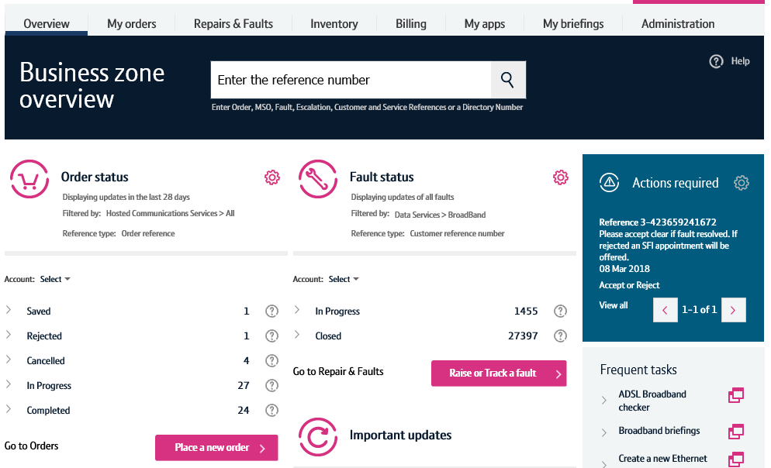
How to launch the diagnostics journey – alternative route
Step 1. Raise or Track a fault
An alternative way to launch the diagnostics journey can be carried out by clicking the ‘Raise or Track a fault’ button on the Business Zone overview page.

Slide 10
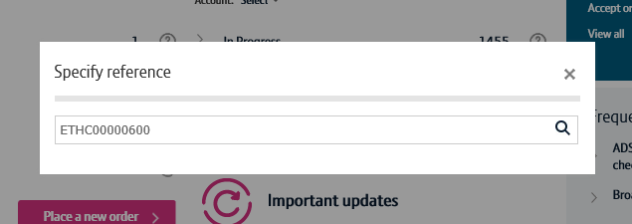
How to launch the diagnostics journey – alternative route
Step 2. Search for your service
Enter the service reference in the search field, then click the magnifying glass.

Slide 11
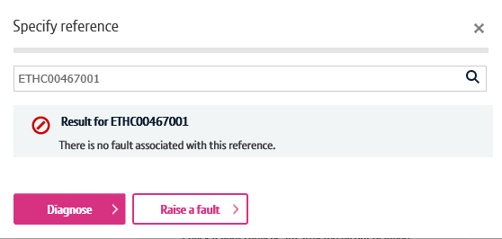
How to launch the diagnostics journey – alternative route
Step 3. Diagnose
Business Zone will now check to see if there’s any open faults on your service.
If there are, you’ll be presented with the fault reference and a shortcut to see the fault details.
We’ll also show you details of recent faults raised on your service to help you diagnose repeat faults.
If you wish to diagnose your service further, click the diagnose button.

Slide 12
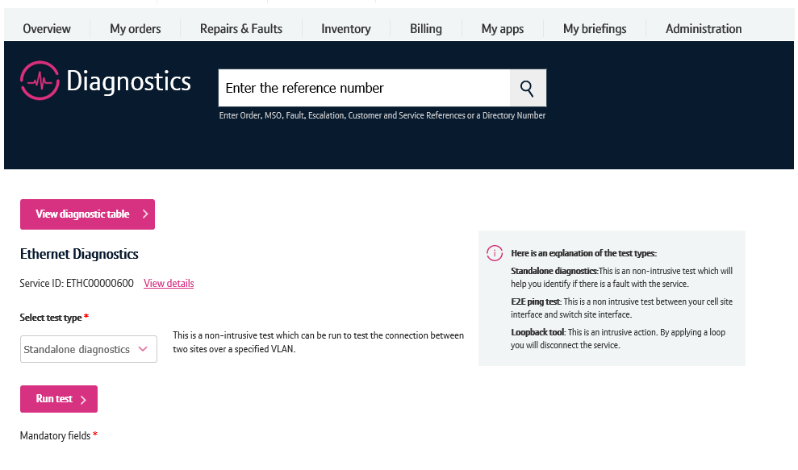
Running the standalone diagnostic test
There’s a number of features on the diagnostics screen.
The view diagnostic table button will take you to the page where all your diagnostic tests are displayed.
The view details option will show you details for the circuit such as the from and to address.
To run the test, first select standalone diagnostics from the dropdown.
Then click run test.
1
2
3
4

Slide 13
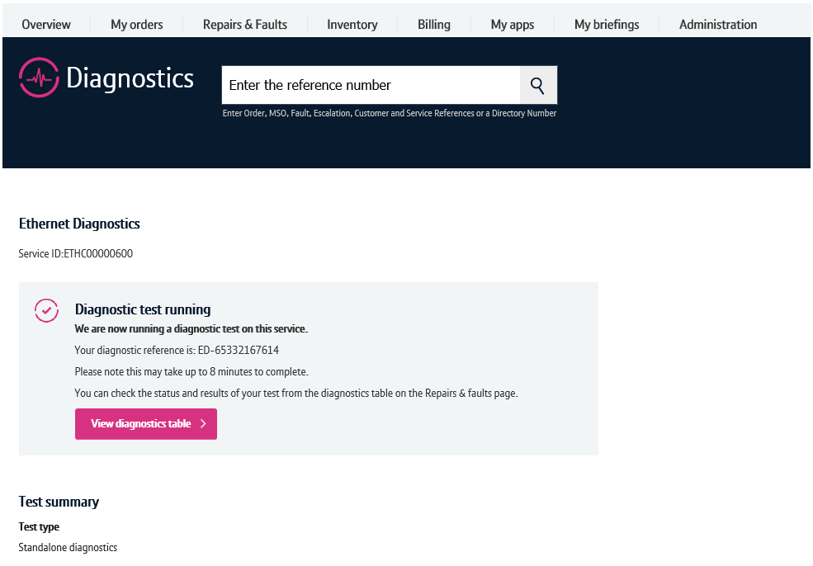
Running the standalone diagnostic test
You’ll now receive a notification that the test is being ran.
To see the result, click ‘View diagnostics table’.

Slide 14
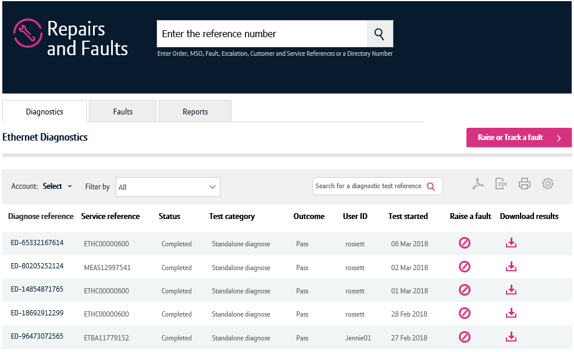
Diagnostic test results
The diagnostics table will show test results ran in the last 2 weeks.
Locate the test that you have just ran on the table. Note, the most recent tests are shown at the top of the table.
To see the results in more detail, click the diagnose reference.

Slide 15
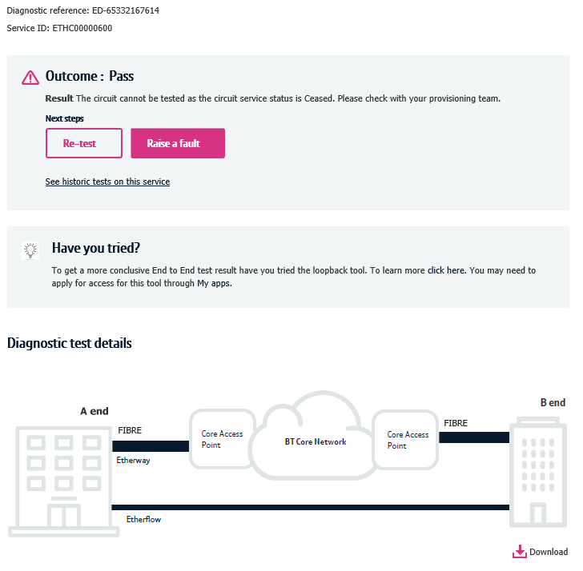
Diagnostic test results
1. Here you can see the test outcome.
Possible outcomes are:
Pass – No fault was found on the service
Fail – A fault was found on the service
Inconclusive – We can’t conclusively tell if a fault is on the service
Time out/Premature Termination – The test failed to run
2. You can re-test the service here or raise a fault
3. The ‘See historic tests on this service’ option will take you to the diagnostics table with a filter applied showing only tests ran on this service.
4. The diagnostic test details section will provide you more details about the result. If a fault was found, the diagram will tell you where in the network it occurred.
5. You can download your diagnostic test results as a PDF here.
1
2
3
4
5

Slide 16
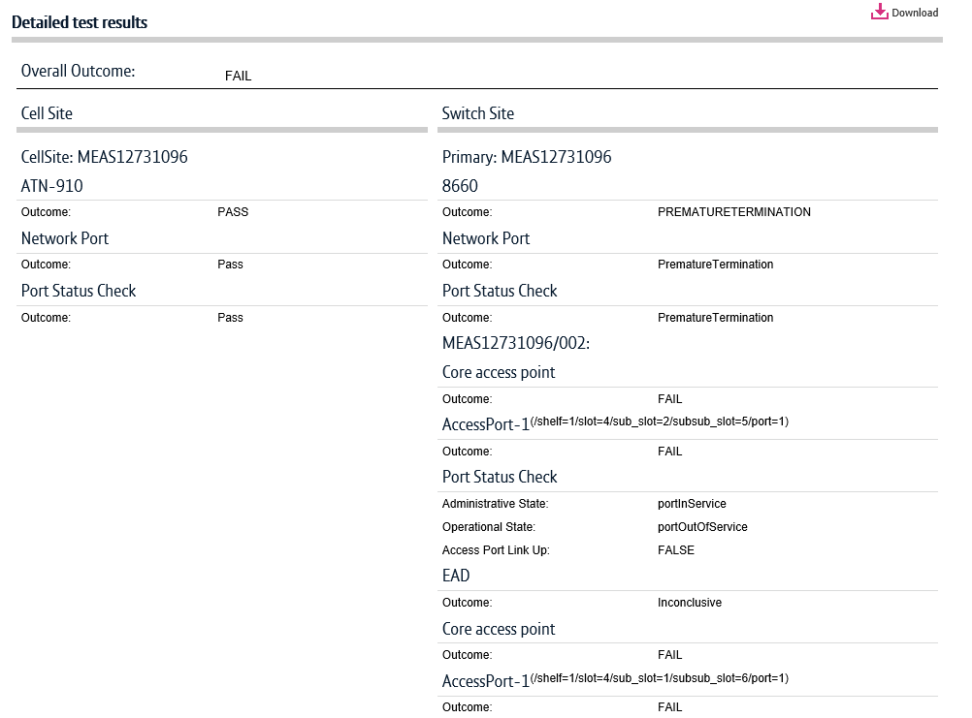
Diagnostic test results
Scrolling down the screen, you’ll be able to see further diagnostic details.

